Slide 1

An application for predicting environmental conditions within an additive manufacturing facility
Adam Roberts, Phivos Ioannou
24-09-2019

Slide 2
Overview
Introduction
Methodology and model
Application overview
Example results
Conclusions
Questions

Slide 3
Introduction

Slide 4
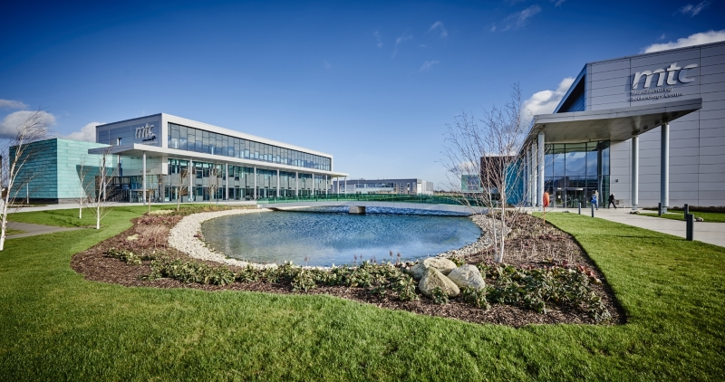





Introduction
Manufacturing Technology Centre (MTC)
Independent research and technology organisation
Opened in 2011
Located in Coventry, United Kingdom
Prove innovative manufacturing ideas
Manufacturing system solutions
Training
Home of the UK’s National Centre for Additive Manufacturing (NCAM)

Slide 5

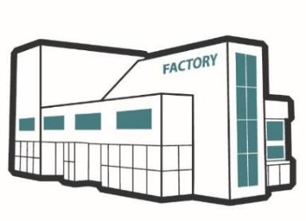









Introduction
DRAMA project
Developing facilities and knowledge that supply chain companies can use to support their journey towards becoming a supplier of additively manufactured components to aerospace.
End-to-end – manufacturing stages including design, build (printing), post-build processing and product verification.
Metal powder bed processes, including binder jetting, electron beam melting and laser powder bed fusion.
Digitally enabled, accessible test bed facilities
Knowledge for supply chain enablement

Slide 6
Digital twins in manufacturing
A definition used at the MTC
A digital model connected to its physical asset, process, or system and automatically updated with ‘real world’ data.
The digital twin augmented with artificial intelligence can then be a powerful predictive tool, enabling rapid generation of knowledge and, ultimately, self-optimising systems.
Action/update
Physical assets or processes
Sensing technologies
Connectivity
Cloud / Storage Platforms
Enterprise Software Platforms
Controls
Digital twin
Real time data
Improved quality
Cost reductions
Greater reliability
Data availability
Collect
Analyse
Act
Parts
Machines
Sensors
Data storage
Intelligence from data
Simulation
Optimisation
Update users
Alter plans
Control processes
Processes
Factories
Greater efficiency
Cost reductions
Flexibility
Autonomous operations
Optimised scheduling
Cost savings
Notes:
Introduce MTC, lead onto NCAM, DRAMA is big project in NCAM focussing on digital twins, digital twins are blah blah
Ask Ksenia about organising practice session
Book a room to do the webinar in
Results in pictures

Slide 7
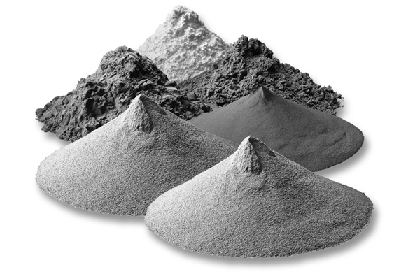
DRAMA facility climate model
Overview
Why?
Environmental factors such as temperature and humidity can negatively affect the quality of metal powder used in additive manufacturing (AM).
Controlling the climate throughout a manufacturing facility can be prohibitively expensive and may thus deter suppliers from adopting metal powder bed technology.
How?
Use the finite element method to predict and visualise temperature and humidity fluctuations, enabling operations to be scheduled and executed around these constraints.
What?
Creating a model that can be used by the DRAMA facility manager:
  Model needs to be able to handle changing machine and facility conditions.
  Model needs to be useable regardless of simulation experience or software knowledge.
  Model needs to solve relatively quickly so that results can be useful.
This is being achieved using COMSOL Multiphysics® and its Application Builder to create an app that can be deployed with either COMSOL Server™ or compiled into a standalone executable.
Various types of metal powder used in powder bed additive manufacturing. Image sourced from: https://www.metal-am.com/gkn-reports-development-new-metal-powder-additive-manufacturing/

Slide 8
Methodology and model

Slide 9
DRAMA facility climate model
Methodology
COMSOL Model Builder
Define geometry
Define materials
Specify physics
Create finite element mesh
Define solver settings
Create and solve studies
COMSOL Application Builder
Create user interface
Create custom methods
Instantiate machines
Specify and assign appropriate boundary conditions
Connect to facility equipment
Final product
Standalone application
No simulation or COMSOL® experience required
Reconfigure facility layout
Use as part of factory digital twin
Minimise effect of temperature and humidity on powder quality

Slide 10
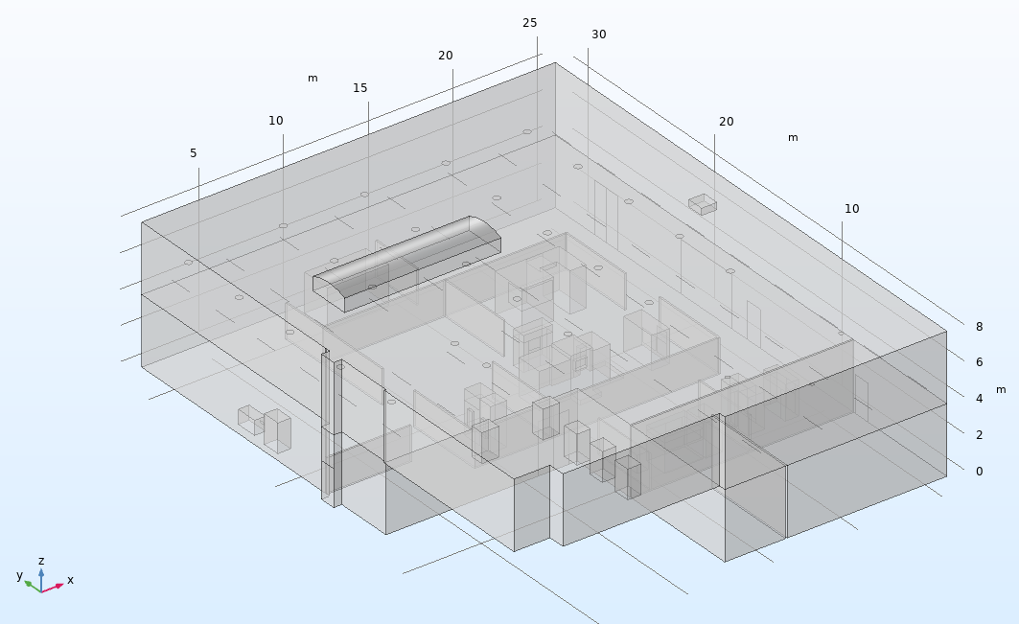
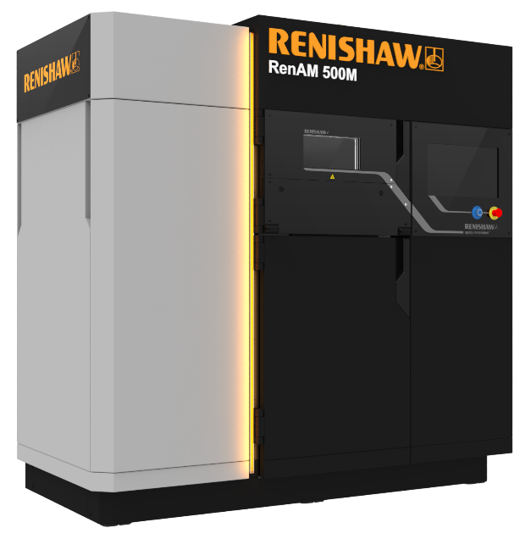
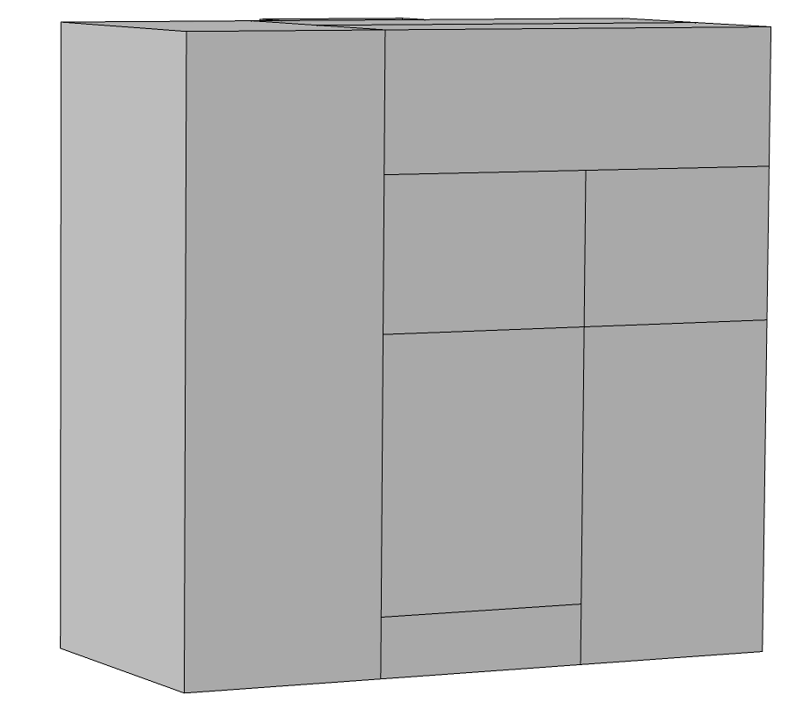
DRAMA facility climate model
Geometry
A Renishaw AM500Q and the simplified representation used in the facility climate model. Left image sourced from: https://www.renishaw.com/en/renishaw-to-showcase-its-new-renam-500m-additive-manufacturing-system-at-farnborough-international-airshow-2016--38960
Simplified geometry of the DRAMA facility used for the climate model, including several AM and post-processing machines.

Slide 11
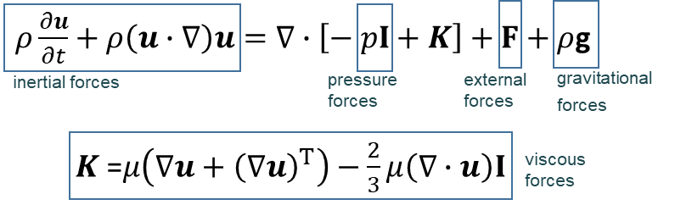

DRAMA facility climate model
Physics – fluid flow
The nonisothermal flow multiphysics interface within COMSOL Multiphysics® was used to model the behaviour of the air within the facility.
The air was treated as a slightly compressible Newtonian fluid under the influence of gravity, and the flow modelled according to the principles of conservation of momentum and conservation of mass.
The air flow was assumed to be laminar and no turbulence models were applied.
  This greatly reduces the computational effort required to solve the model and was felt to be a reasonable assumption due to the relatively low air speeds within the facility.
The material properties of the moist air were derived from empirical models within COMSOL®, according to the temperatures predicted by the heat transfer equation.
Conservation of momentum (Navier-Stokes equation):
Conservation of mass (continuity equation):
ρ – density
p – pressure
u – velocity
g – acceleration due to gravity
μ – dynamic viscosity

Slide 12
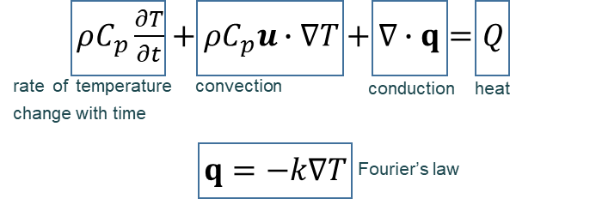

DRAMA facility climate model
Physics – heat transfer
Conservation of energy (heat equation):
The air temperature was predicted through conservation of energy using the heat equation.
The moisture within the air was quantified via relative humidity, defined as the ratio between the partial pressure of the water vapour in the air and the saturation pressure of the air at a given temperature.
The partial pressure of water vapour throughout the domain is assumed to be homogeneous, with the relative humidity predicted purely dependent on temperature variations.
The thermodynamic properties of the air are defined as a function of the relative humidity, pressure and temperature.
Relative humidity equation:
ρ – density
C_{p} – specific heat capacity
T - temperature
u – velocity
q – heat flux
φ – relative humidity
p_{v} – partial pressure of water vapour
p_{sat}(T) – saturation pressure of air at temperature T
Q – heat (source or sink)

Slide 13
Application overview

Slide 14
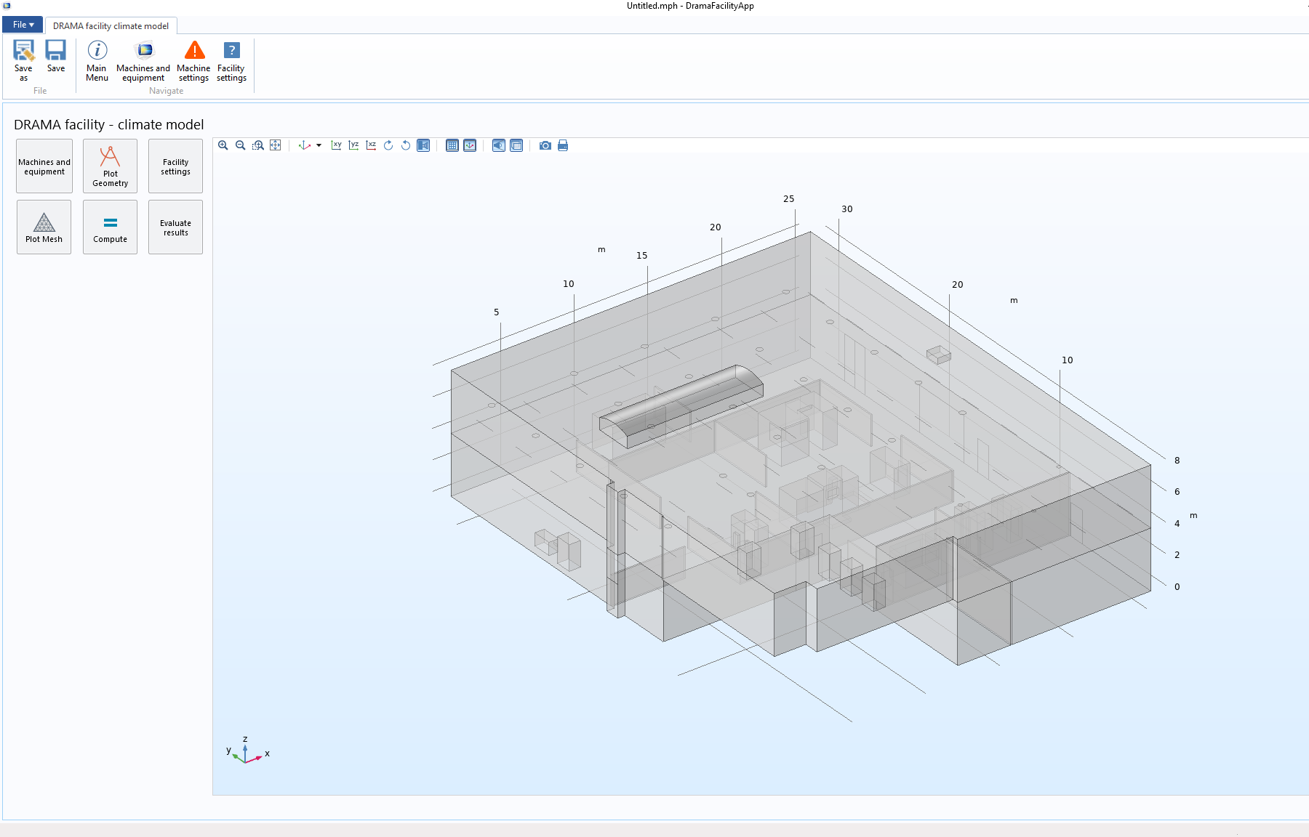
DRAMA facility climate app
Main menu
Following its creation, the climate model was packaged into a standalone application.
The app simplifies the set-up and analysis of a model so that it can be used by anyone, regardless of COMSOL® or modelling experience.
It enables facility layout, initial environmental conditions, and machine operating settings to be customised in a straightforward fashion by the user.
  Models and machine layouts can be saved for use at a later date.
  Real environmental condition data can be imported from temperature and humidity sensors.
The main menu of the facility app.

Slide 15
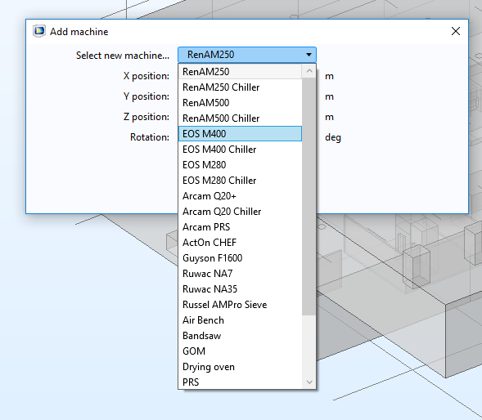
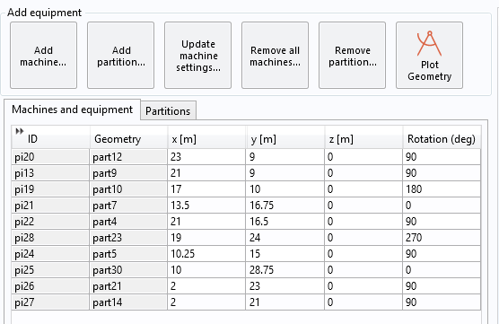
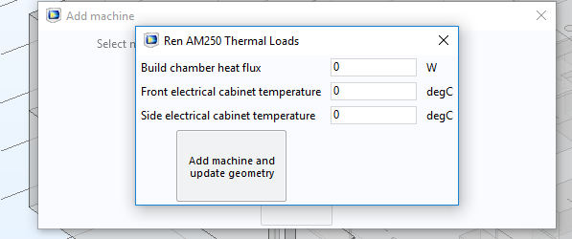
DRAMA facility climate app
Machine reconfiguration
The machines and equipment table that allows the repositioning of machines already in the model. A similar menu exists for adjusting the reconfigurable partitions in the facility. The data in both tables can be saved and loaded to/from external files if required.
Adding a new machine to the model. The user can select the desired machine from a dropdown menu and specify its x, y, and z position along with its rotation, before specifying the settings of that particular machine instance. Similar options exist for adding new partitions, where the user can specify the dimensions of the partition as well as the position and rotation.

Slide 16
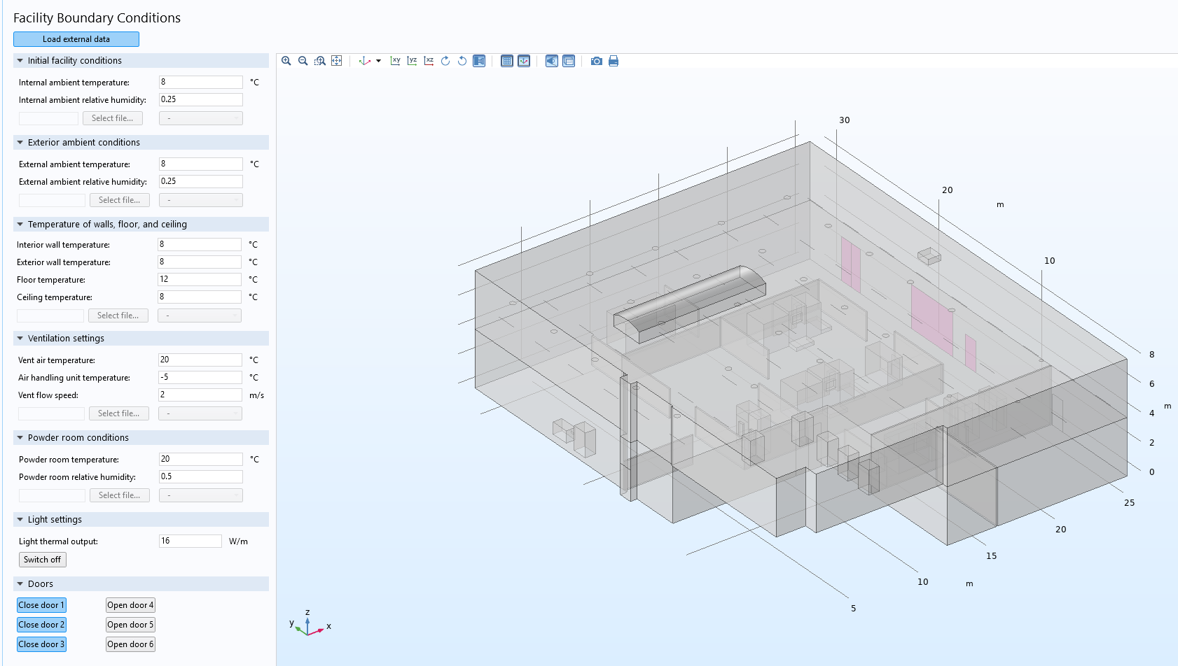
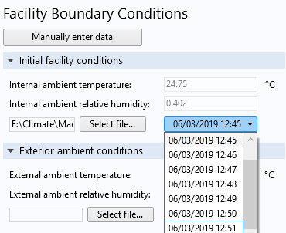
DRAMA facility climate app
Sensor data
Loading facility data from an external sensor. The user can specify the file they wish to load data from, and then select the time of the reading they wish to use.
The menu for setting the environmental conditions in the facility. The user can specify the initial temperature and humidity throughout the DRAMA cell, along with the settings of the air handling system, lights, and powder room. Doors can be specified as either open (highlighted in pink) or closed (grey).

Slide 17
Example results

Slide 18
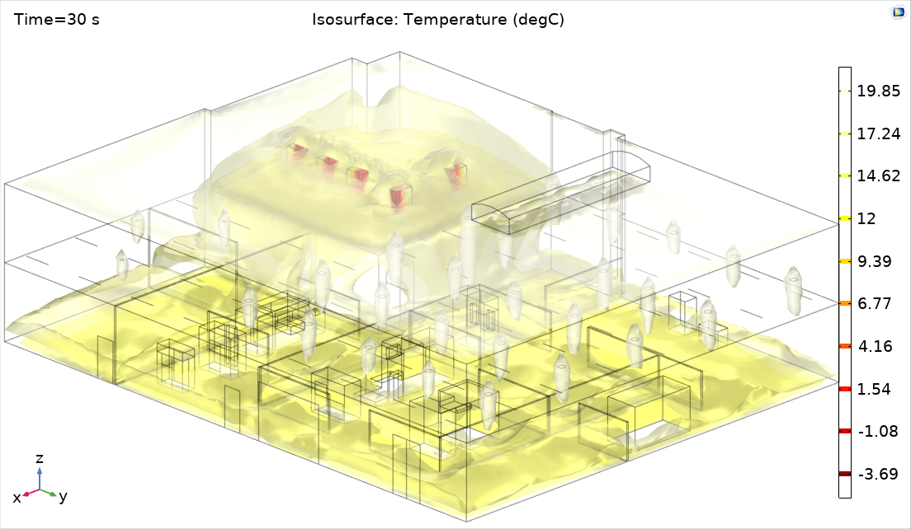
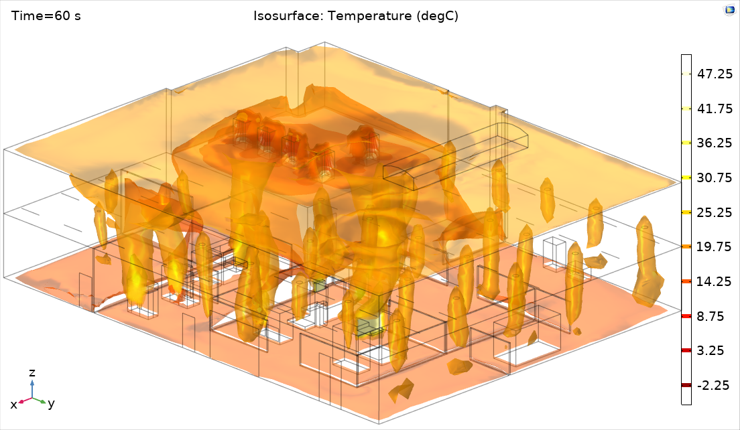
DRAMA facility climate model
Example results – running machines
The thermal and fluid output of the machines can be changed over the course of a simulation, enabling a user to predict how machine use will affect the climate and whether it will cause potential issues for powder handling.
(a) Build chambers closed.
(b) Build chambers opened.
Isothermal surface plots showing the effect of opening the build chambers of every AM machine on the temperature within the DRAMA facility. Each build chamber is assumed to be at 50 degC.

Slide 19
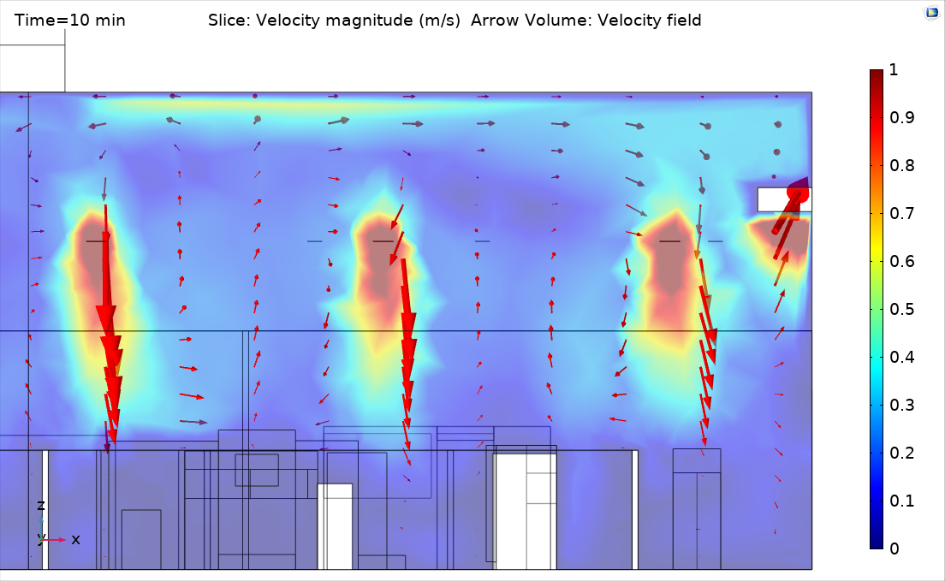
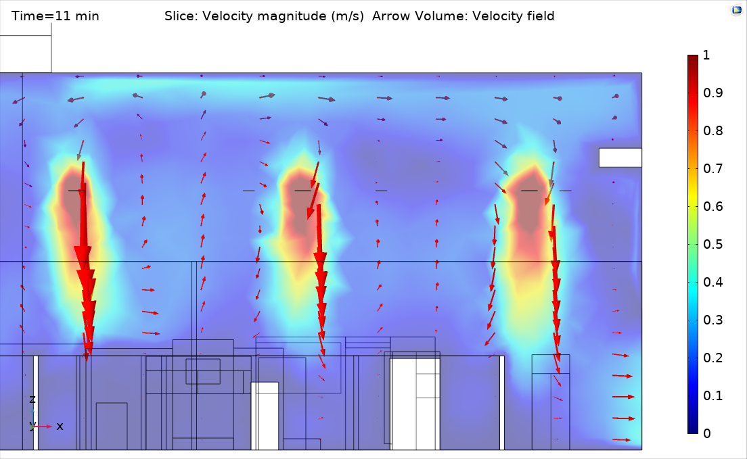
DRAMA facility climate model
Example results – opening a door
In addition to studying the effects of machine layout and thermal loads, the user can also account for changing facility conditions such as the opening and closing of doors.
  This may also be of use for investigating powder travel throughout the facility.
(a) Door closed
(b) Door opened
Slice plots showing the effect of opening a door on the air flow within the facility. The flow of air towards the outlet duct is significantly weakened when the door directly beneath it is opened.

Slide 20
Summary and future applications

Slide 21
DRAMA facility climate model
Conclusions and future work
A finite element model for predicting the temperature, humidity, and air flow within an additive manufacturing facility has been created using COMSOL Multiphysics®.
This model has been packaged into an application so that it can be used by anyone, regardless of their COMSOL® experience.
  The app enables the location, type, and number of machines and partitions within the facility to be reconfigured.
  Machine operating conditions and facility parameters, such as initial environmental conditions and the settings of the air handling system, can also be adjusted by the user. This includes the option to import real data from sensors.
Further development work and potential uses include:
  Testing and validation of the model and its assumptions.
  Using the air flow predictions of the model to study powder travel.
  Identifying the optimal layout of the machines within the factory.
  Contributing to a factory digital twin that can schedule and execute operations around environmental constraints.
  Interpolate facility sensor data to provide visualisations of the climate throughout the facility.

