Slide 1
Heat and Moisture Transport in a Wall, Response Analysis

Slide 2
Model description
The wall consists of load bearing and finishing material (hygroscopic).
Simulation is over 5 days, with variable exterior temperature, interior pressure and moisture flux on the exterior side.
1D model is defined in HAMSTAD-WP2 Modeling, Benchmark 4:
  Project for the validation of numerical simulations for coupled heat and moisture transport in building materials.
  Reference: Hagentoft, C.E.: HAMSTAD WP 2 Modeling – Final report: Methodology of HAM-modeling R-02:8. Gothenburg, Department of Building Physics, Chalmers University of Technology (2002).

Slide 3



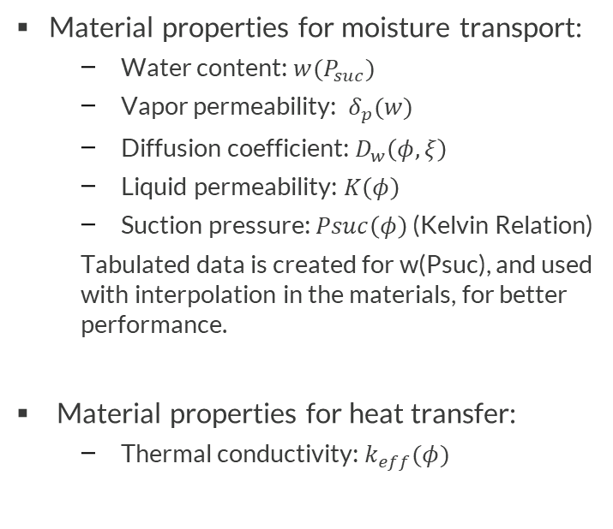
Geometry & Material properties
Load
bearing
Finishing
Material properties for moisture transport:
  Water content: $w(P_{suc})$
  Vapor permeability: $δ_{p}(w)$
  Diffusion coefficient: $D_{w}\left(φ,ξ\right)$
  Liquid permeability: $K\left(φ\right)$
  Suction pressure: $Psuc\left(φ\right)$ (Kelvin Relation)
  Tabulated data is created for w(Psuc), and used with interpolation in the materials, for better performance.
Material properties for heat transfer:
  Thermal conductivity: $k_{eff}(φ)$
$$g_{l}$$
Exterior,
$${p_{v}}_{e}, T_{e}$$
Interior,
$${p_{v}}_{i},T_{i}$$
0.1m
0.02m

Slide 4
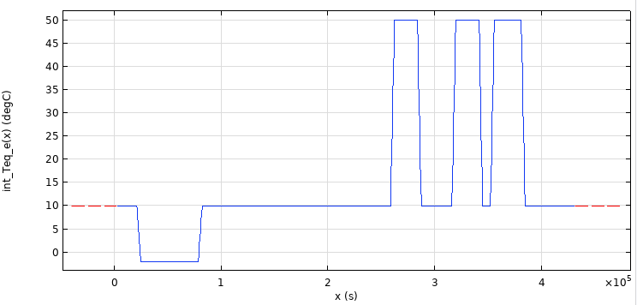
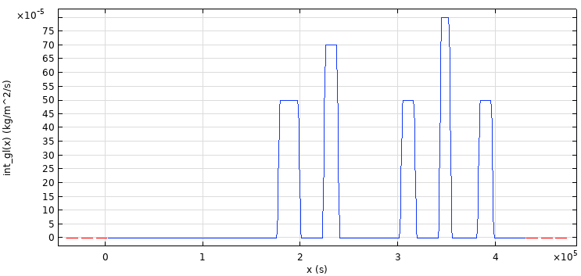
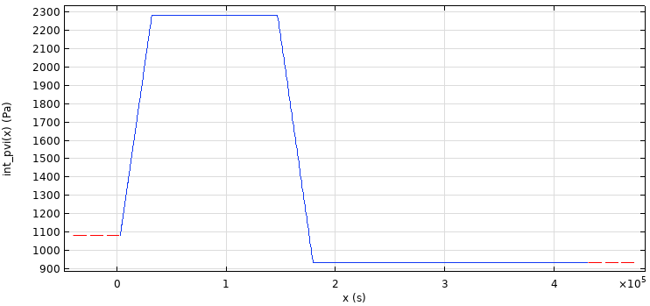
Boundaries and Initial Conditions
Exterior:
  Temperature from climate data, used to define convective heat flux
  Moisture flux from climate data, used to define moisture flux
Interior:
  Partial vapor pressure from climate data, used to defined convective heat flux
Initial condition:
  Temperature: 20°C
  Relative Humidity: 41%

Slide 5



Model definition
Heat transfer in Building Materials interface:
$${\left(ρc_{p}\right)}_{eff}\frac{∂T}{∂t}+∇∙q=Q$$
Heat storage
$$q=−(k_{eff}∇T+L_{v}δ_{p}∇\left(φp_{sat}\left(T\right)\right))$$
Thermal conduction
Latent heat source
Moisture transport in Building Materials interface:
$$ξ\frac{∂φ}{∂t}+∇∙g=G$$
Moisture storage
$$g=−(ξD_{w}∇φ+δ_{p}∇\left(φp_{sat}\left(T\right)\right))$$
$$ξ=\frac{∂w}{∂φ}$$
Vapor diffusion
Liquid transport by capillary suction forces

Slide 6
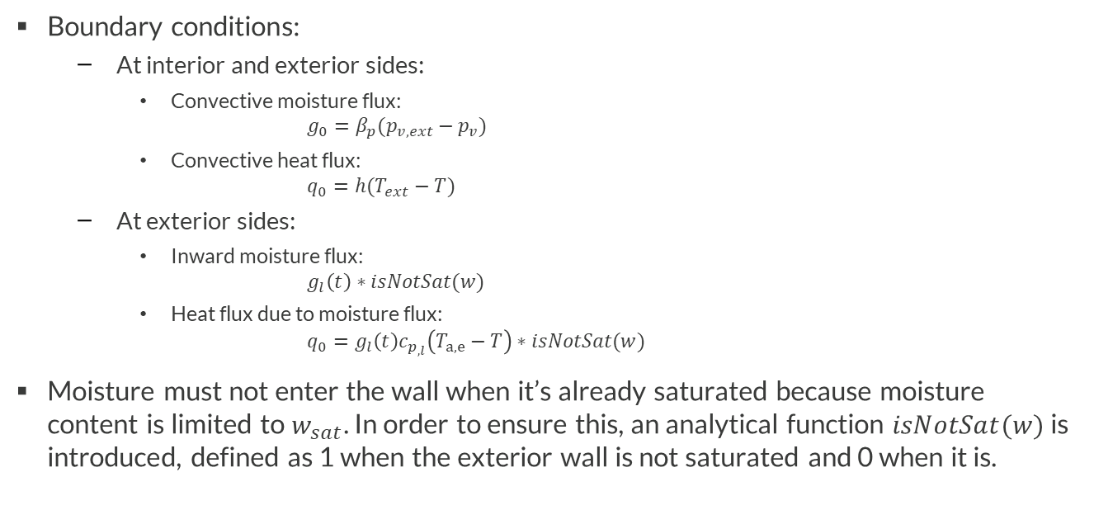
Model definition
Boundary conditions:
  At interior and exterior sides:
    Convective moisture flux:
    $$g_{0}=β_{p}(p_{v,ext}−p_{v})$$
    Convective heat flux:
    $$q_{0}=h(T_{ext}−T)$$
  At exterior sides:
    Inward moisture flux:
    $$g_{l}\left(t\right)∗isNotSat(w)$$
    Heat flux due to moisture flux:
    $$q_{0}=g_{l}\left(t\right)c_{p_{,l}}\left(T_{a,e}−T\right)∗isNotSat(w)$$
Moisture must not enter the wall when it’s already saturated because moisture content is limited to $w_{sat}$. In order to ensure this, an analytical function $isNotSat(w)$ is introduced, defined as 1 when the exterior wall is not saturated and 0 when it is.

Slide 7
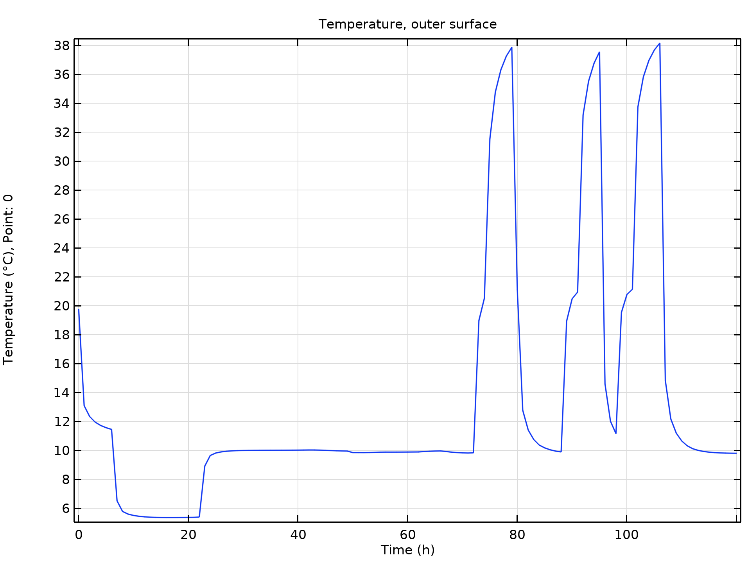
Temperature on outer surface in time

Slide 8
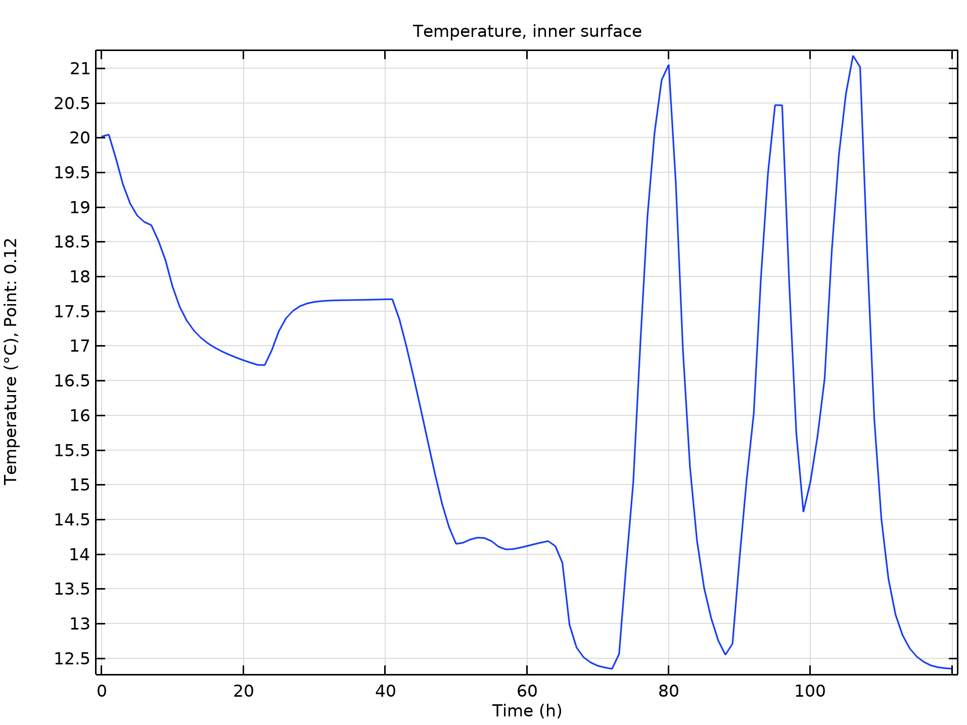
Temperature on inner surface in time

Slide 9
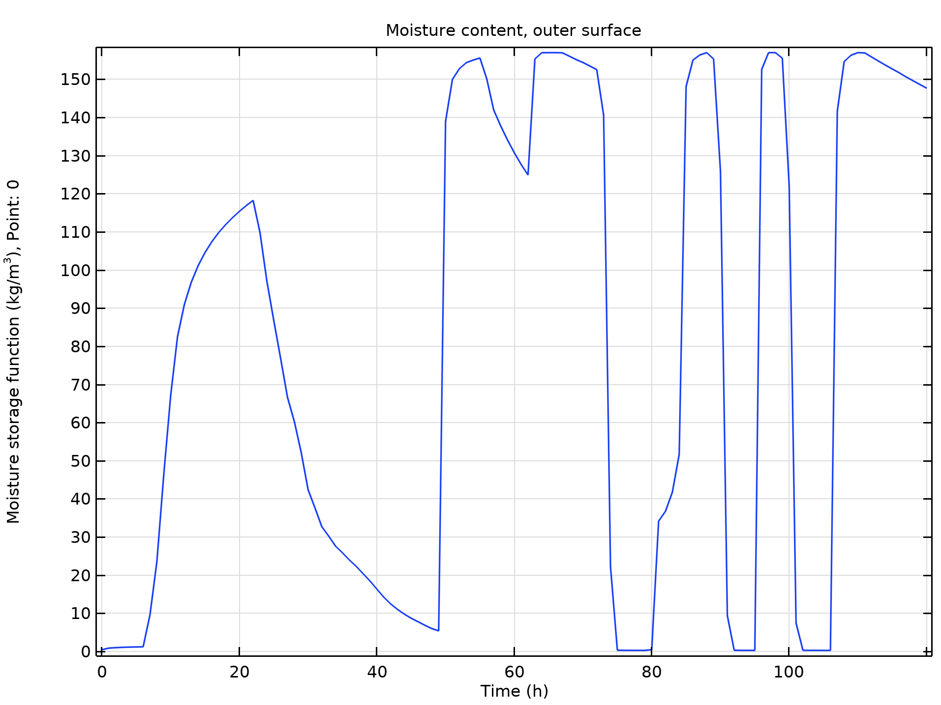
Moisture content on outer surface in time

Slide 10
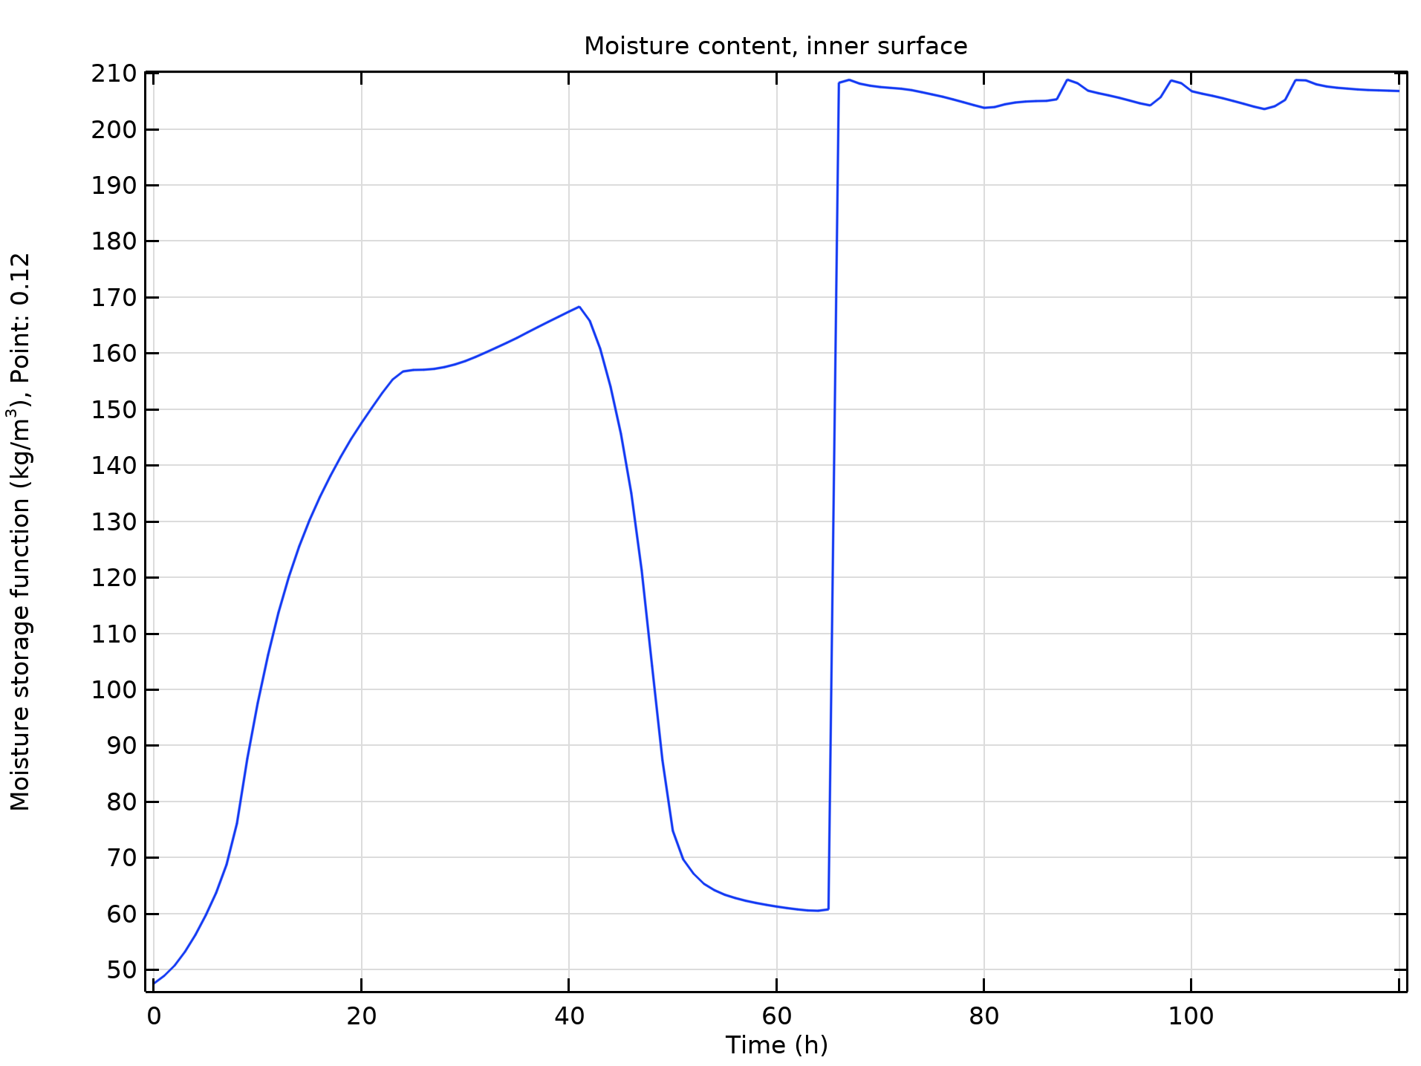
Moisture content on inner surface in time

Slide 11
Validation
Numerical results obtained with COMSOL Multiphysics are in good agreement with the results of the benchmark.
Tools used in the model:
  Heat and Moisture Transport in Building Materials predefined interface.

