Slide 1
Holographic Page Data Storage Simulation
COMSOL

Slide 2
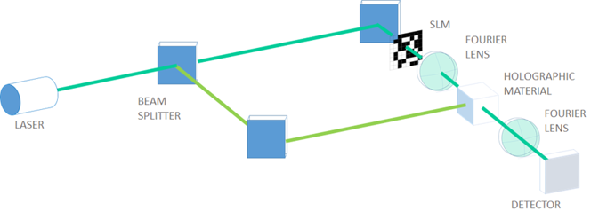
Introduction
This model simulates a holographic page data storage.
The studies include the recording and retrieval processes.
The object beam encrypting an 8 bit data is focused into a holographic material by a Fourier lens (Fourier transformation).
In the recording process, the object beam and the reference beams intersect each other and make an interference fringe pattern, which is the page hologram.
Page holographic data storage system

Slide 3
Introduction
In the retrieval process, the object beam is turned off and the reference beam is diffracted by the hologram restoring the object beam. The original 8 bit data is recovered by the other Fourier lens (Fourier transformation).
This model is related to the blog post: https://www.comsol.com/blogs/how-to-simulate-a-holographic-page-data-storage-system.
Page holographic data storage system

Slide 4
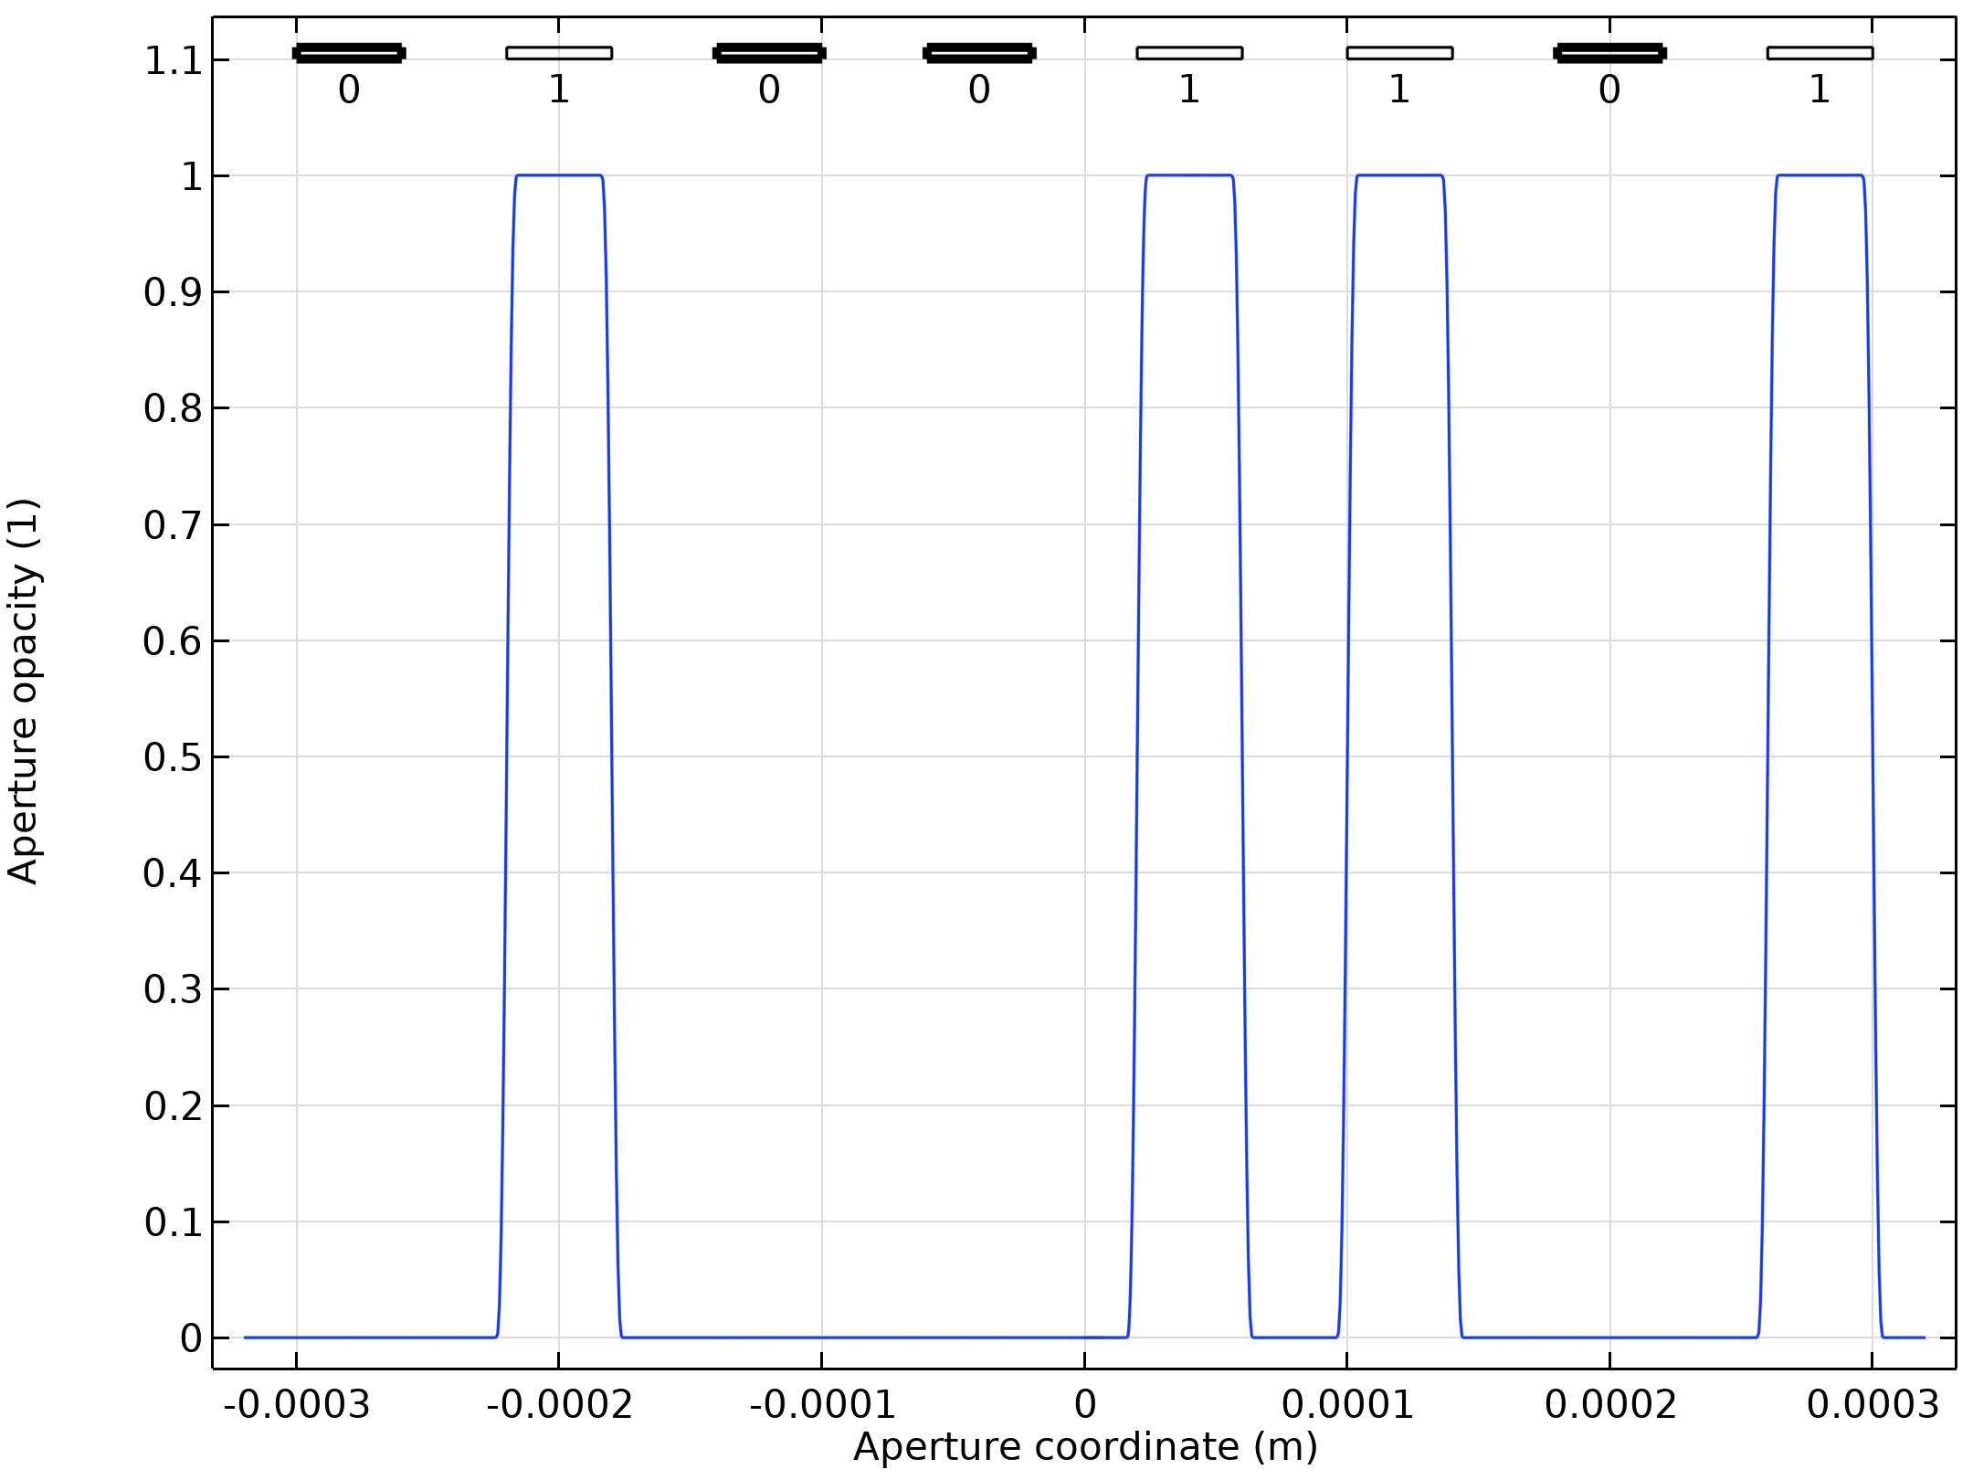
Results
Encrypted 8 bit data (01001101)

Slide 5
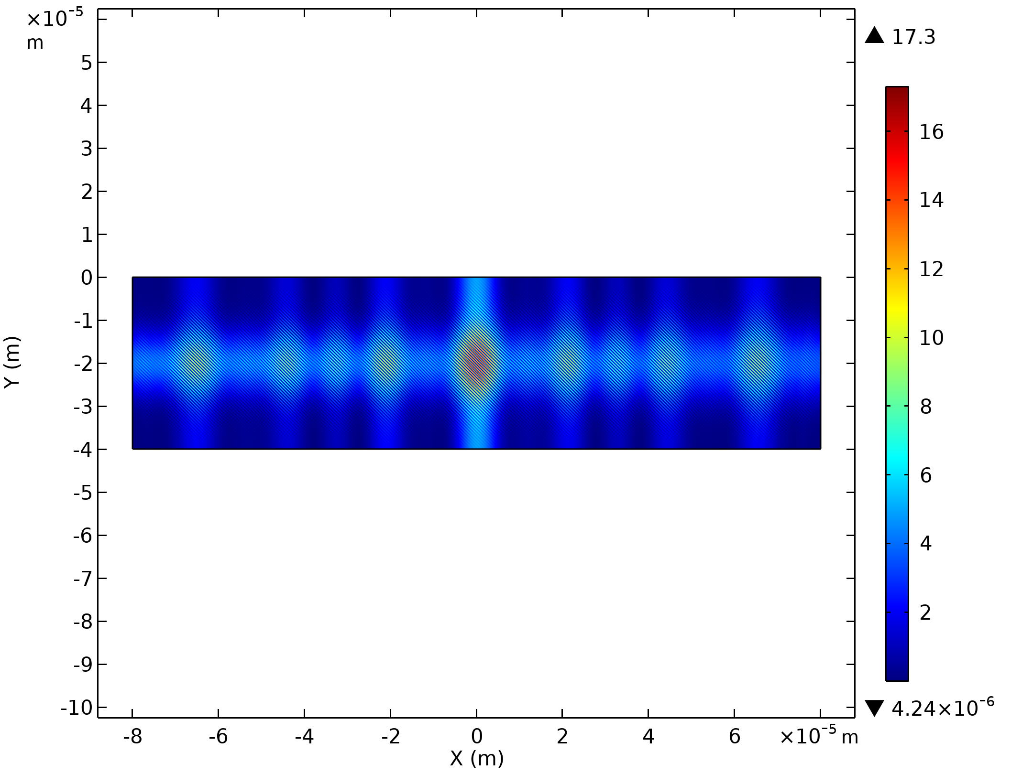
Results
Interference pattern in recording

Slide 6
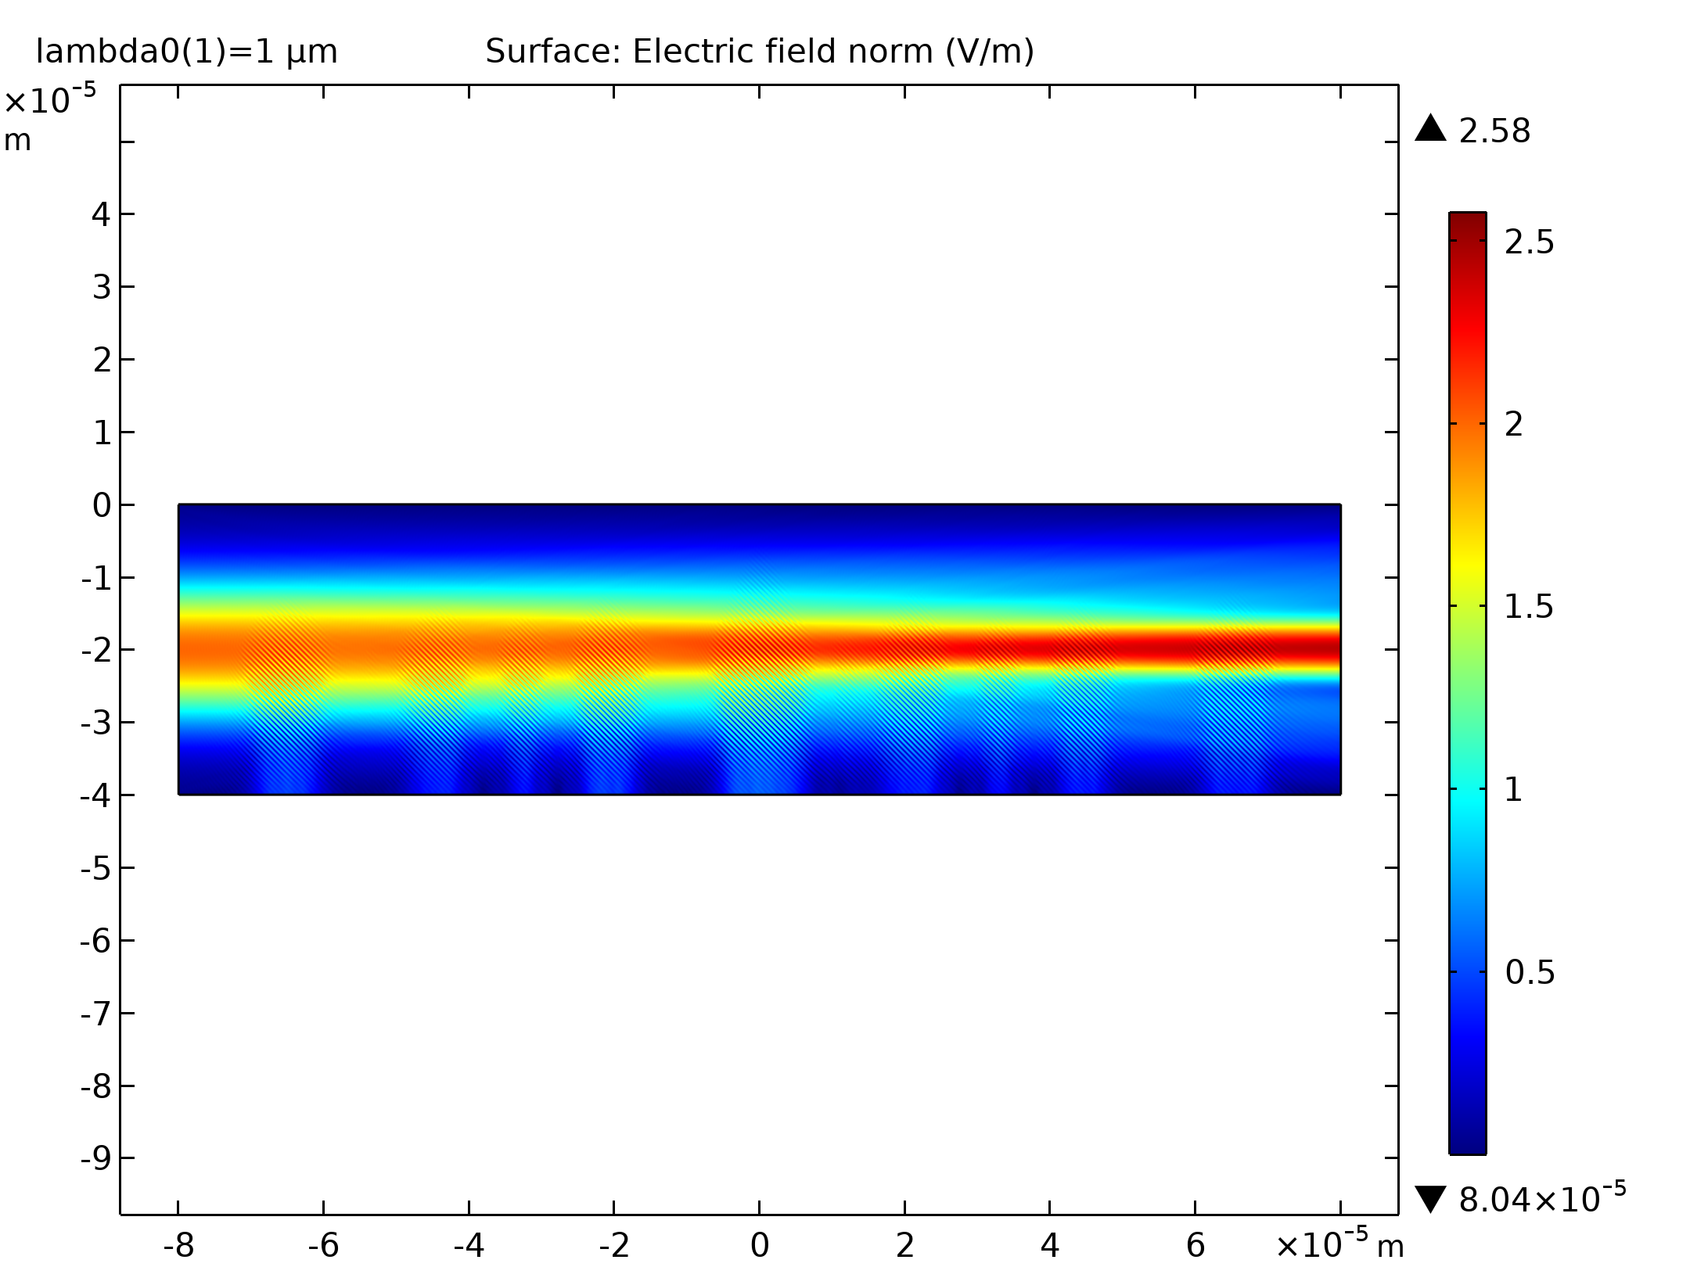
Results
Reference beam diffraction in retrieving

Slide 7
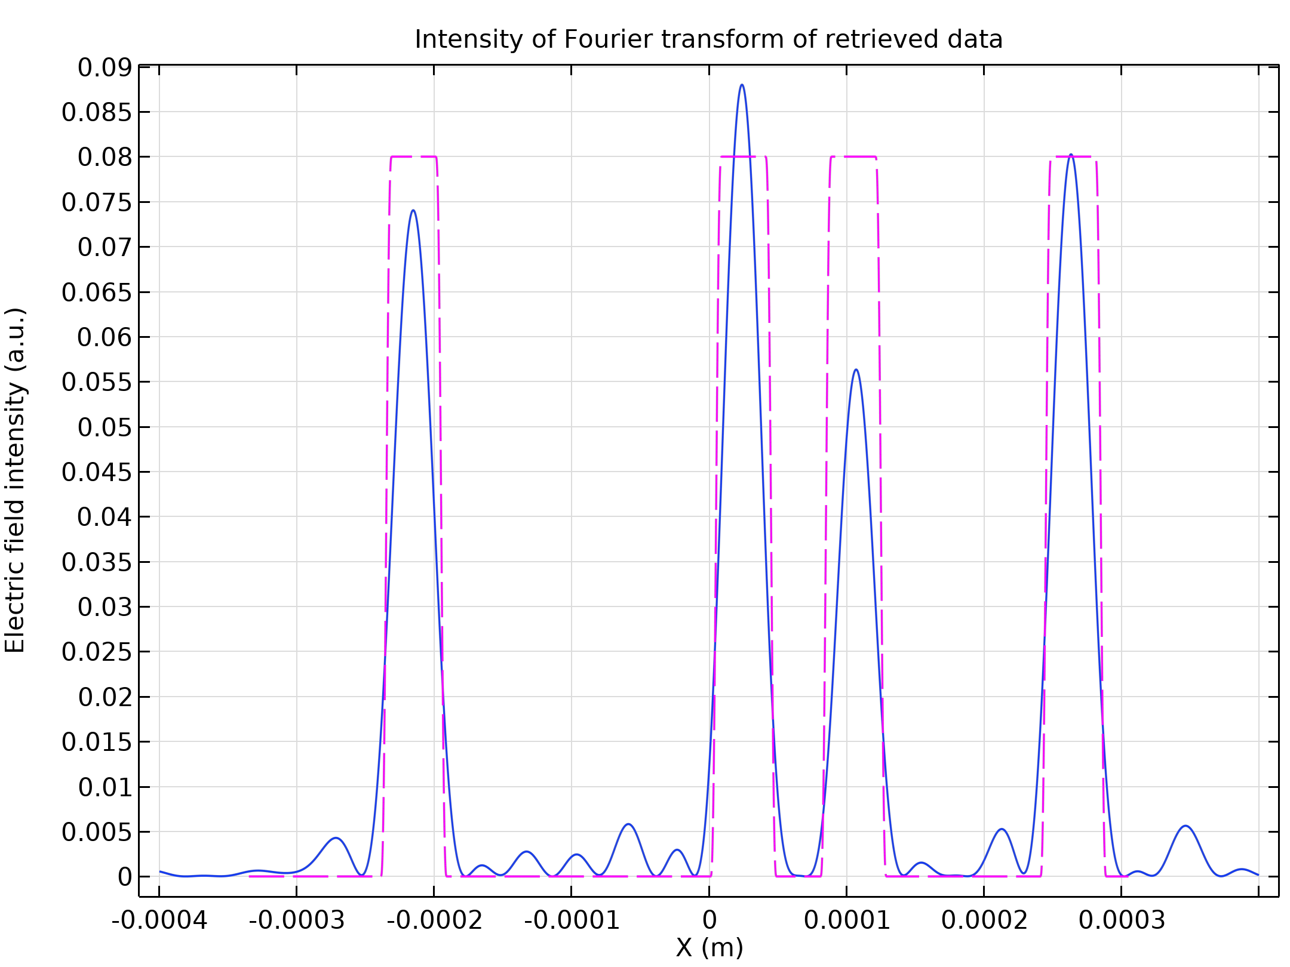
Results
Restored data

