Slide 1
Wicking in a Paper Strip
COMSOL

Slide 2
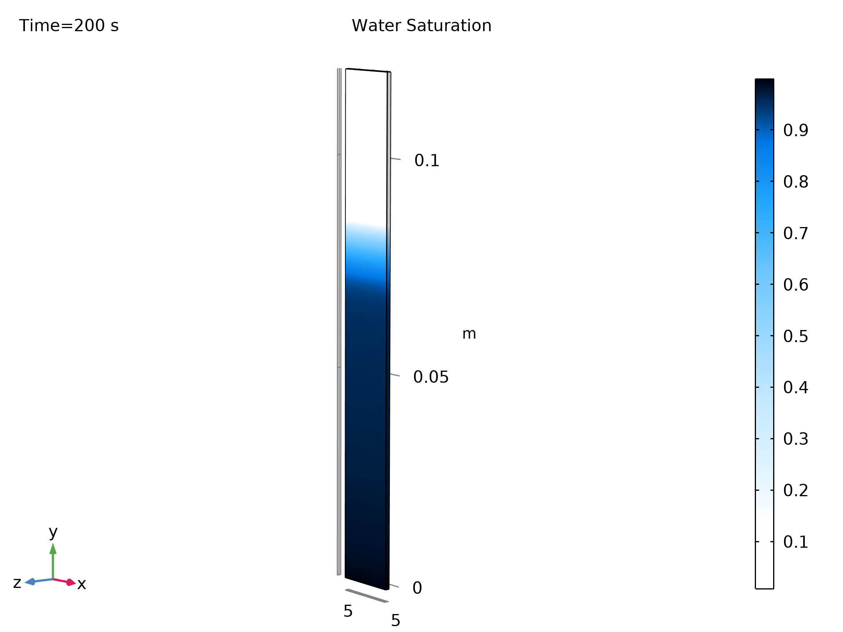
Introduction
When a dry porous material is put into contact with a fluid, it will absorb the fluid due to capillary forces.
Absorption will continue until an equilibrium is reached where the gravitational forces balance the capillary forces.
Water saturation in a wicking paper strip

Slide 3
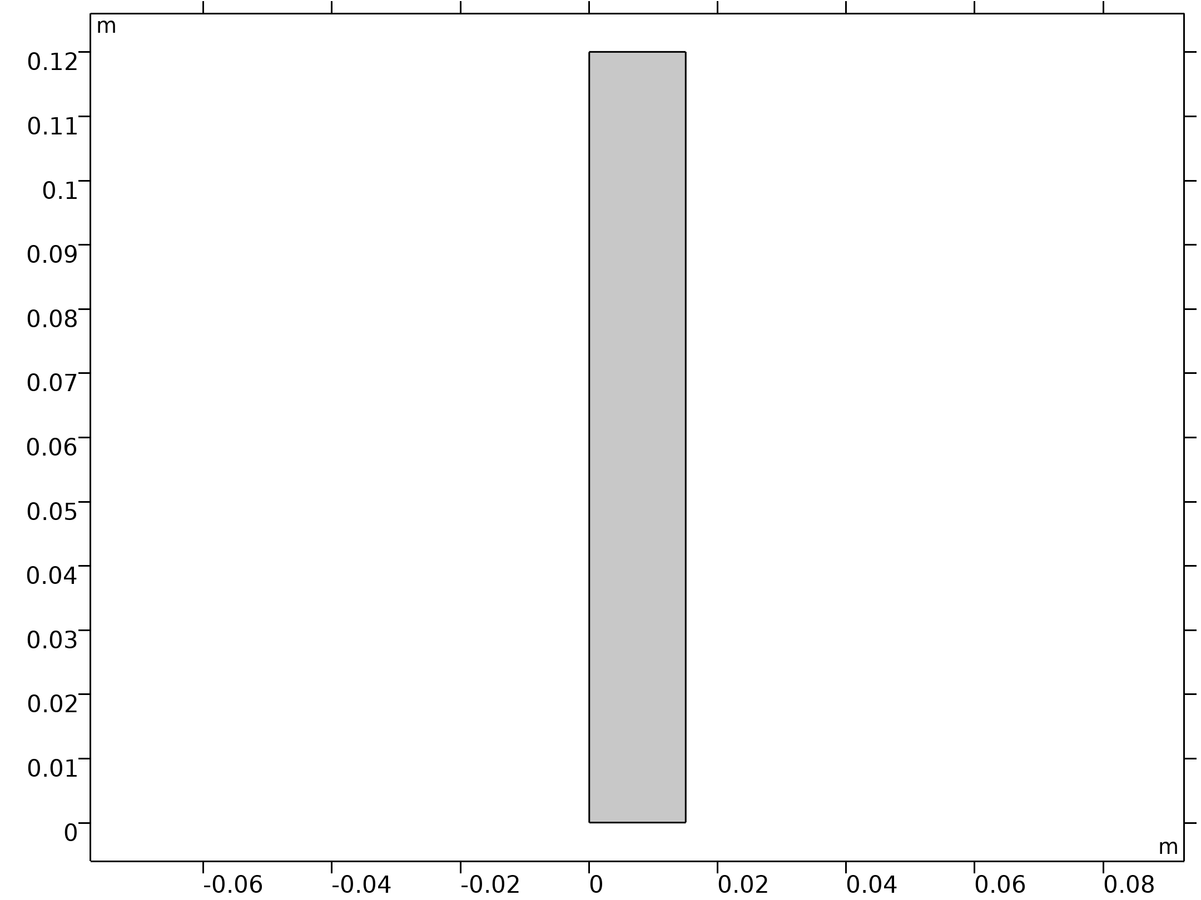
Model Overview
The interface Multiphase Flow in Porous Media is used with the phases water and air.
The porous domain is modeled in 2D (0.015 m x 0.12 m).
The model solves for air saturation and water pressure.
The Brooks and Corey-Model for capillary pressure and relative permeability is used.
Permeability and entry pressure values are taken from: Masoodi, R. and Pillai, K.M. (2010):"Darcy's law-based Model for Wicking in a Paper-like swelling Porous Media". AlChE J., 56, 2257-2267. doi:10.1002/aic.12163
Geometry 1

Slide 4
Model Overview
Parameters 1
Name | Expression | Value | Description
gamma | 0.0723[N/m] | 0.0723 N/m | Surface tension
theta | 0 | 0 | Contact angle
Rc | 8.8e-7[m] | 8.8E−7 m | Pore radius
pec | 2*gamma*cos(theta)/Rc | 1.6432E5 N/m² | Entry capillary pressure
lp | 2 | 2 | Pore size distribution index
por | 0.6 | 0.6 | Porosity
K | por/8*Rc^2 | 5.808E−14 m² | Permeability

Slide 5
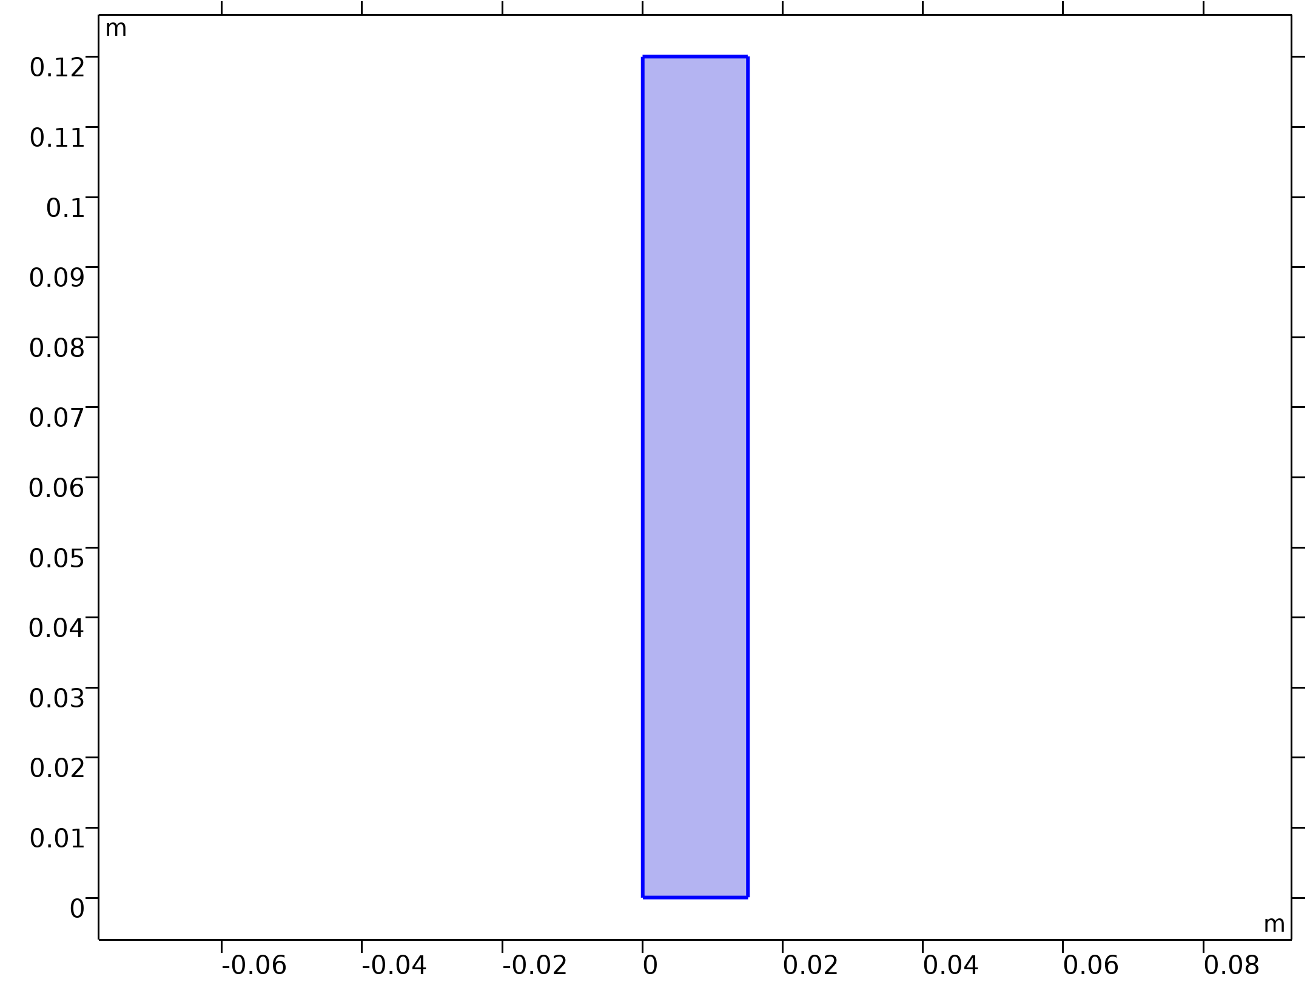
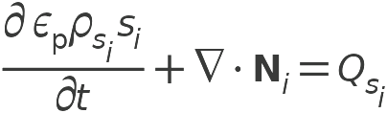
Model Equations
Phase Transport in Porous Media
Phase Transport in Porous Media

Slide 6


Model Equations
Darcy's Law
Darcy's Law

Slide 7
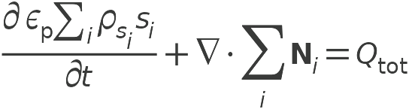
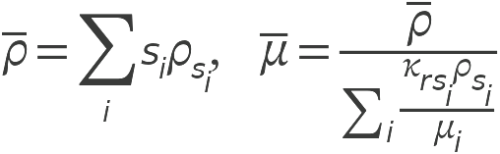
Model Equations
Multiphase Flow in Porous Media 1

Slide 8
Initial and Boundary Conditions
Initial air saturation: 0.99
No flux and no flow conditions at the side boundaries
Bottom boundary:
  Atmospheric (reference) pressure for water phase
  No flux for air phase
Top boundary:
  (Hydrostatic) atmospheric pressure minus the capillary pressure for water phase (weak constraint)
  Mass flux for air phase equal to the Lagrange multiplier corresponding to this pressure condition for the total mass conservation

Slide 9
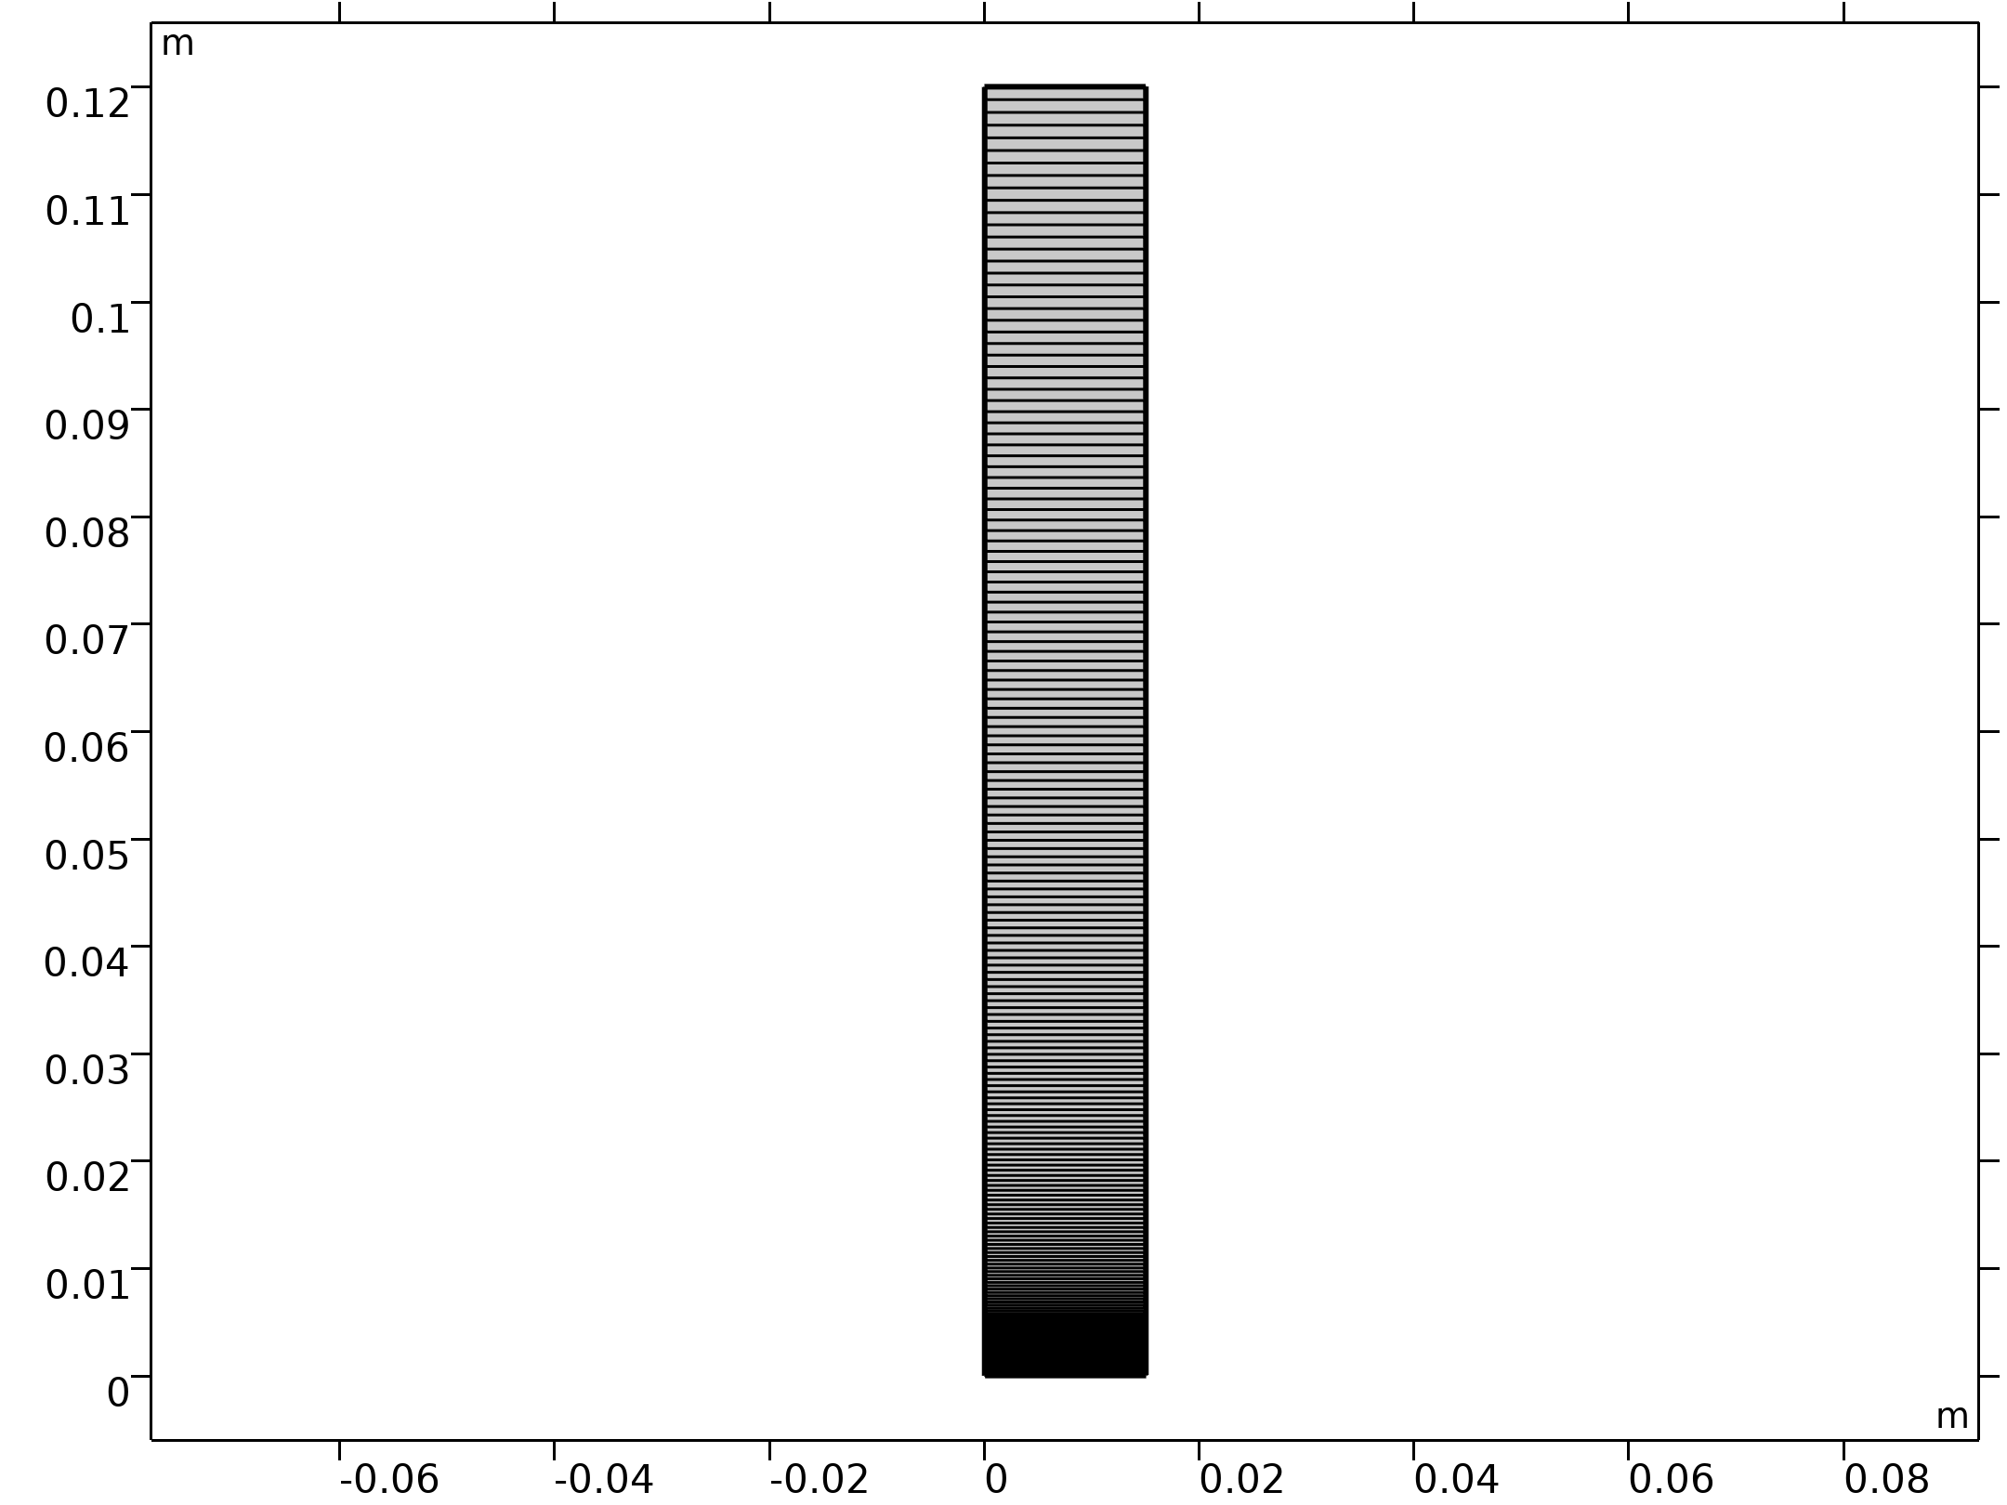
Mesh
Mapped mesh: 1x200
Distribution in vertical direction: arithmetic sequence with element ratio of 1000
Dense mesh at the bottom is needed to resolve very steep saturation gradients in the initial phase of the process
Mesh 1

Slide 10
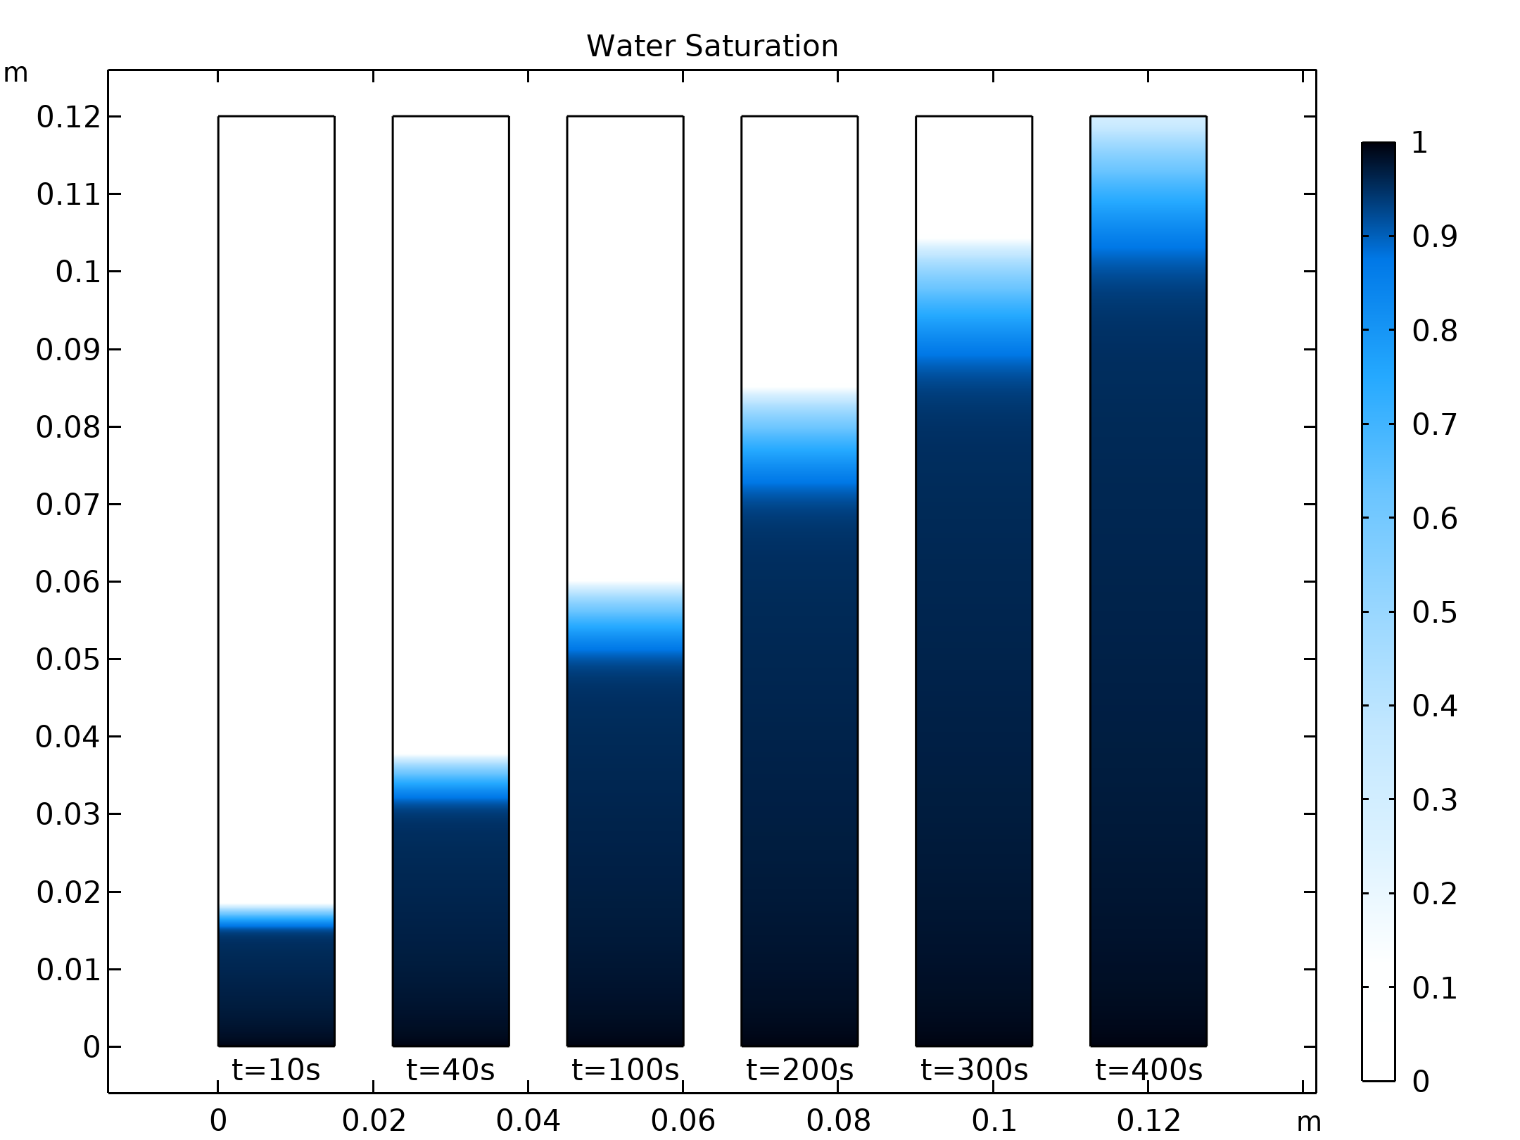
Results
After 600 s, the paper strip is already soaked with water.
The figure shows the water saturation for different output times.
Water Saturation

Slide 11
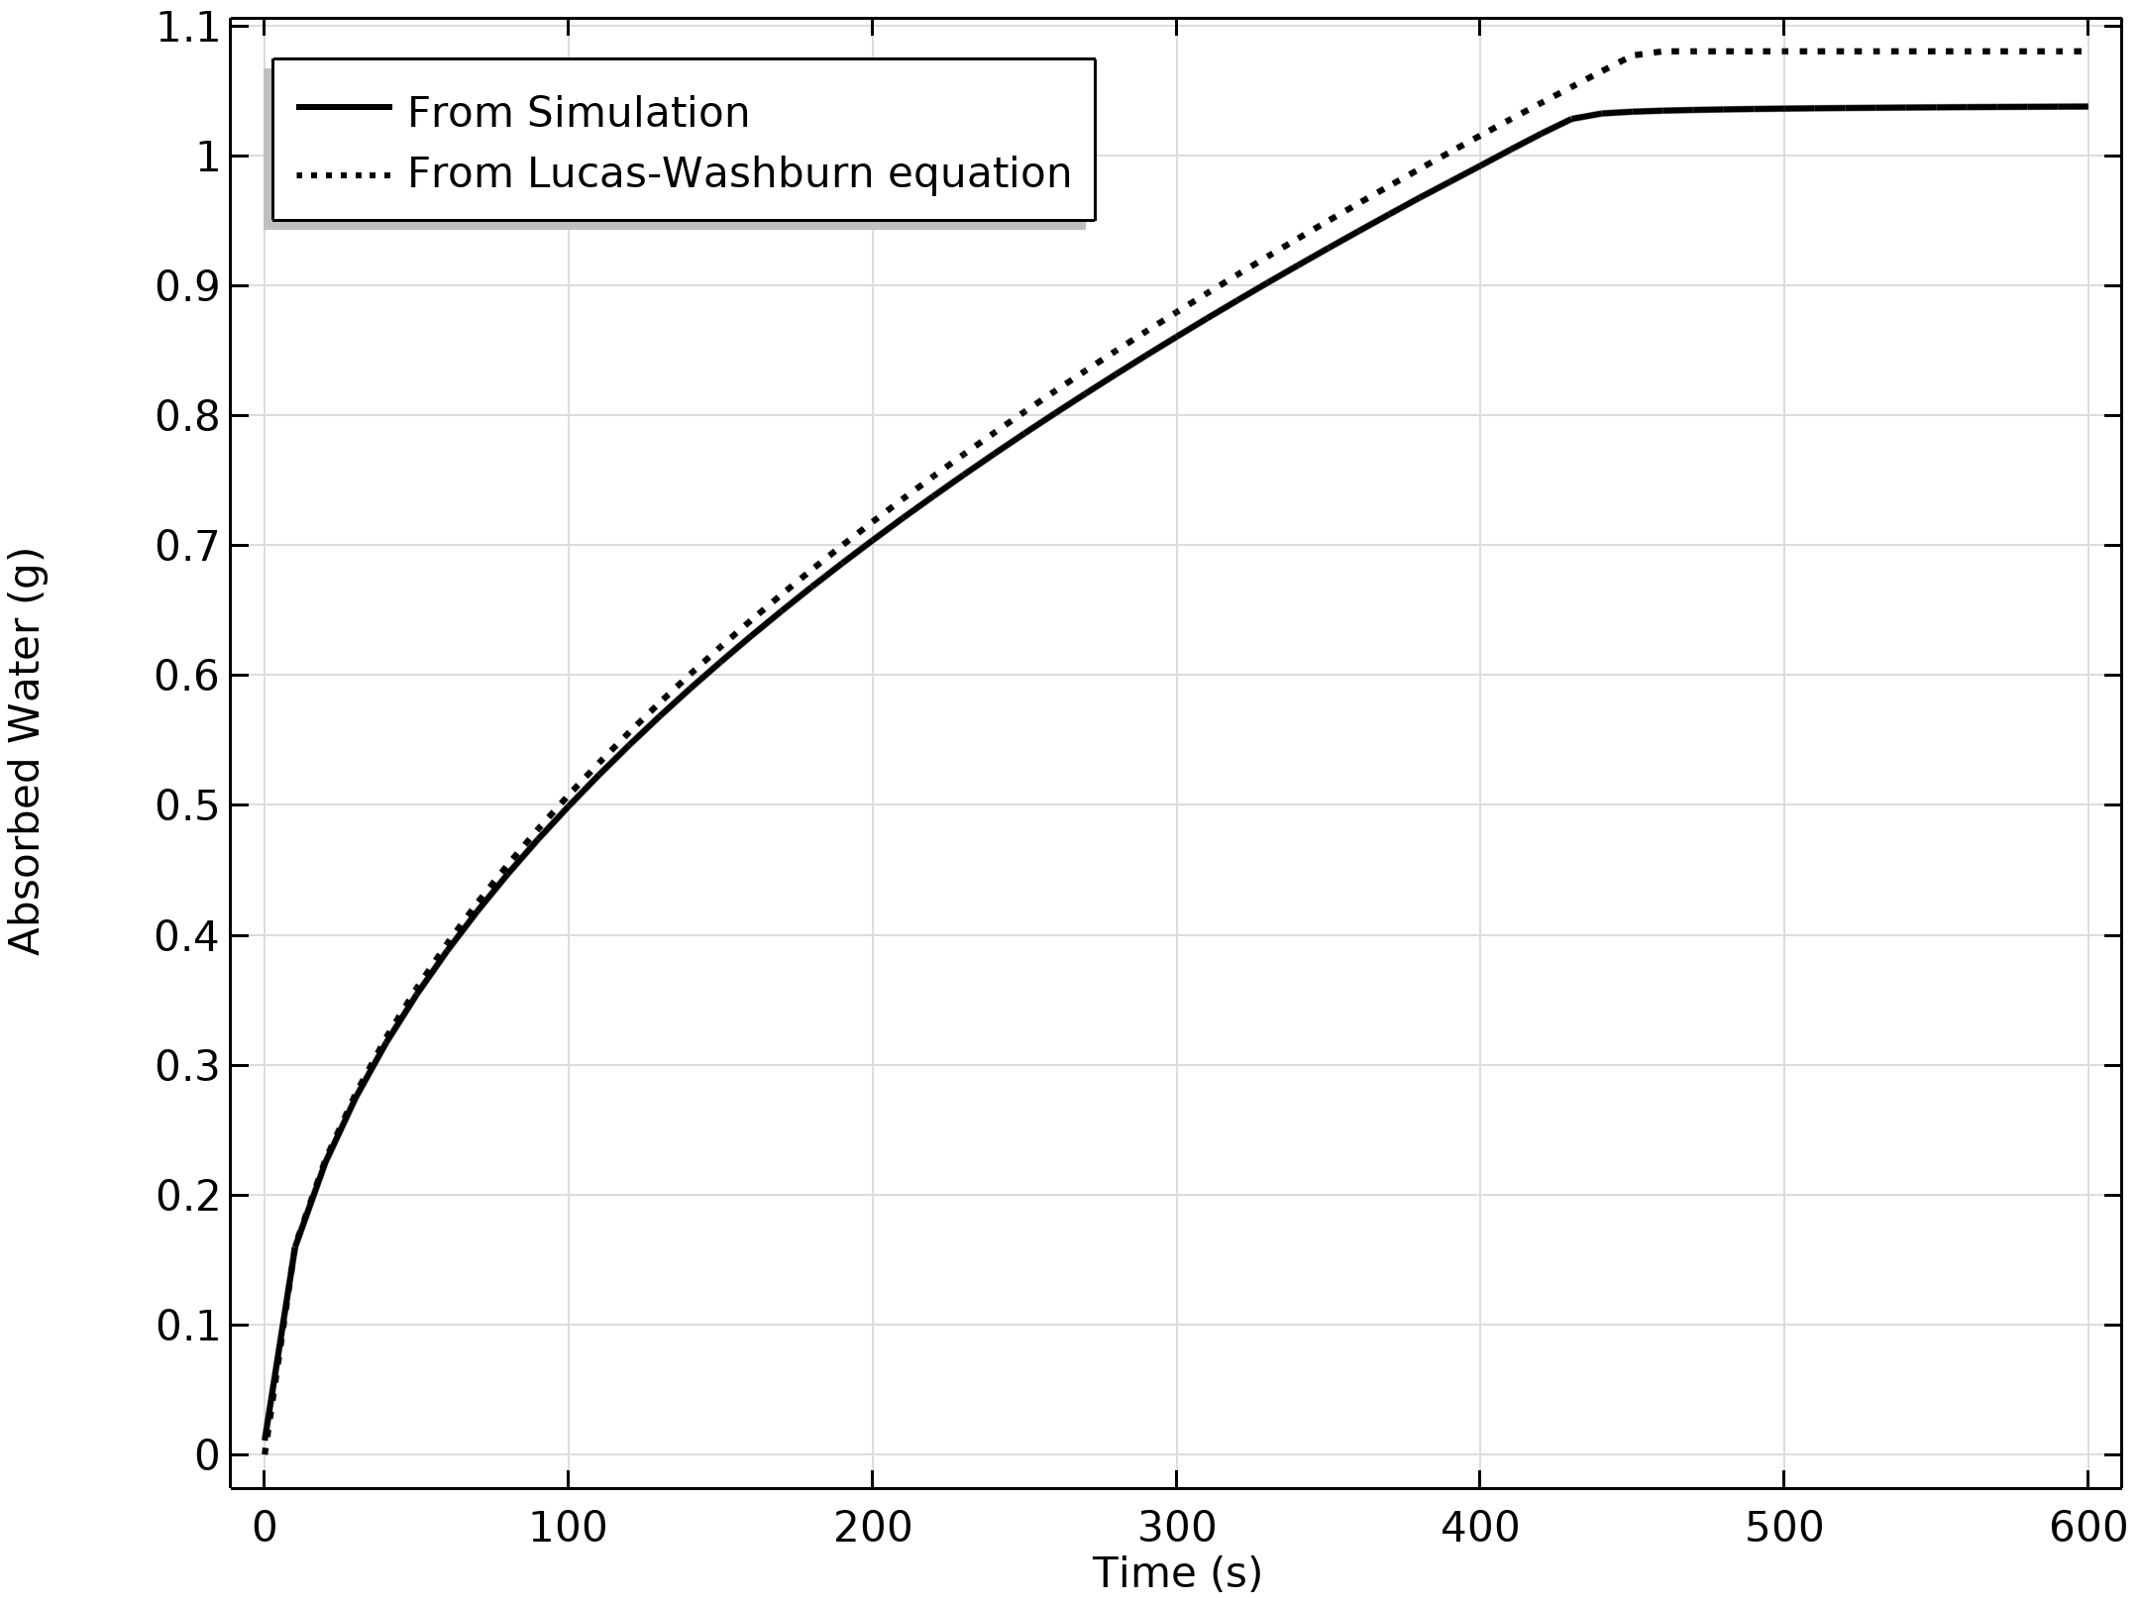
Results
The figure shows the amount of water that is absorbed by the paper strip as a function of time.
The simulation values (solid line) are compared with those calculated from the analytical expression given by the Lucas-Washburn equation (dotted line)
Water uptake versus time. Solid line: numerical simulation; dotted line: Solution from Lucas-Washburn equation

Slide 12
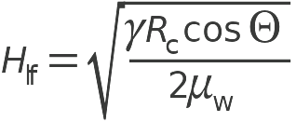
Lucas-Washburn-Equation
H_{lf} is the liquid water front, γ the surface tension, R_{c} the pore radius, Θ the contact angle, and μ_{w} the dynamic viscosity of water.
Water uptake versus time. Solid line: numerical simulation; dotted line: Solution from Lucas-Washburn equation

