Slide 1
Primary Current Distribution in a Lead–Acid Battery Grid Electrode
COMSOL

Slide 2
Introduction
This example demonstrates the use of the Primary Current Distribution interface for modeling current distributions in electrochemical cells
In a primary current distribution, the potential losses due to electrode kinetics and mass transport are assumed to be negligible, and ohmic losses are governed by the current distribution in the cell
Here you investigate a primary current distribution in a positive lead-acid battery grid electrode during a high load (100 A) discharge

Slide 3
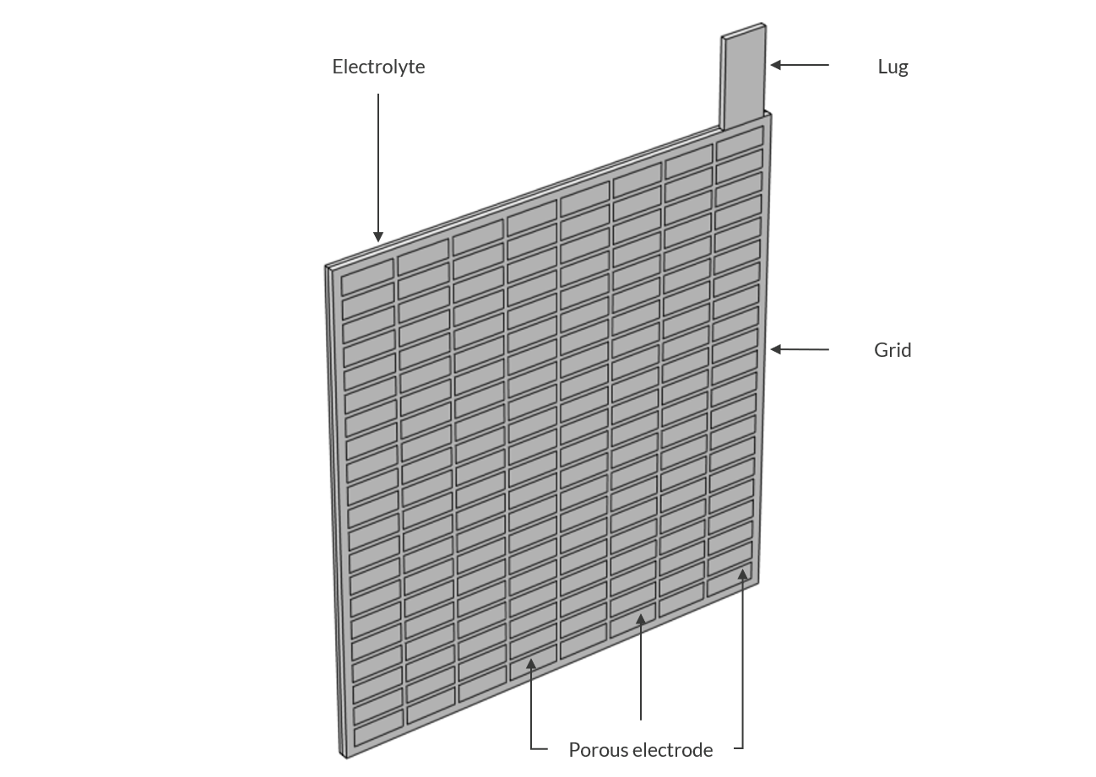
Model Definition
The half-cell geometry consists of a grid and a lug of the same metal material, a matrix of porous electrodes residing within the grid, and an electrolyte domain
The figure shows the geometry
Modeled Geometry

Slide 4
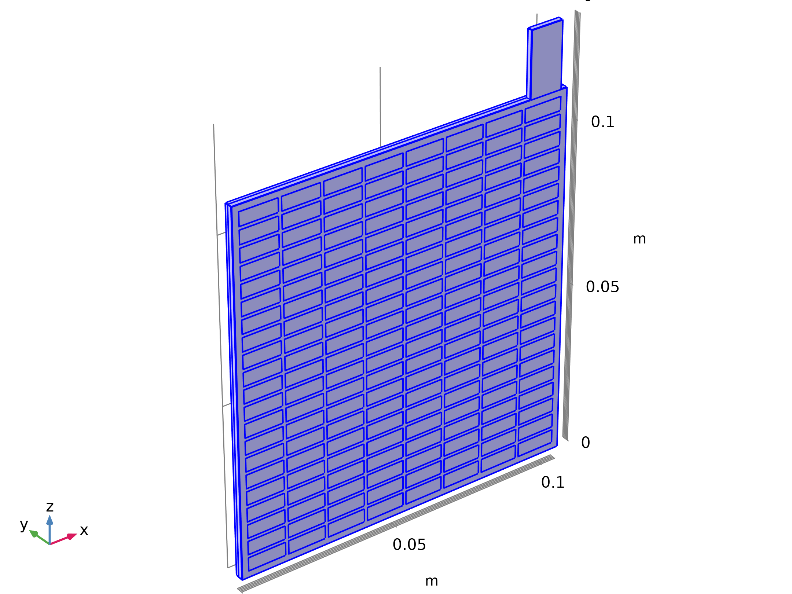



Model Definition
Primary Current Distribution

Slide 5
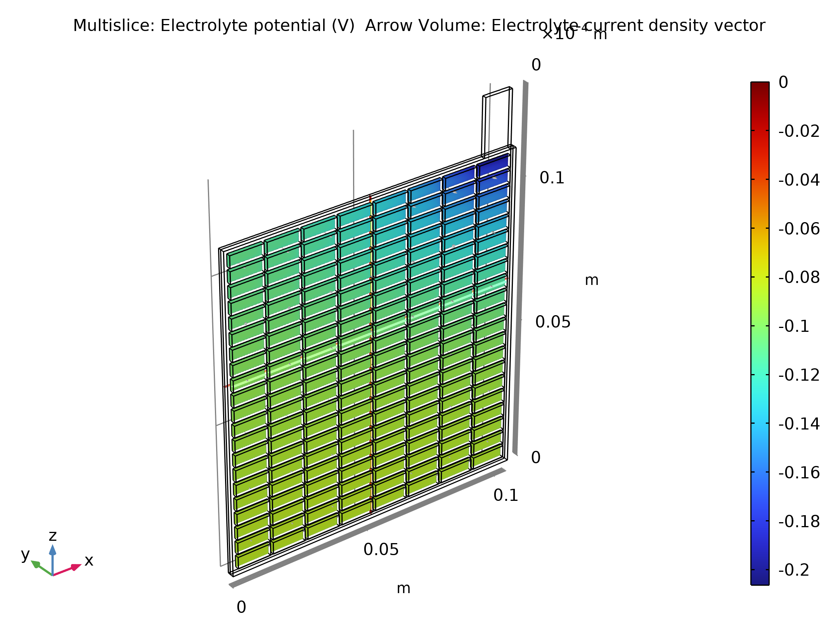
Results
The figure shows the electrolyte potential in the electrolyte and the porous electrode domains
The potential drop is highest, roughly 0.2 V, in the area close to the lug
Electrolyte potential in the electrolyte and porous electrodes

Slide 6
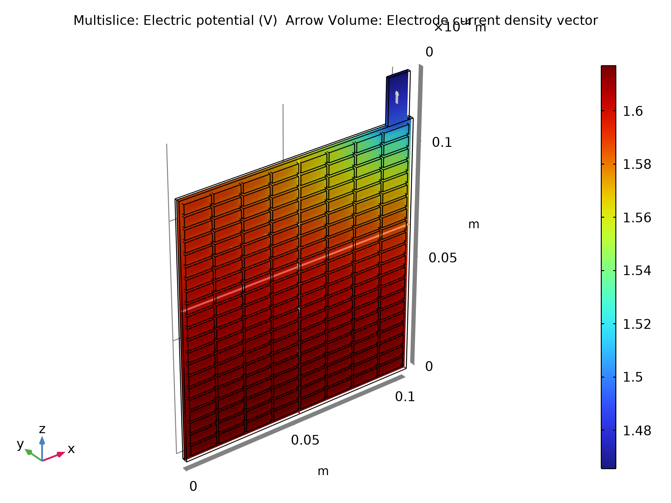
Results
The figure shows the potential in the grid and the lug
The potential difference between the corner of the grid closest to the lug and the far end corner is about 0.15 V
Electric potential in the grid and the lug

Slide 7
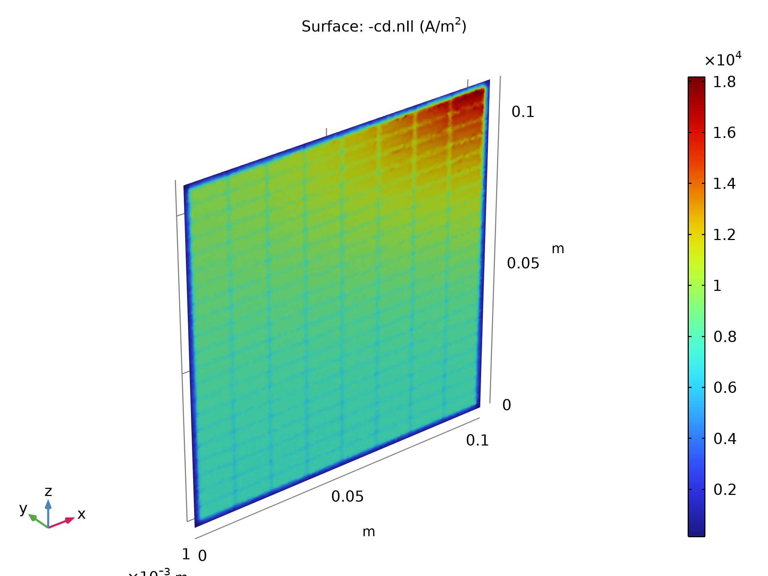
Results
Finally, the current density distribution in the electrolyte symmetry plane is plotted in the figure
The currents are about twice as high in the active region closest to the lug compared to the opposite corner of the cell
In this case an improvement of the battery performance would be possible by making the frame of the grid thicker toward the lug corner, thereby achieving a more uniform current distribution
Electrolyte current density at the half-cell boundary

