Slide 1
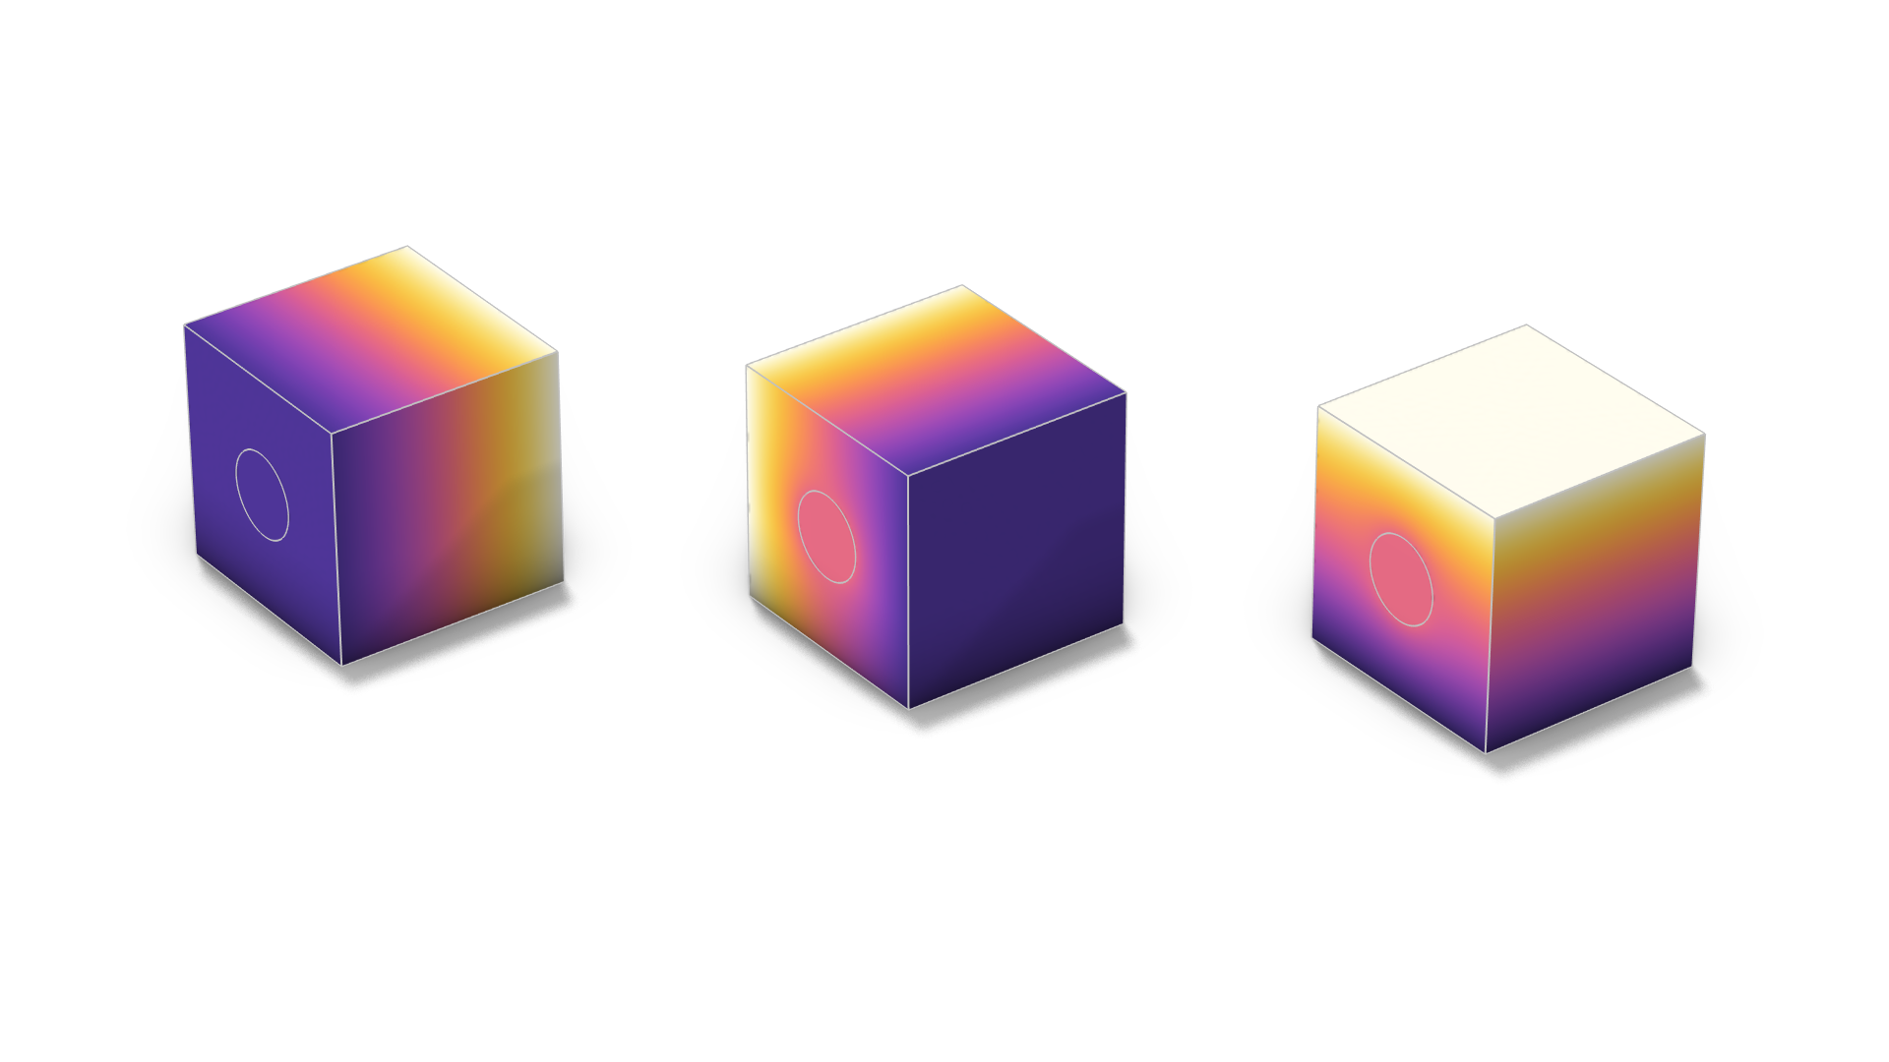
Homogenization of Fiber Composite Thermal Properties

Slide 2
Background
The use of fiber-reinforced composites is increasing in various industries like automotive, aerospace, infrastructure, and many more.
These composite materials are used on large scale simulation. Therefore, effective properties are often necessary to limit the calculation cost.
This model demonstrates how to use the heat transfer Cell Periodicity feature to compute homogenized thermal material properties.
A periodic repeating unit cell (RUC) of a fiber composite is considered.
A homogeneous material is created with the effective thermal properties.

Slide 3

Model Definition
Geometry and materials
Dimension:
  Length of the cubic repeating unit cell: 10 cm
  Radius of the fiber: 1.8 cm
Materials:
  Matrix material: epoxy resin
  Fiber material: carbon fiber
Repeating unit cell of a composite fiber material

Slide 4
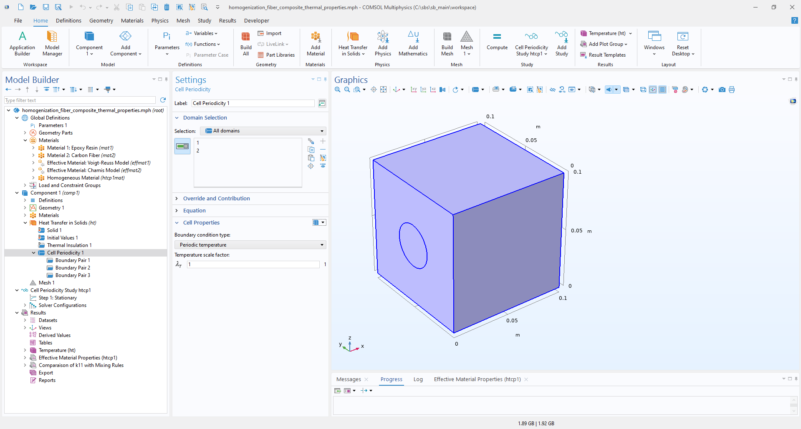
Model Definition
Cell Periodicity
Cell Periodicity feature is used with Periodic temperature option.
Boundary Pair features are defined to impose the periodic condition on each set of opposite boundaries.

Slide 5
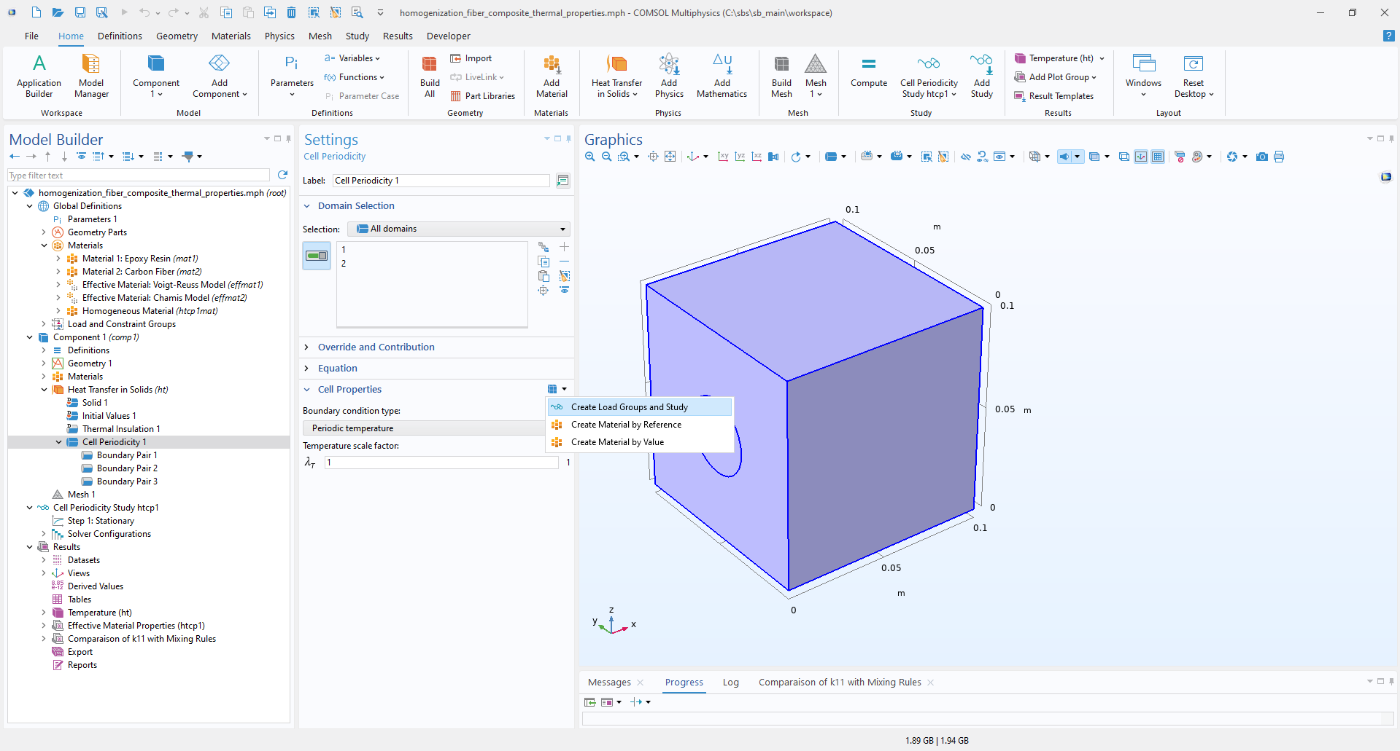
Model Definition
Study creation
2
Select Cell Periodicity feature
Create study and load groups with “Create Load Groups and Study” menu button.
Compute the Cell Periodicity Study htcp1.
2
1
1
3
3

Slide 6
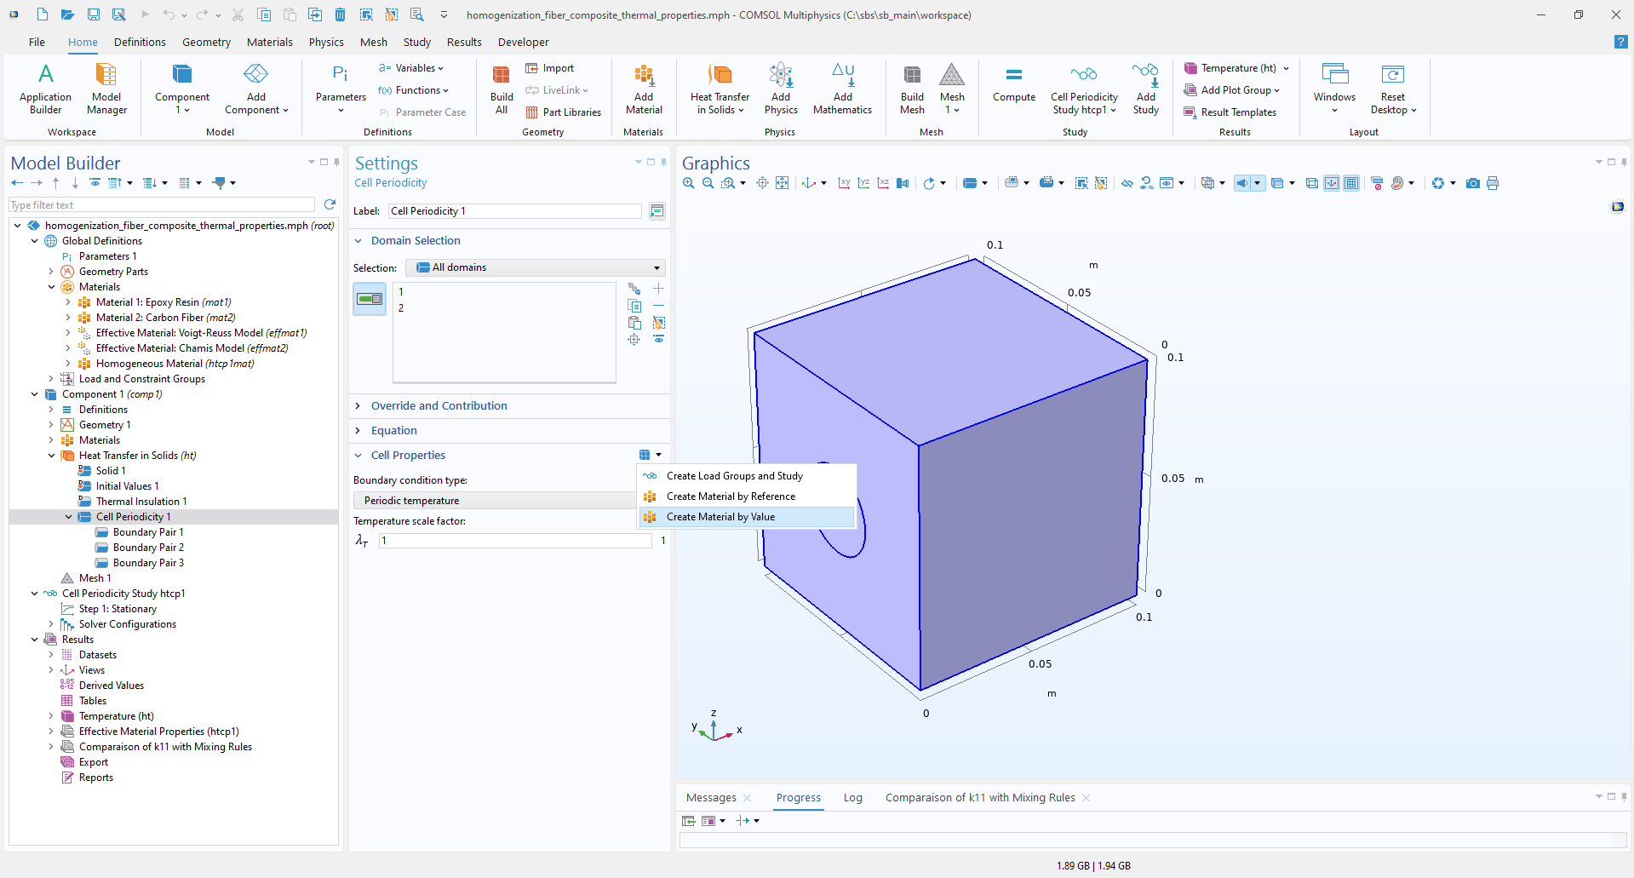
Model Definition
Material creation
2
2
Create the homogeneous material using the menu button in Cell Periodicity feature.
The new homogeneous material is created in the materials section and can be saved in a database.
Effective properties are plotted in the Effective Material Properties evaluation group.
1
1
3
3

Slide 7
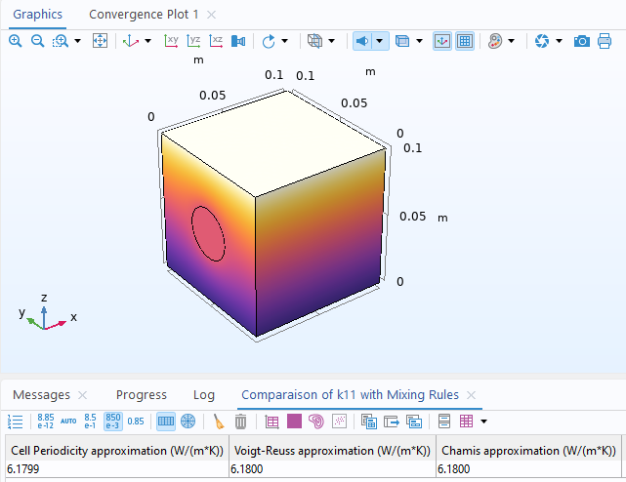
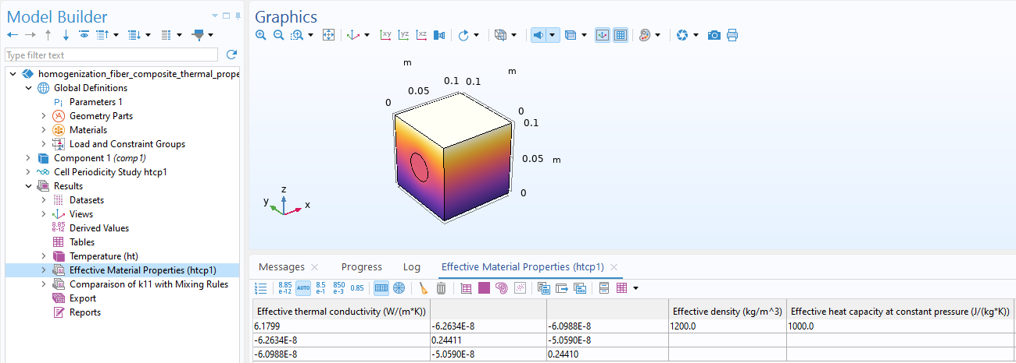
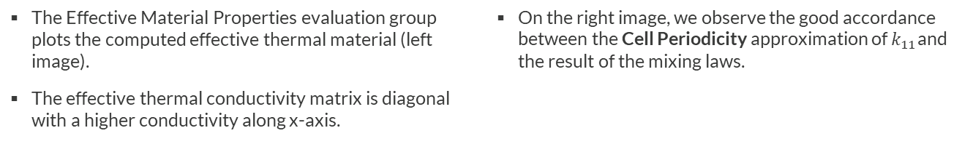
Results
Effective thermal properties
The Effective Material Properties evaluation group plots the computed effective thermal material (left image).
The effective thermal conductivity matrix is diagonal with a higher conductivity along x-axis.
On the right image, we observe the good accordance between the Cell Periodicity approximation of $k_{11}$and the result of the mixing laws.

Slide 8
Conclusion
The Cell Periodicity feature with periodic temperature option computes effective thermal properties of a repeating unit cell.
Resulting properties can be stored as a material and reused in large scale model.

