Slide 1
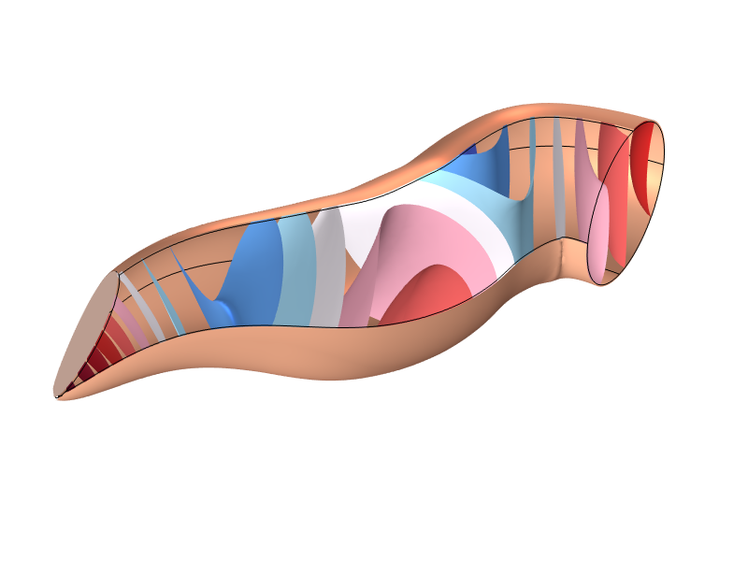
Tutorial:
Ear Canal Acoustics

Slide 2
Background and Motivation
In this tutorial, the acoustics of the human ear canal are investigated. The output includes the input impedance and the transfer impedance, as well as the level transformation from the entrance to the ear drum.
With the increase in tools that can scan the ear canal, the simulation approach presented here also allows for “custom simulations” for individuals. Earbuds or hearing aids can, for example, be virtually customized and fitted.

Slide 3
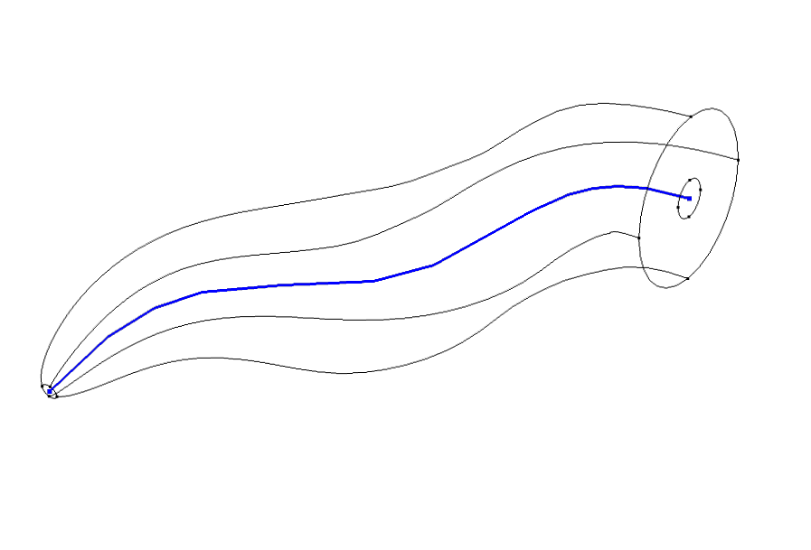
Geometry
Ear canal center
line curve: g(s)
The geometry of the ear canal used is based on measurements from test subjects reported in literature.
The ear canal in this model has a radius of 4 mm at the entrance and narrows down toward the ear drum. The dimensions indicate that some losses due to the thermal and viscous boundary layers exist. The boundary layer thickness is about 0.22 mm at 100 Hz and decreases with increasing frequency. This indicates that the layers are not overlapping and the so-called boundary layer impedance (BLI) model can be used to model these losses.
Ear canal area
function: A(s)
Reference: M. R. Stinson and B. W. Lawton, “Specification of the geometry of the human ear canal for the prediction of sound-pressure level distribution,” J. Acoust. Soc. Am. 85, 2492-2503 (1989).

Slide 4
Model setup
Ear drum
impedance
The ear drum is modeled using the built-in physiological impedance model for the Human ear drum, and the impedance of the ear canal boundaries is modeled using the Human Skin. To include the thermoviscous boundary layer losses, the Thermoviscous Boundary Layer Impedance feature is used.
The Thermoviscous Boundary Layer Impedance feature represents a way to handle the thermoviscous losses using an impedance-like boundary condition. The formulation is only valid for non-overlapping boundary layers (it is not valid in very narrow regions) and only valid for geometries with radii of curvature much larger than the boundary layer length scale.
Skin impedance and
BLI impedance
  References: M. Berggren, A. Bernland, and D. Noreland, “Acoustic boundary layers as boundary condition,” JCP 371, 633-650 (2018).
  J. S. Bach and H. Bruus, “Theory for acoustics with viscous boundary layers and streaming in curved elastic cavities,” JASA 144, 766-784 (2018).

Slide 5
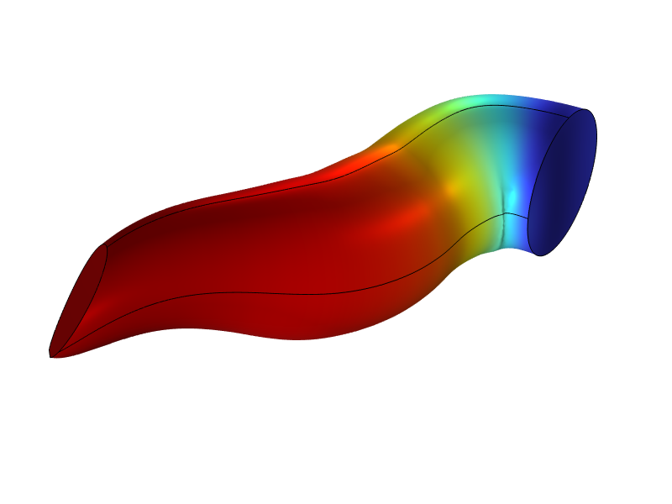
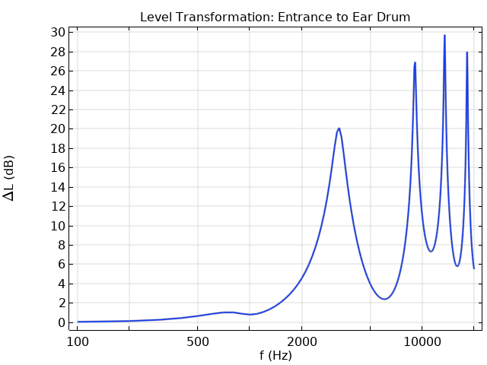
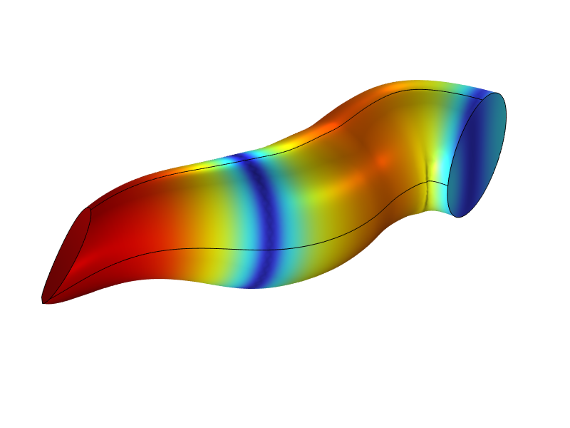
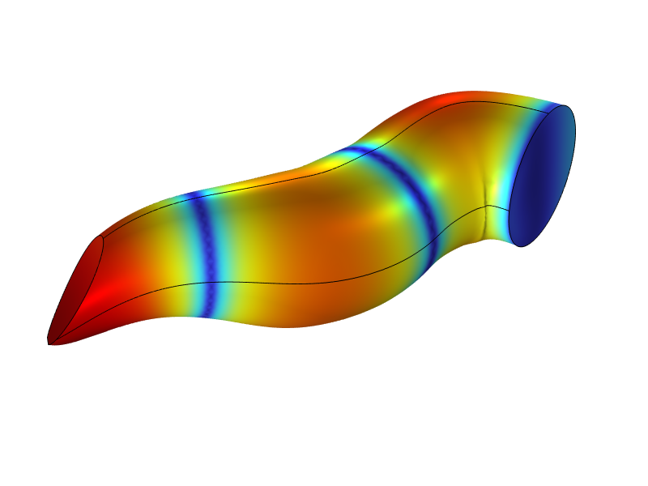
Results: Level Transform

Slide 6
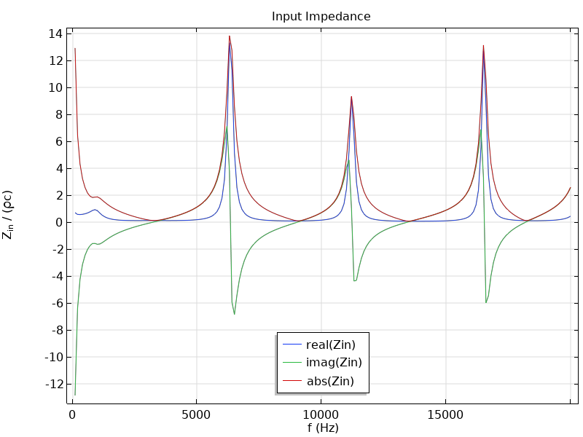
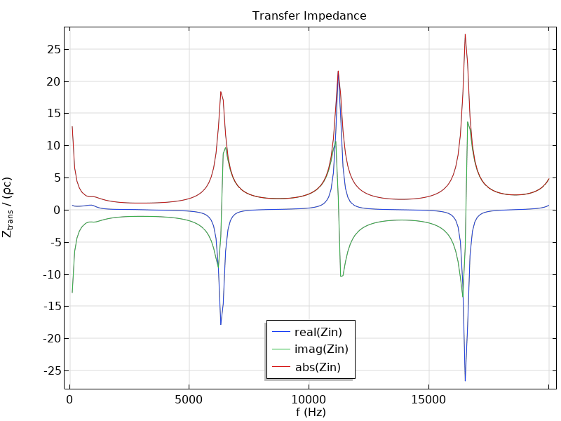
Results: Impedances

Slide 7
info@comsol.com

