Slide 1
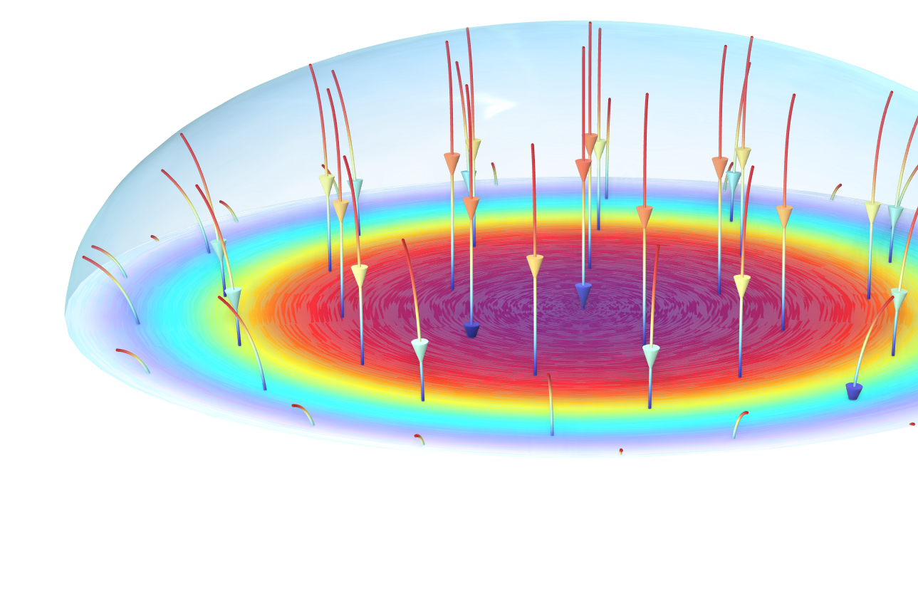
Corrosion Under an Evans Droplet
COMSOL

Slide 2
Overview
The century-old Evans droplet experiment demonstrates corrosion that is limited by oxygen transport.
This Evans droplet tutorial model defines the corrosion of an iron surface in contact with a water droplet in a surrounding atmosphere that contains both carbon dioxide and oxygen.
The model accounts for the charge and mass transport of a multitude of species as well as iron dissolution, oxygen reduction, carbonic acid equilibria, and iron hydroxide formation.
The model computes the transient and spatial distributions of the various species within the droplet.
A spatial gradient in the pH is demonstrated and is attributed to the complex interplay between the dissolved iron and the carbonic acid.
N₂, O₂, CO₂
H₂O
Fe

Slide 3
Model Definition
Geometry defined in 2D with axial symmetry: An electrolyte droplet covers the metal surface.
The modeled electrolyte species are:
  H⁺, OH⁻, Fe²⁺, O₂, CO₂, H₂CO₃, HCO₃–, and CO₃²⁻.
Homogeneous reactions in the electrolyte:
  H ⁺ + OH⁻ ⇔ H₂O
  CO₂ + H₂O ⇔ H₂CO₃
  H₂CO₃ ⇔ HCO₃⁻ + H ⁺
  HCO₃⁻ ⇔ CO₃²⁻ + H ⁺
Fixed concentrations are set for O₂ and CO₂ at the droplet surface boundary facing the air.
Symmetry
line, r = 0
Droplet surface
boundary
Model
domain
Fe electrode
surface boundary

Slide 4
Model Definition
There is an oxygen reduction reaction at the metal surface that is more dominant at the edge of the droplet:
  4H⁺ + 4e⁻ + O₂ → 2H₂O
Iron is oxidized to balance the reduction reaction:
  Fe(s) → Fe²⁺ + 2e⁻
Dissolved iron then forms iron hydroxide due to a precipitation reaction at the electrode surface:
  Fe²⁺ + 2 OH⁻ → Fe(OH)₂(s)
Protons are formed by water autoprotolysis to counterbalance the hydroxide ions consumed:
  H₂O → H⁺ + OH⁻
CO₂ is dissolved at the droplet surface and is consumed inside the droplet in homogeneous reactions. This results in a lower pH at the surface of the droplet and a higher pH inside the droplet.
Symmetry
line, r = 0
Edge of
the droplet
7.155 mm

Slide 5
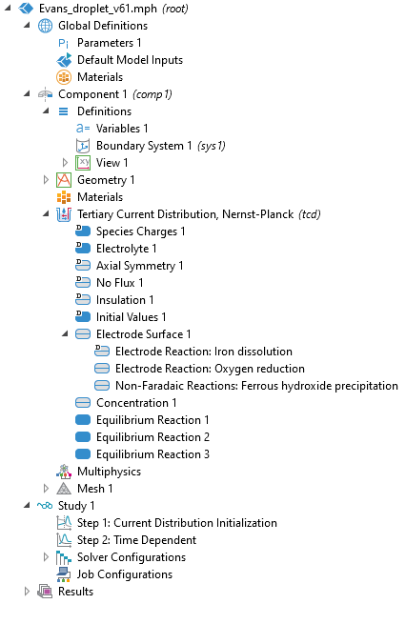
Implementation
The Tertiary Current Distribution, Nernst-Planck interface defines the transport of charged and neutral species.
  The water-based model with an electroneutrality charge balance defines c_{H} and c_{OH} as built-in variables and defines the water autoprotolysis equilibrium automatically.
Iron dissolution and oxygen reduction reactions are set using the Electrode Reaction node.
The Fe(OH)₂(s) precipitation reaction is set using the Non-Faradaic Reaction node.
Homogeneous reactions are set using the Equilibrium Reaction nodes.

Slide 6
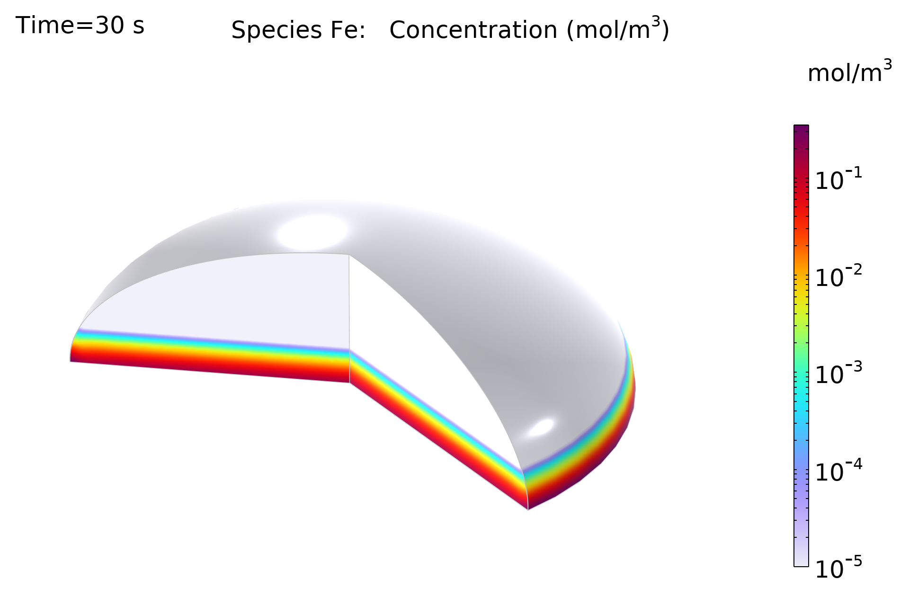
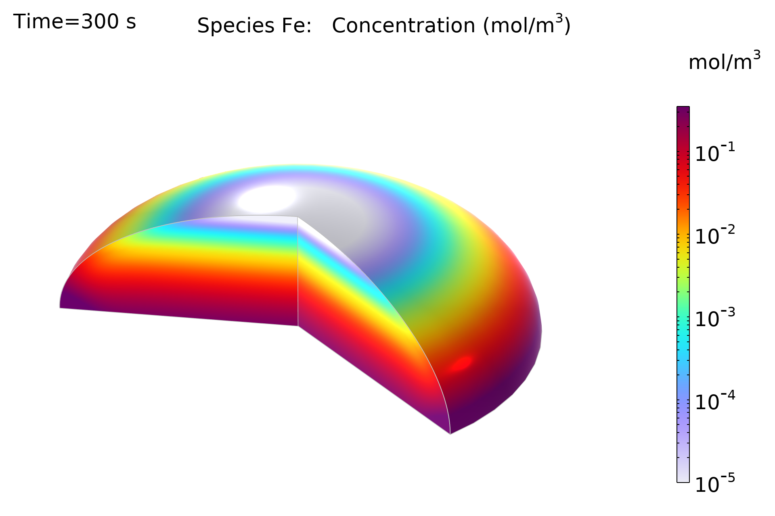
Results: Iron Concentration
Concentration of iron ions at 30 s and 300 s. The iron ion concentration is slightly higher toward the edge of the droplet.

Slide 7
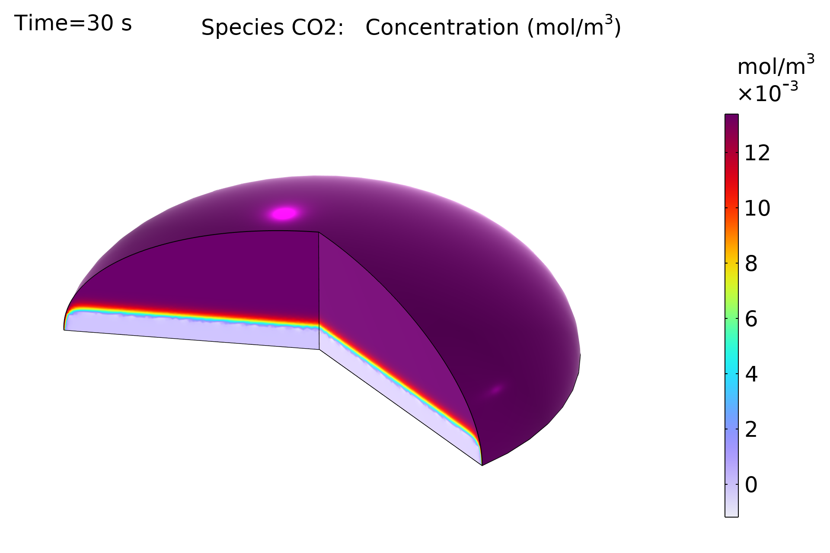
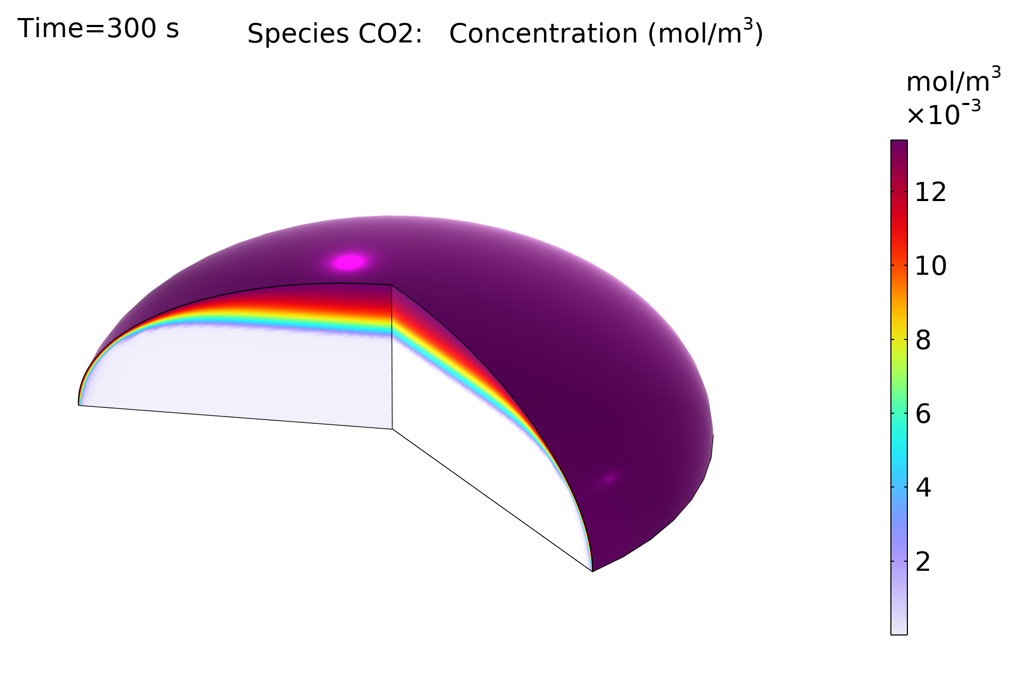
Results: Carbon Dioxide Concentration
Concentration of carbon dioxide at 30 s and 300 s. The CO₂ concentration is the lowest at the core of the droplet, since it is consumed in a homogeneous reaction.

Slide 8
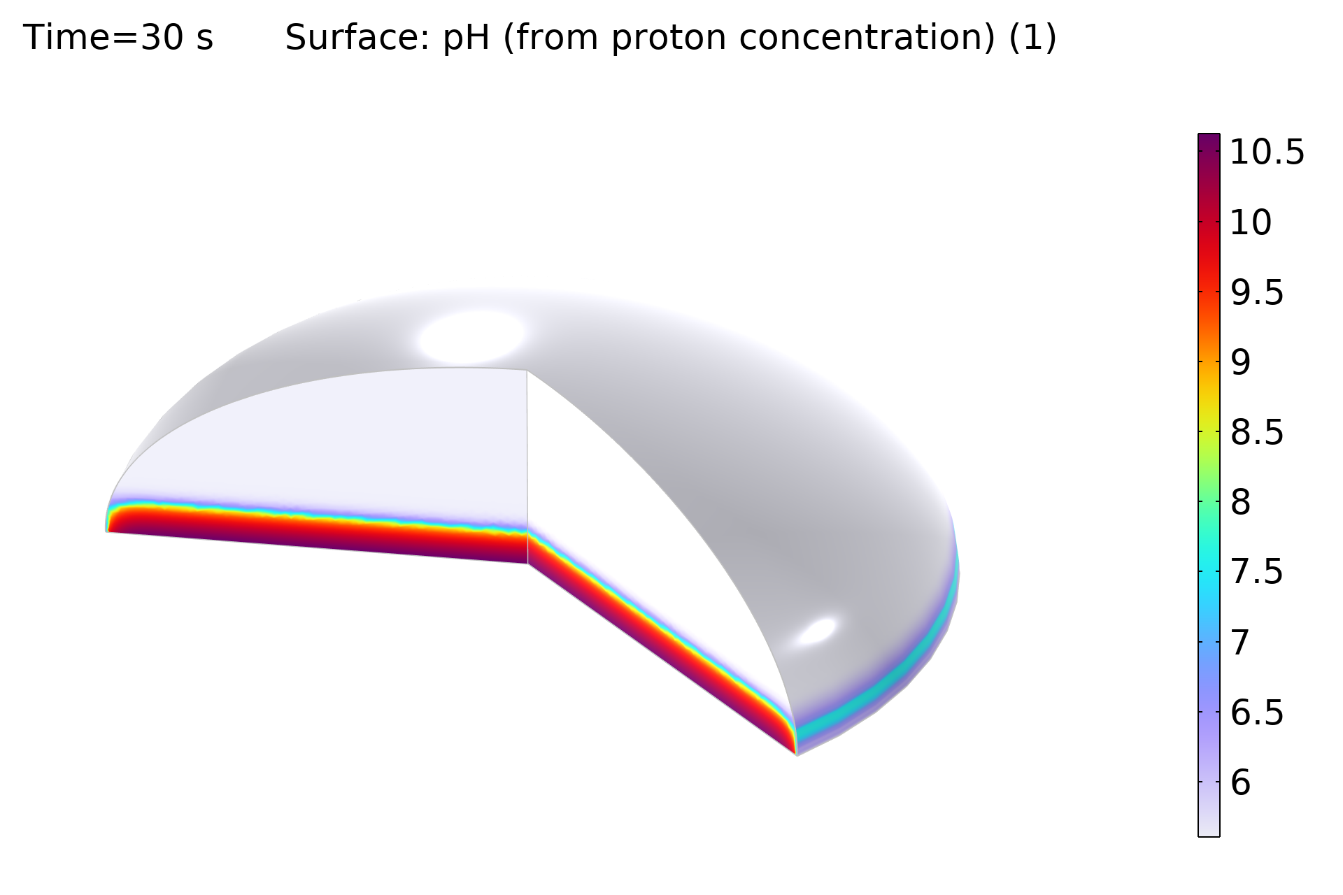
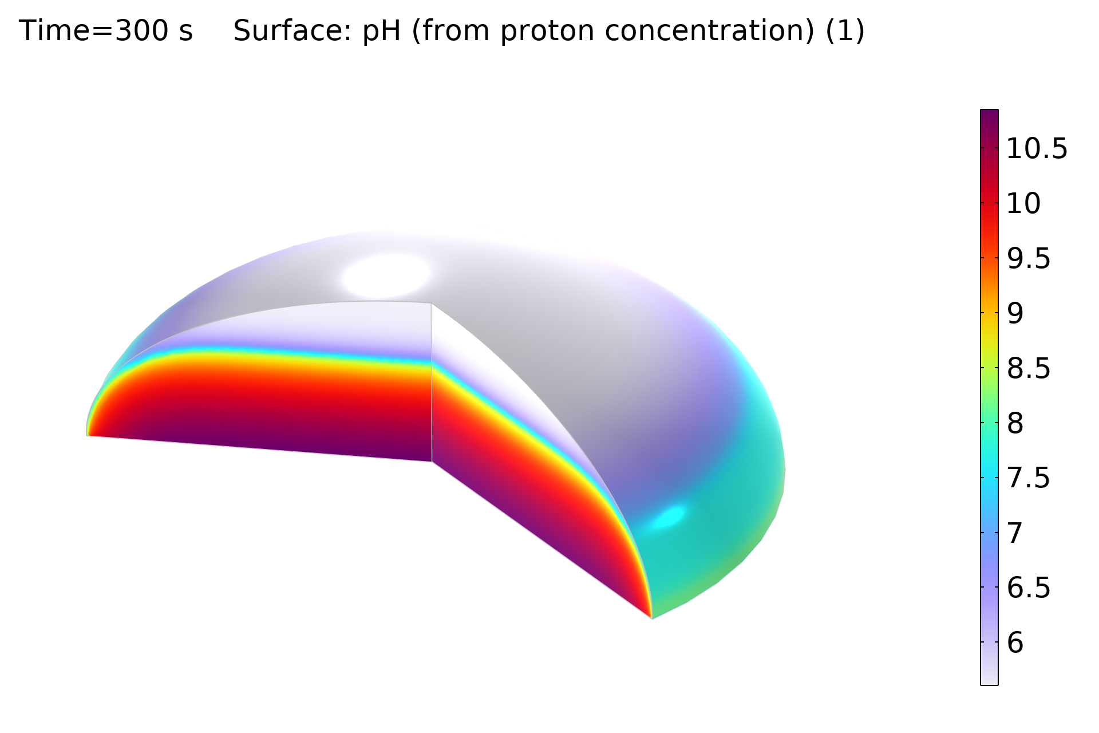
Results: pH
pH at 30 s and 300 s. The iron ion concentration is slightly higher toward the edge of the droplet. The pH is lower toward the edge of the droplet due to CO₂ dissolution at the surface and higher toward to the core of the droplet due to homogeneous reactions.

Slide 9
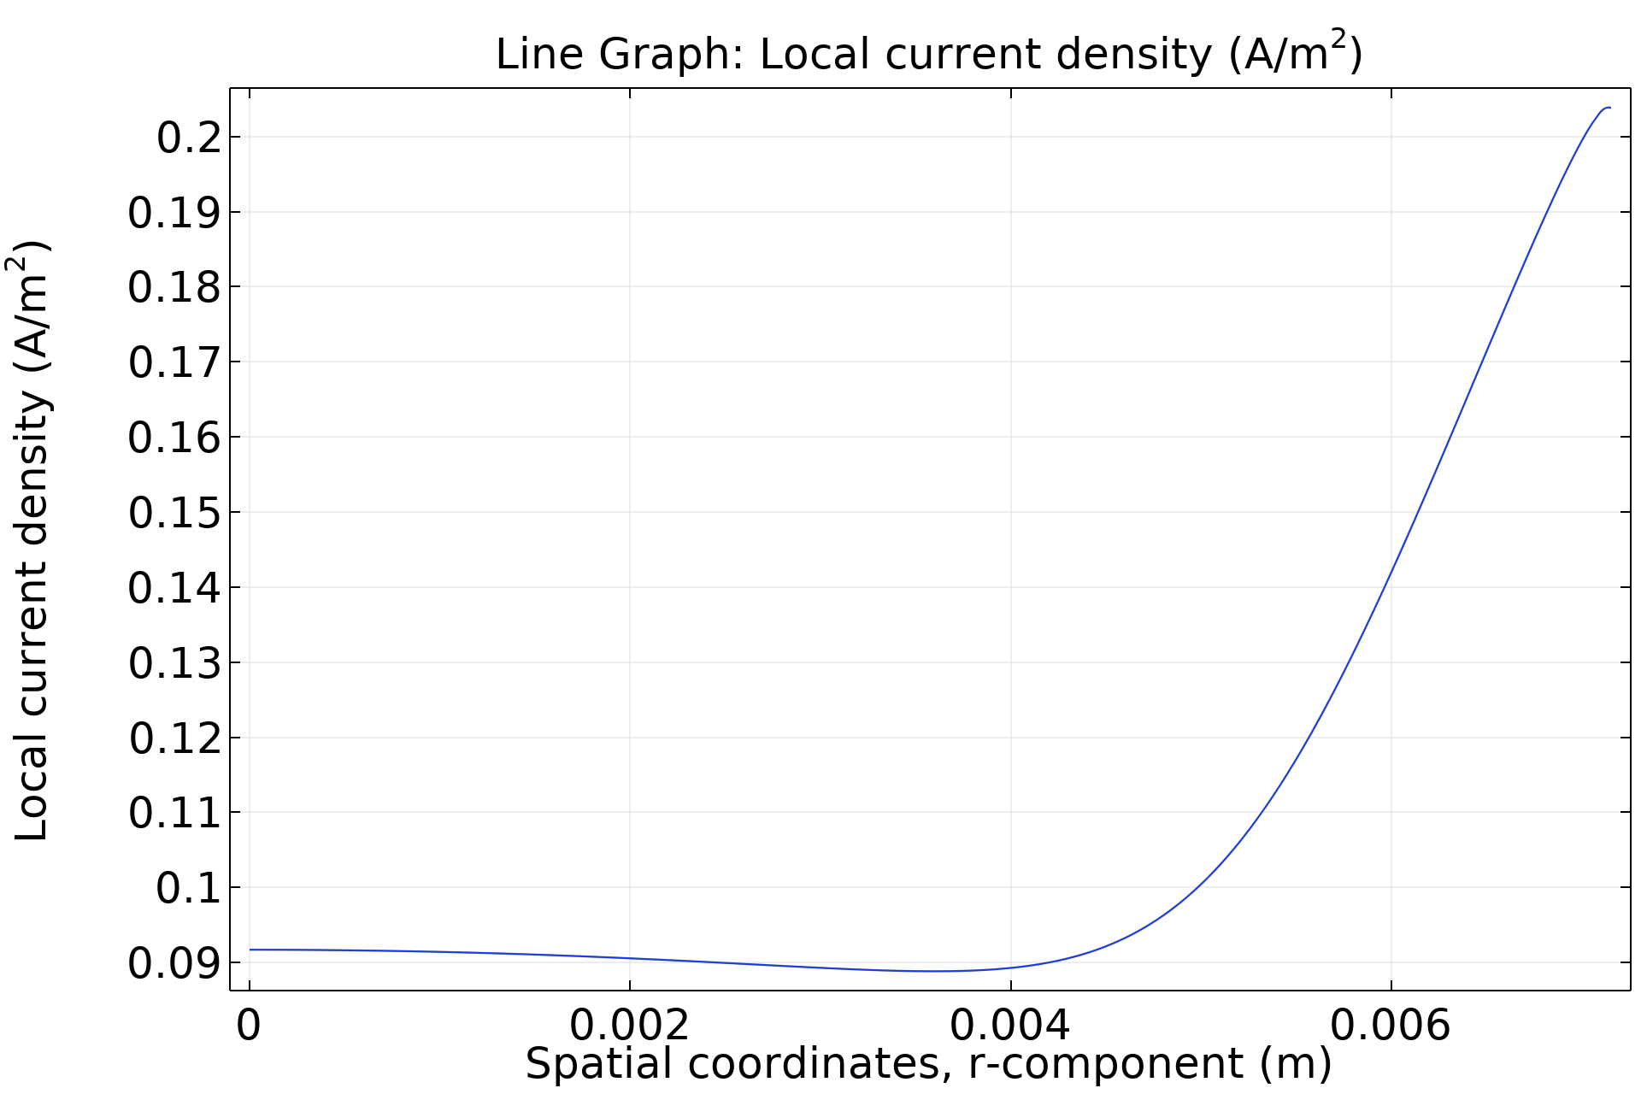
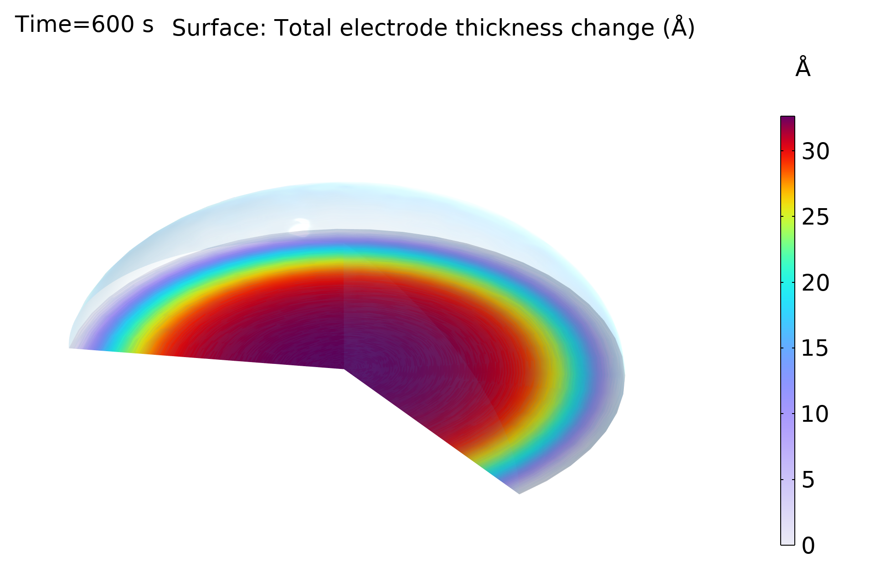
Results: Current Density and Iron Hydroxide Layer
The anodic current density is higher toward the edge of the droplet, indicating a higher corrosion rate. The Fe(OH)₂(s) precipitation thickness is higher toward the center of the droplet.

Slide 10
References
A. Sainz-Rosales et al., “Classic Evans’s Drop Corrosion Experiment Investigated in Terms of a Tertiary Current and Potential Distribution,” Corrosion and Materials Degradation, vol. 3, no. 2, pp. 270–280, 2022.
A. Kahyarian and S. Nesic, “On the mechanism of carbon dioxide corrosion of mild steel: Experimental investigation and mathematical modeling at elevated pressures and nonideal solutions,” Corrosion Science, vol. 173, no. 108719, pp. 1–27, 2020.

