Slide 1
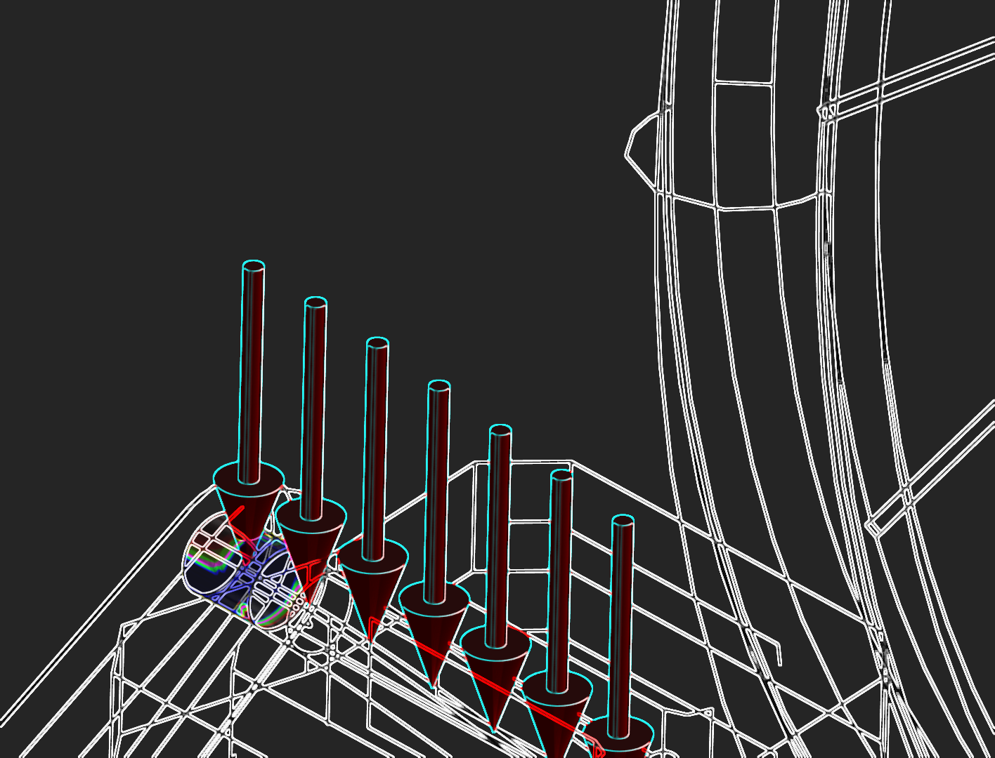
Mechanical Precession for the Axle of a Bicycle Pedal

Slide 2
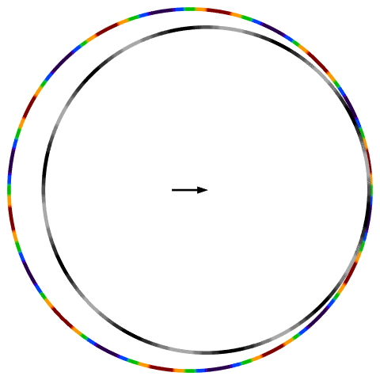
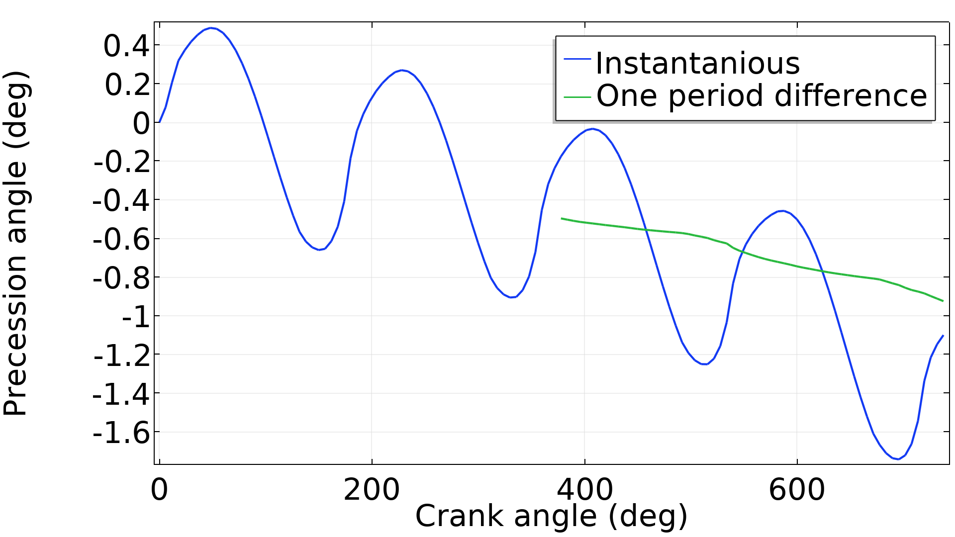
Mechanical Precession for the Axle of a Bicycle Pedal
Mechanical precession has the following properties
It occurs whenever a bolt is subjected to a force spinning around the bolt axis.
The effect causes the bolt to tighten or loosen – depending on the thread orientation.
In this model the precession causes a bolt rotation of 1 degree per force rotation.
This is for 50 kN peak z force, so realistically the rotation is significantly smaller.
Modelling requires contact analysis with the augmented Lagrangian formulation.
The contact analysis has to consider friction.

Slide 3
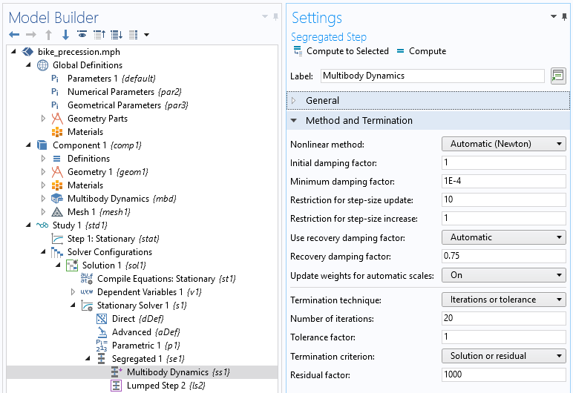
Mechanical Precession for the Axle of a Bicycle Pedal
Solver setup
Expand the continuation section in the settings for the parametric solver and enable tuning of step size. Decrease the initial – and minimum step size to 1e-10.
Change the non-linear method for the Multibody Dynamics step to Automatic (Newton) and increase the number of iterations from 7 to 20.

Slide 4
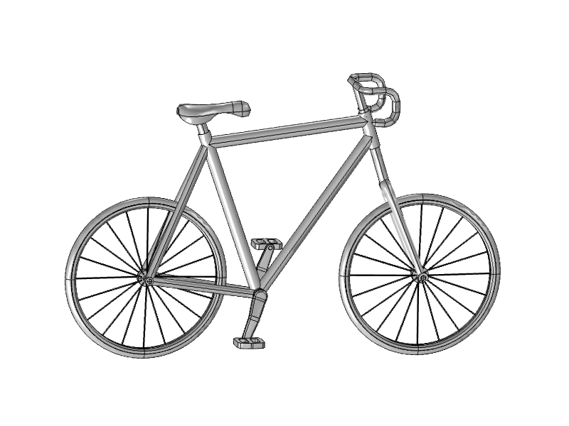
Animation in saddle frame

Slide 5
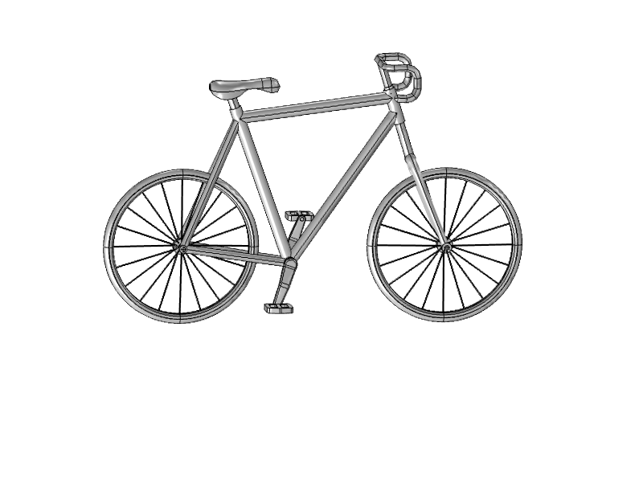
Animation in crank frame
(pedal force moves
in a half circle)
Mechanical Precession for the Axle of a Bicycle Pedal

