Slide 1
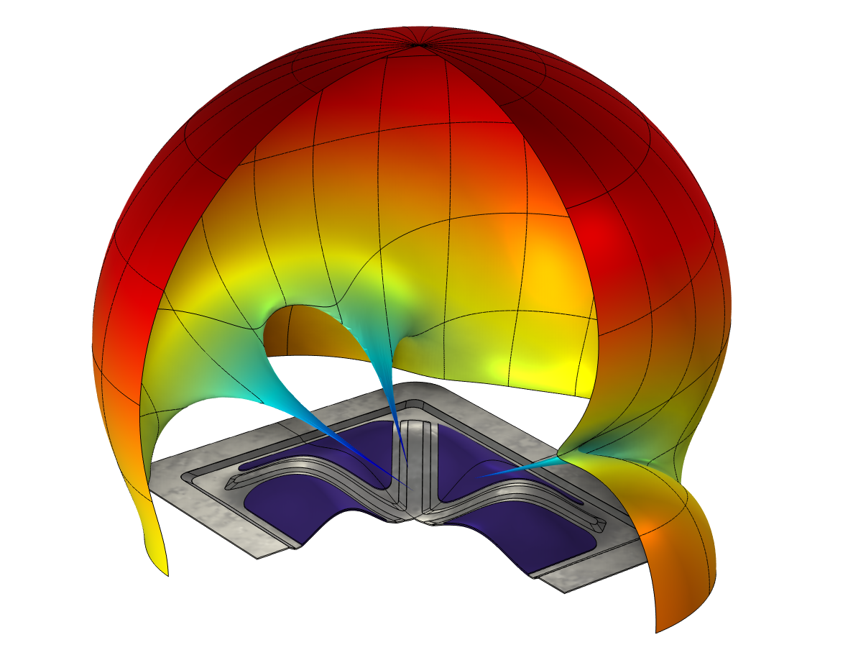
Damping Pad with a
Constrained Layer

Slide 2
Damping Pads
Stress
Vibrating panel act as acoustic sources in many different applications: vehicles, white goods, or industrial machinery.
Panels usually produce undamped resonances which stand out and can be very noticeable.
A common strategy to reduce the radiated noise at the resonance frequencies is to use a viscoelastic material to dissipate the vibrational energy.
Time
Strain
Time
Stress and strain on a viscoelastic Kelvin-Voigt material model

Slide 3
Constrained Layer Material
A structural panel where a viscoelastic material is glued locally, will dissipate energy and thus limit the radiated noise.
As the main mechanism of dissipation is through hysteresis in the viscoelastic material, the damping effect will increase as the stress in the viscoelastic material increases.
A very efficient method to fully utilize the viscoelastic material is to add a thin constraining layer that will force the material into shear.
From top to bottom: Undamped panel vibrating. Free layer damping material. Constrained layer damping material.

Slide 4
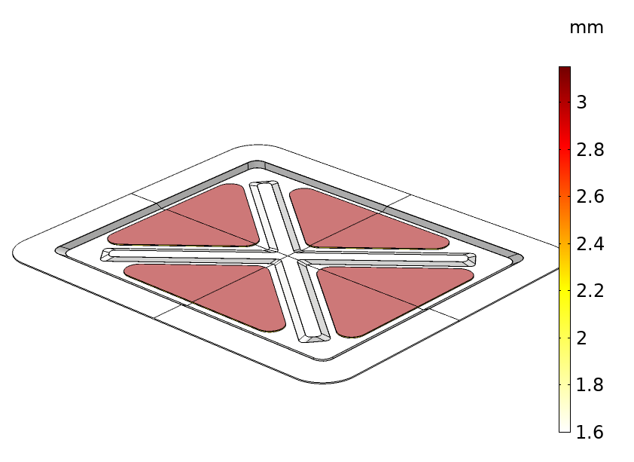
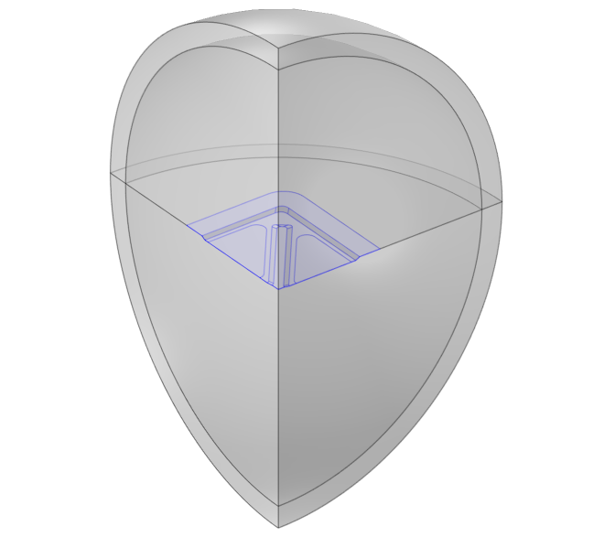
Model Description
A small steel panel of uniform thickness with swages is included in a baffled infinite acoustic domain.
A vertical acceleration imposed in the outer frame and used as an excitation.
Two planes of symmetry are considered to reduce the model size.
Panel thickness with damping pads applied
Acoustic domain with PML

Slide 5
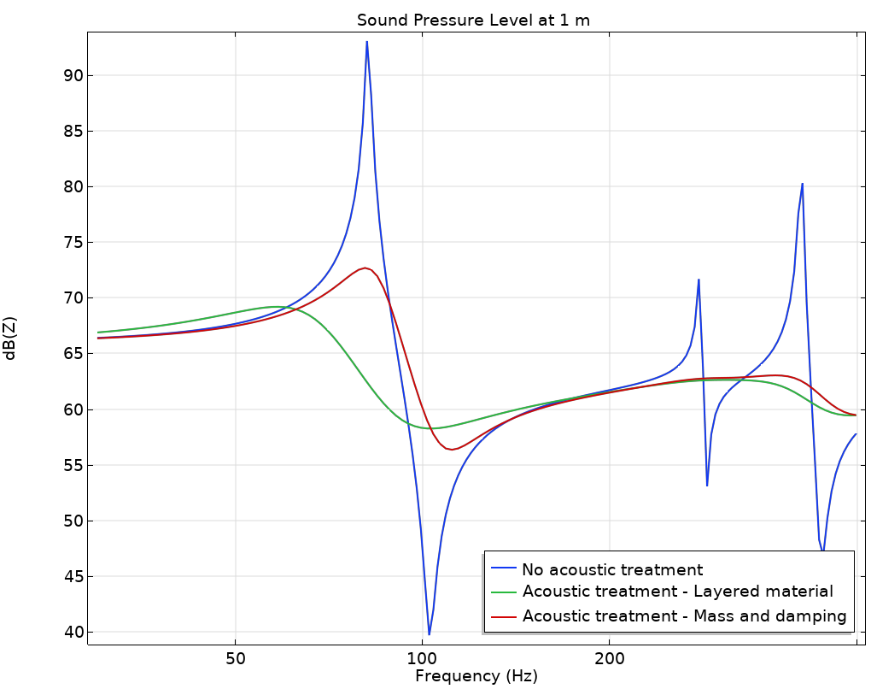
Modeling the Damping Pad
The model analyses three versions of the panel:
  Untreated panel, where only the steel is included.
  Panel with acoustic treatment (damping pad) applied and modeled through the Linear Elastic Material, Layered¹ feature.
  Panel with acoustic treatment modeled as additional mass and damping . This is the traditional way to model damping pads.
The traditional “mass and damping” method produces the wrong frequency and level response when compared to the layered material method.
Sound pressure level at 1 meter in front of the panel.
¹Set the Shear Correction Factor option to Based on 3D elasticity theory.

Slide 6
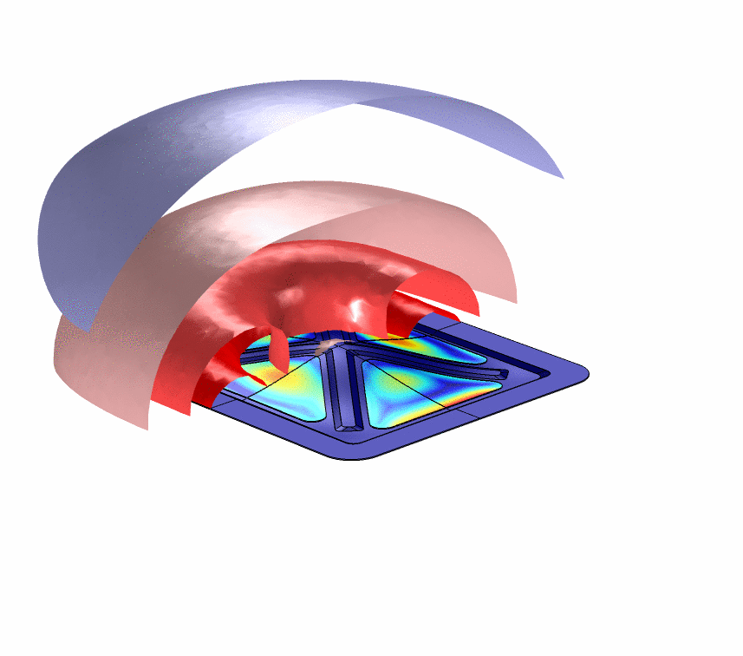
Conclusions
A small mass of damping pads can substantially decrease the radiated noise in panels.
Traditionally used modeling approaches and simplifications can lead to models that do not represent the structure accurately.
Laminates composed of layers with very different constitutive models can be efficiently model in COMSOL using the Layered Material feature.
Animation of the interlaminate stress at the viscoelastic pads and the acoustic pressure surrounding the panel

Slide 7
info@comsol.com

