Slide 1
Electrodeposition of an Inductor Coil
COMSOL

Slide 2
Introduction
This example models the deposition of an inductor coil on the μm-scale, where diffusion limitations govern the deposition rate
A 10 μm thick photoresist mask has been used create the deposition pattern
As the deposition process proceeds, the depth of the pattern created by the mask decreases, which in turn affects the current distribution over the active surface

Slide 3
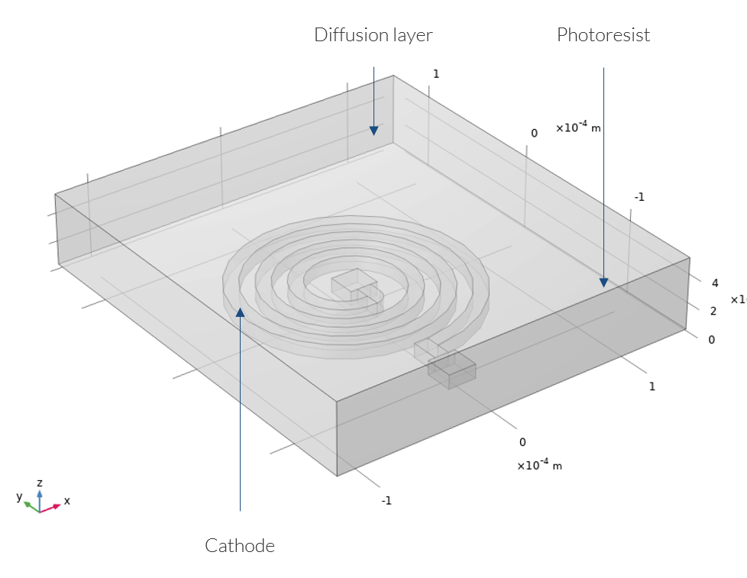
Model Definition
Geometry
The figure shows the model geometry
The geometry consists of two domains: the 10 μm extrusion of the deposition pattern down into the photoresist film, and a diffusion layer in form of a rectangular block, 50 μm thick, on top of the photoresist

Slide 4
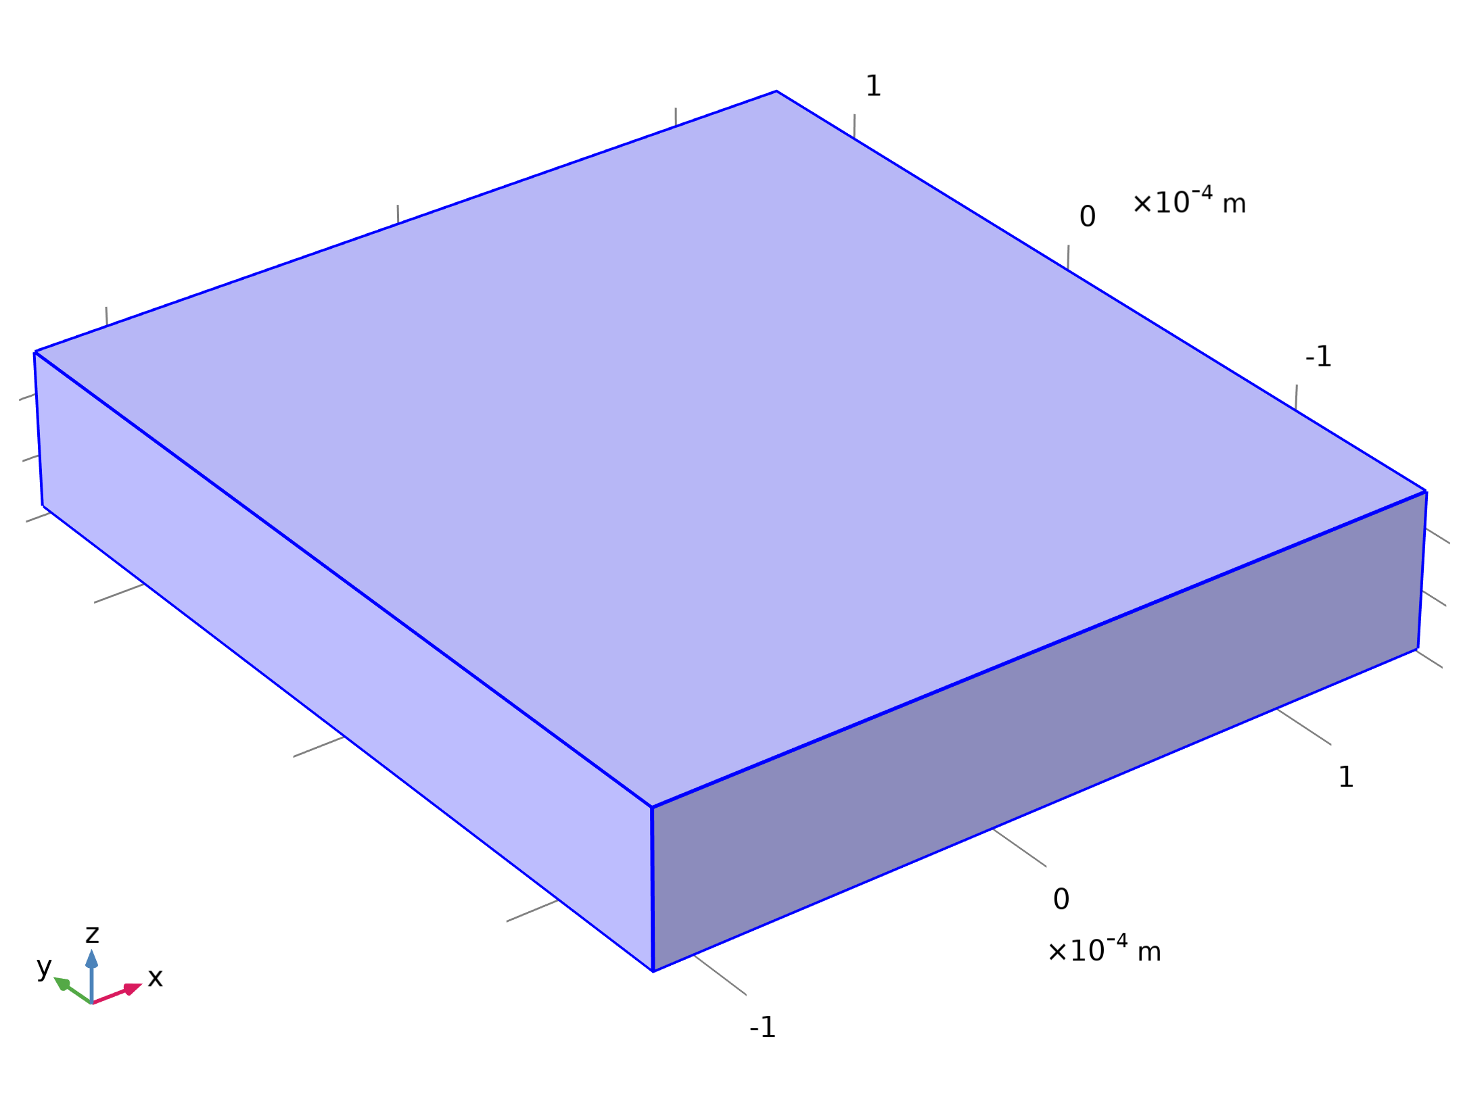




Model Definition
Tertiary Current Distribution, Nernst-Planck

Slide 5

Model Definition
Tertiary Current Distribution, Nernst-Planck

Slide 6
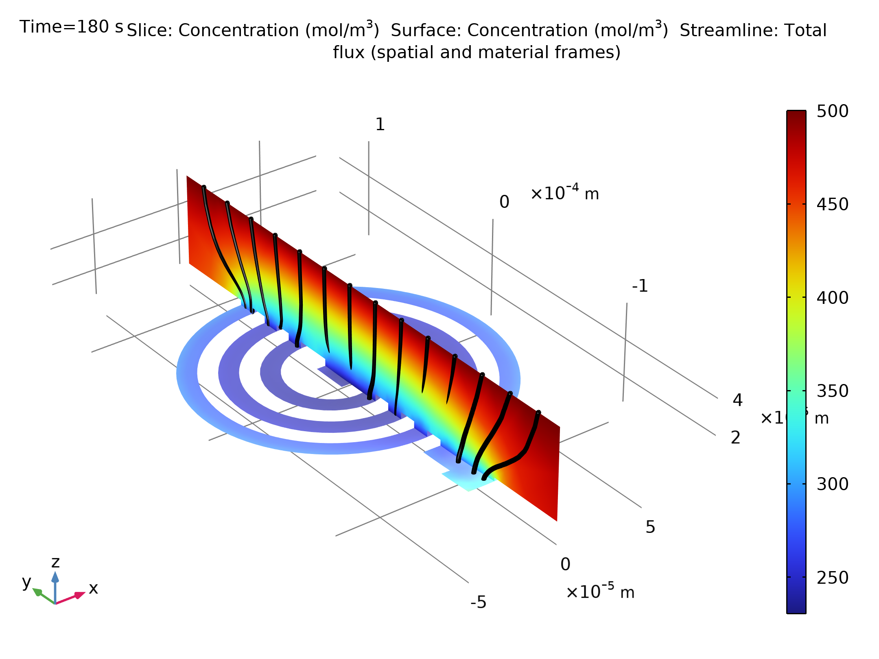
Results
The figure shows the concentration and current streamlines in the electrolyte after 180 s
The copper-ion concentration at the cathode is significantly lower than in the bulk
In addition, the concentration at the cathode is slightly higher in outer parts of the pattern compared to the center
Concentration profile and current streamlines in the electrolyte at t = 180 s

Slide 7
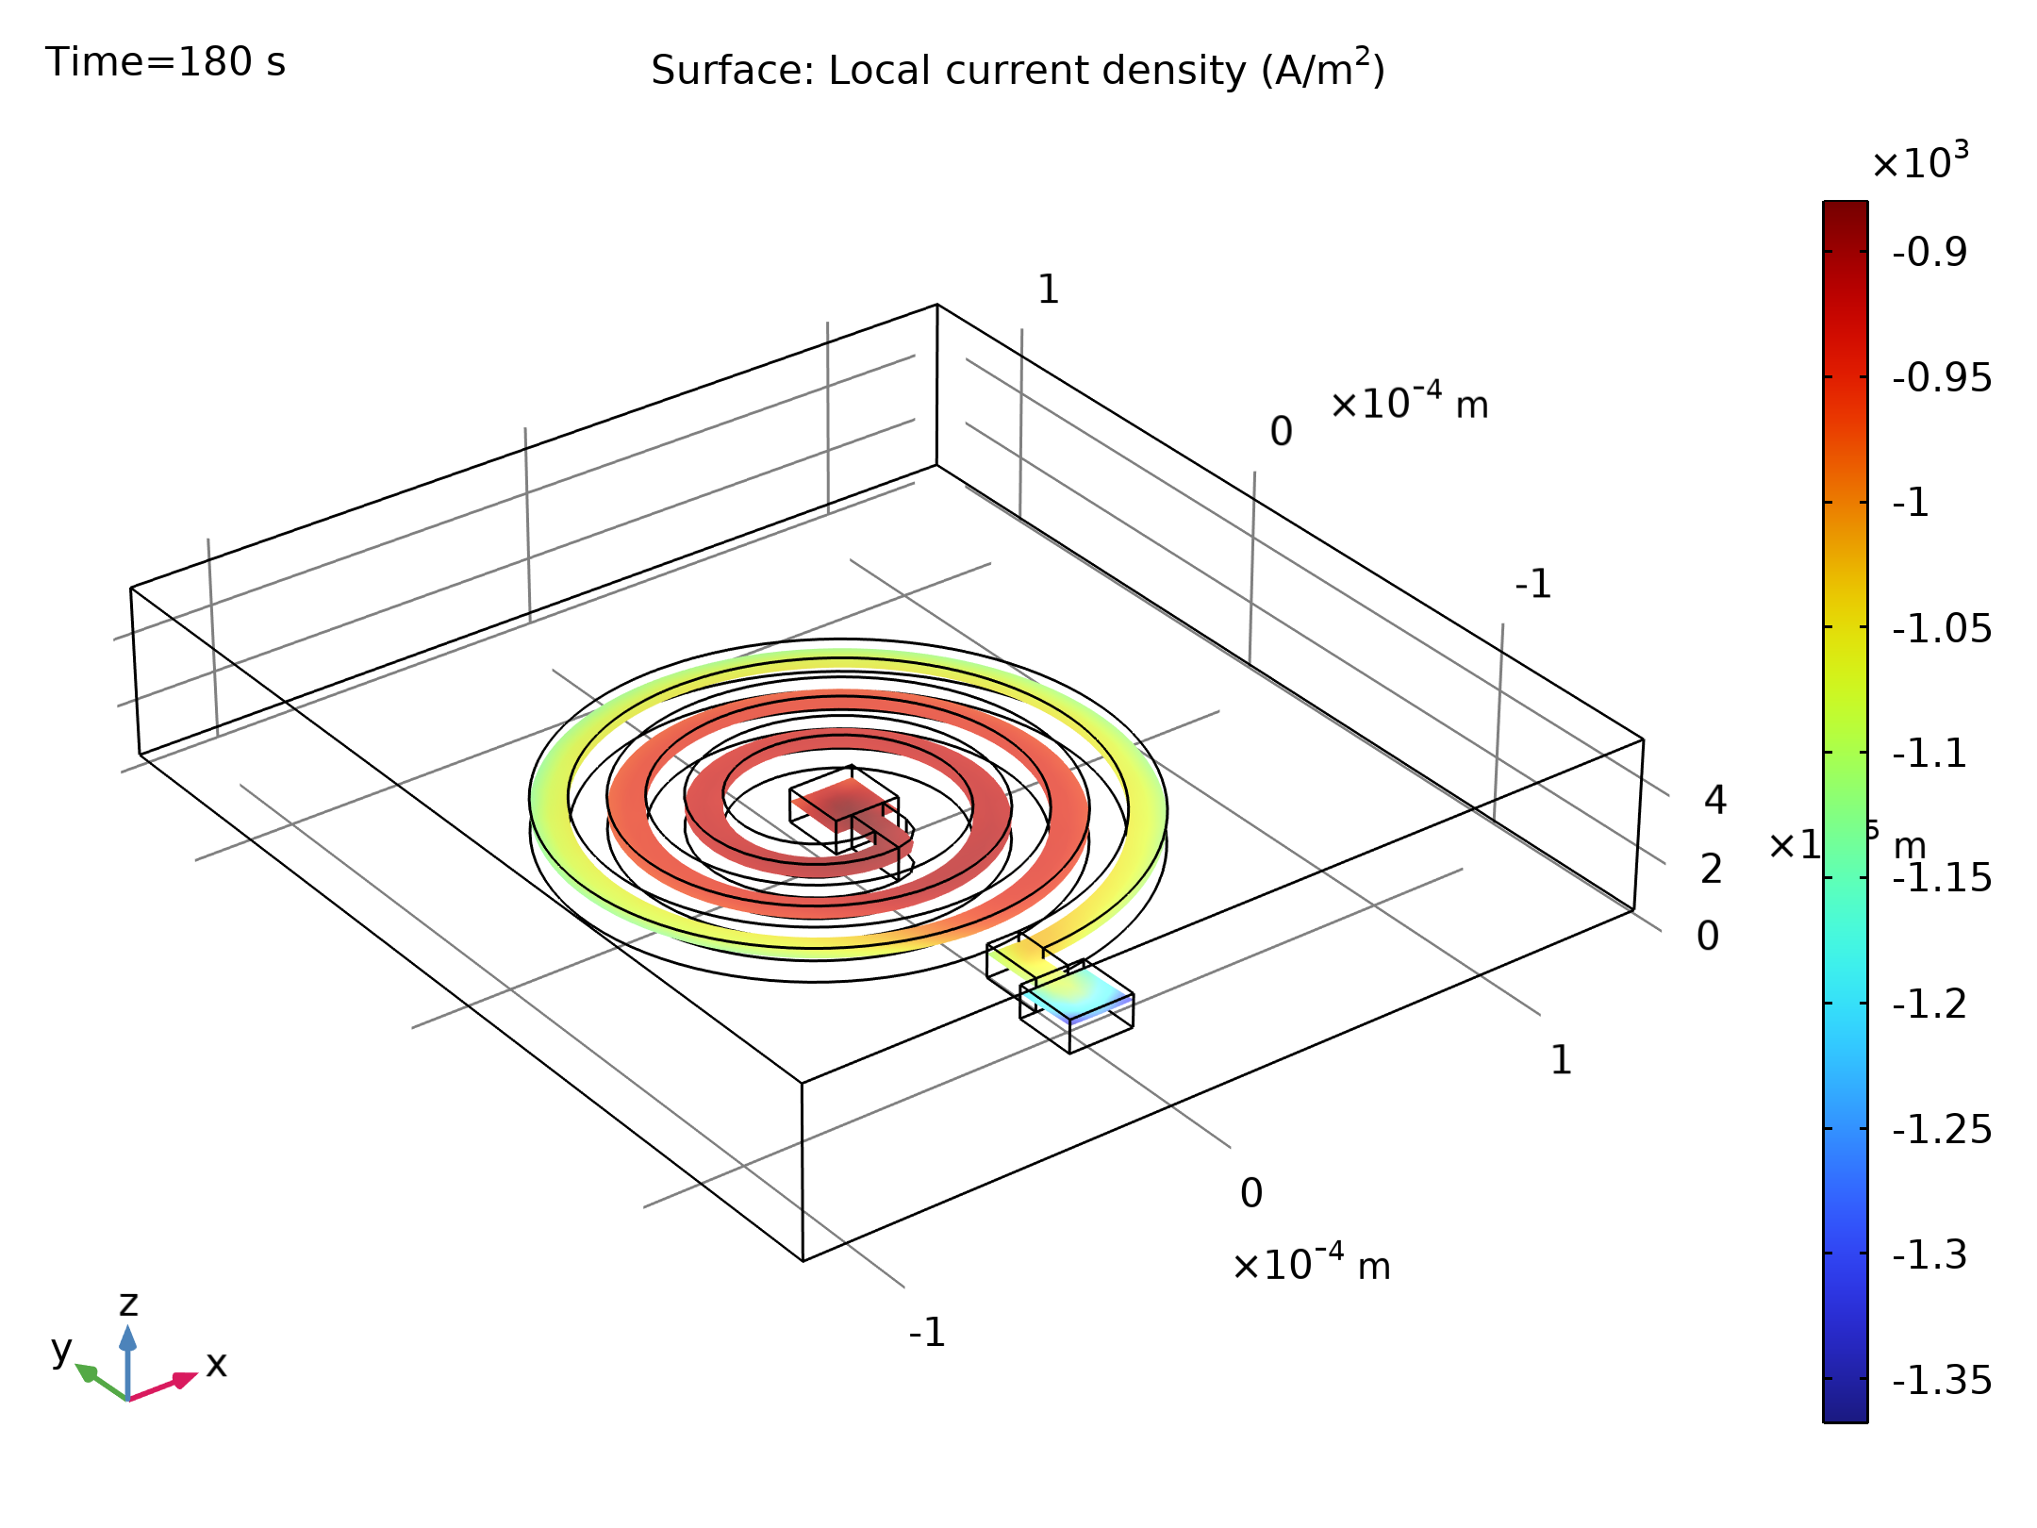
Results
The figure shows the local electrode current, ict, at the cathode at t=180 s
The deposition currents are higher at the outer parts of the pattern due to the higher copper-ion concentration
Electrode reaction current density at t = 180 s

Slide 8
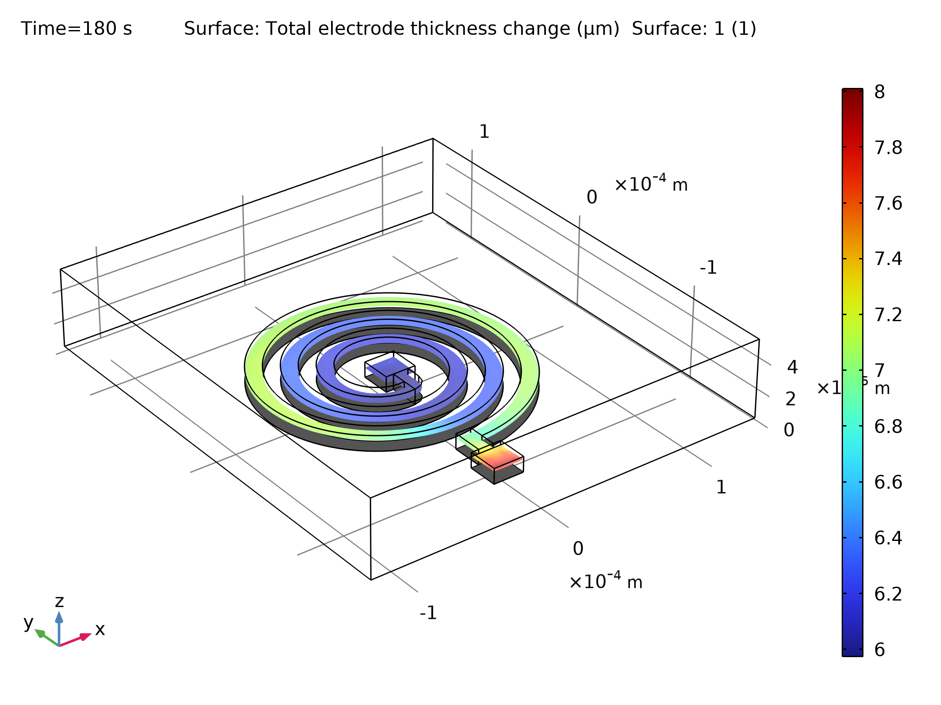
Results
The figure shows the deformation and deposited copper thickness after 180 s
The thickness is significantly thicker on the outermost part of the pattern
Thickness of the deposited copper layer at 180 s

