Slide 1
Drug Release from a Biomaterial Matrix
COMSOL

Slide 2
Introduction
Biomaterial matrices for drug release are useful for in vivo tissue regeneration
The following example describes the release of a drug from a biomaterial matrix into damaged cell tissue
Specifically, a nerve guide delivers a regenerating drug to damaged nerve ends
This model examines detailed drug-release kinetics, with rate expressions handling drug dissociation/association reactions as well as matrix degradation by enzyme catalysis
The enzyme reaction is described by Michaelis-Menten kinetics
The model enables investigation of design parameters governing the rate of drug release such as drug-to-biomaterial affinity, biomaterial degradation, drug loading, and the influence of geometry and composition of the biomaterial matrix

Slide 3


Model Definition

Slide 4
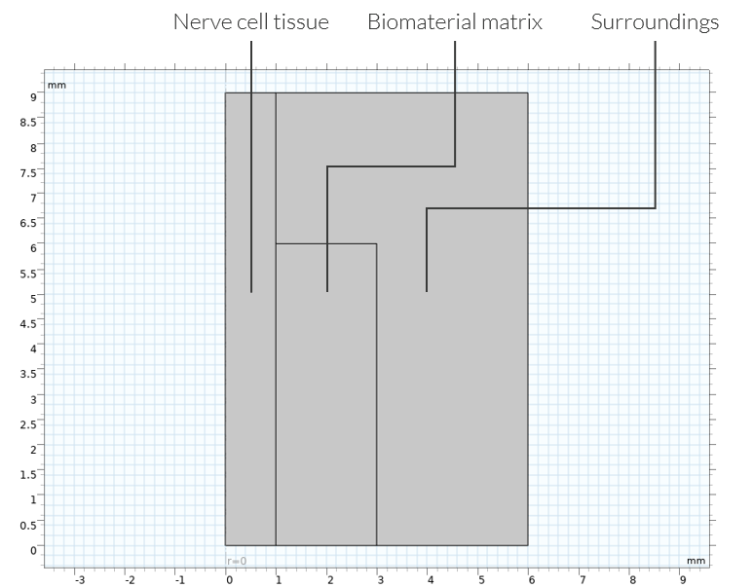
Model Definition
The figure shows the 2D modeling domain, reduced by axial symmetry and a mirror plane, for the space-dependent model
The biomaterial holding the drug is assumed to have a strictly cylindrical shape
Modeling domains reduced to 2D by axial symmetry. The regions are: the nerve-cell tissue, the biomaterial matrix, and the surrounding medium

Slide 5
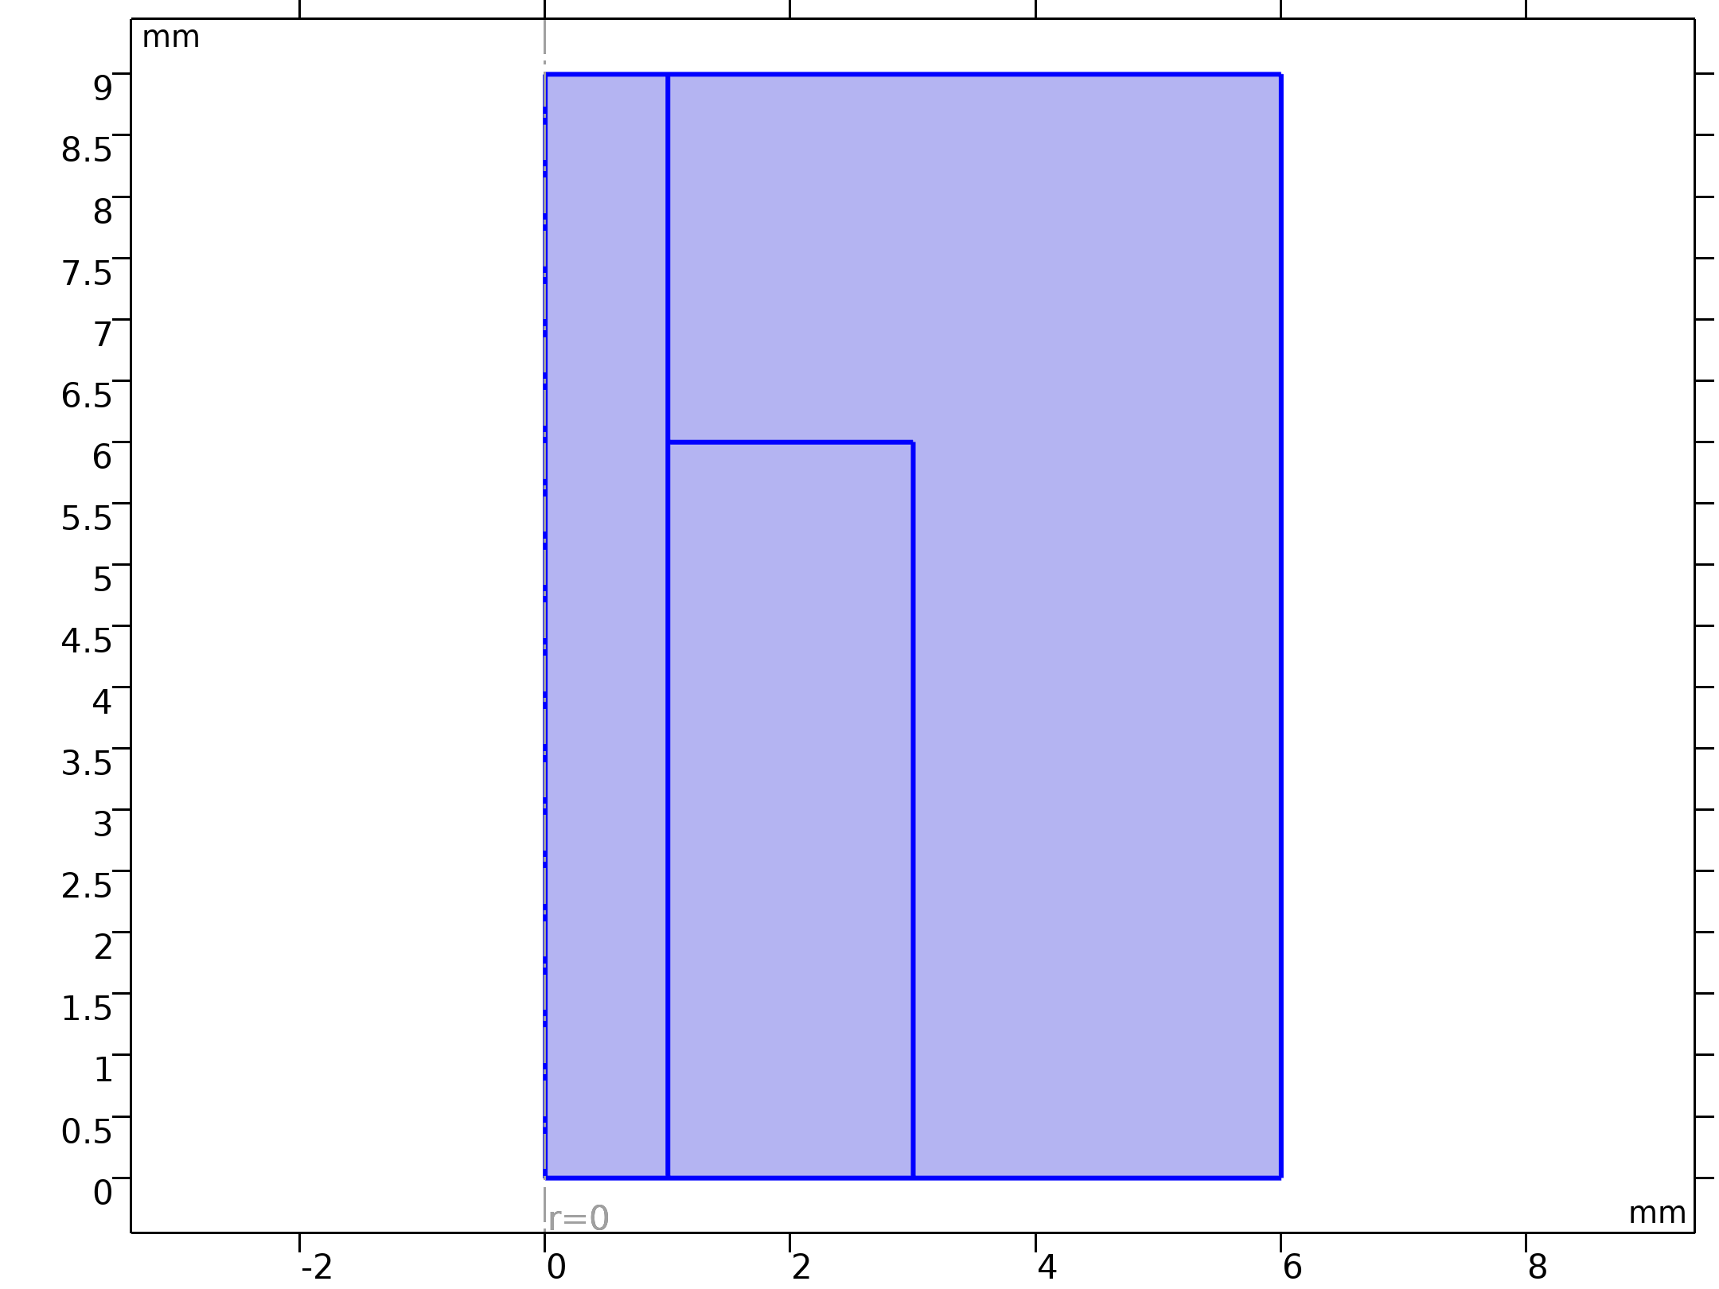
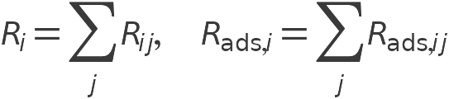
Model Definition
Chemistry 1

Slide 6
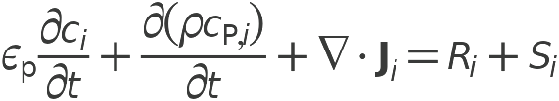

Model Definition
Transport of Diluted Species in Porous Catalysts

Slide 7
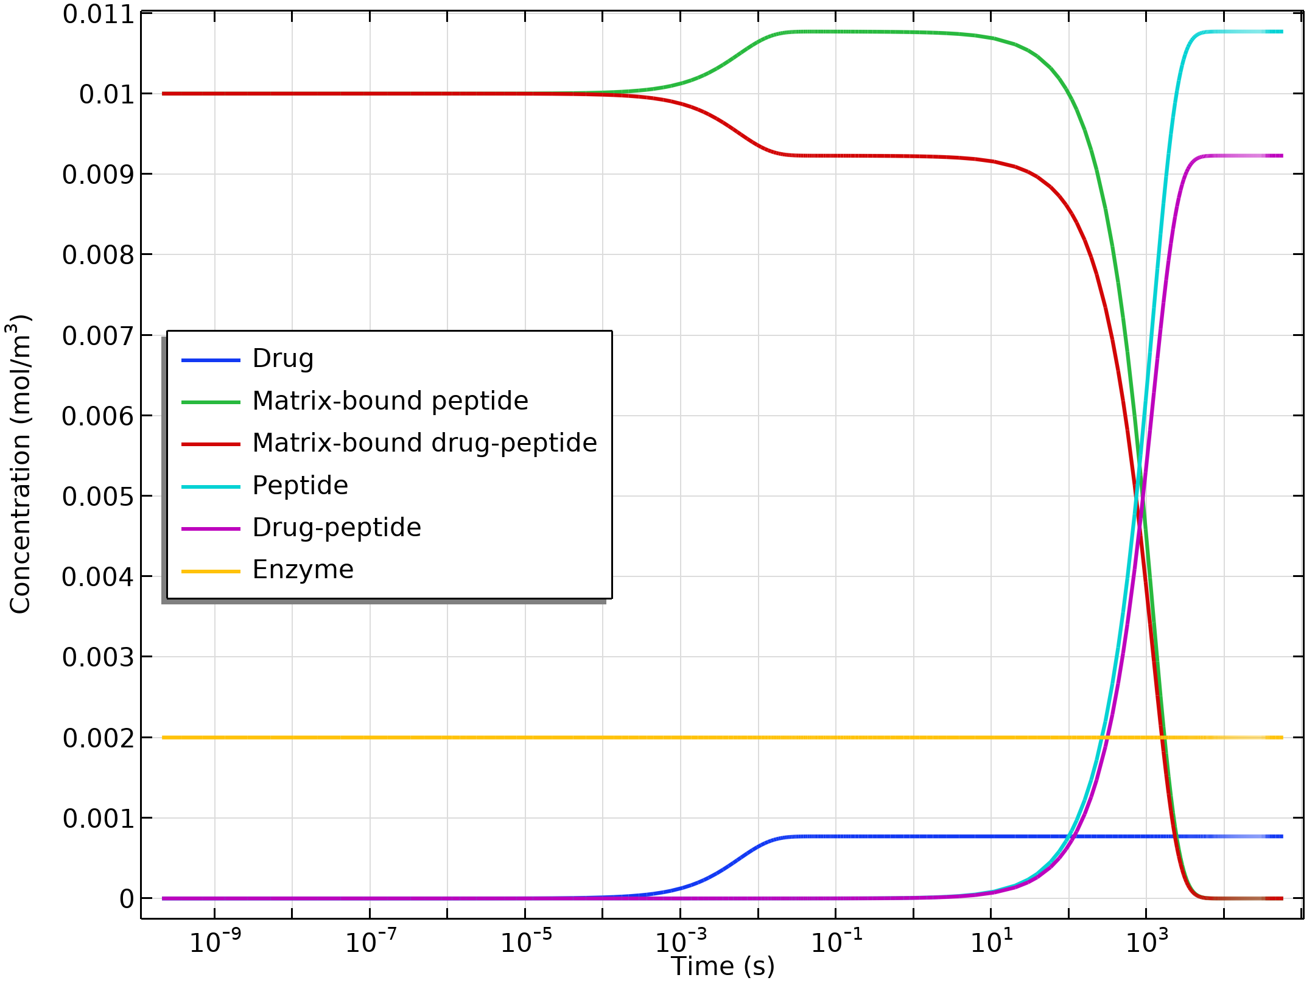
Results
The figure shows the concentration transients of the reacting species in a perfectly mixed (space-independent) system
Concentrations of all reacting species (mol/ m³) as functions of time (s)

Slide 8
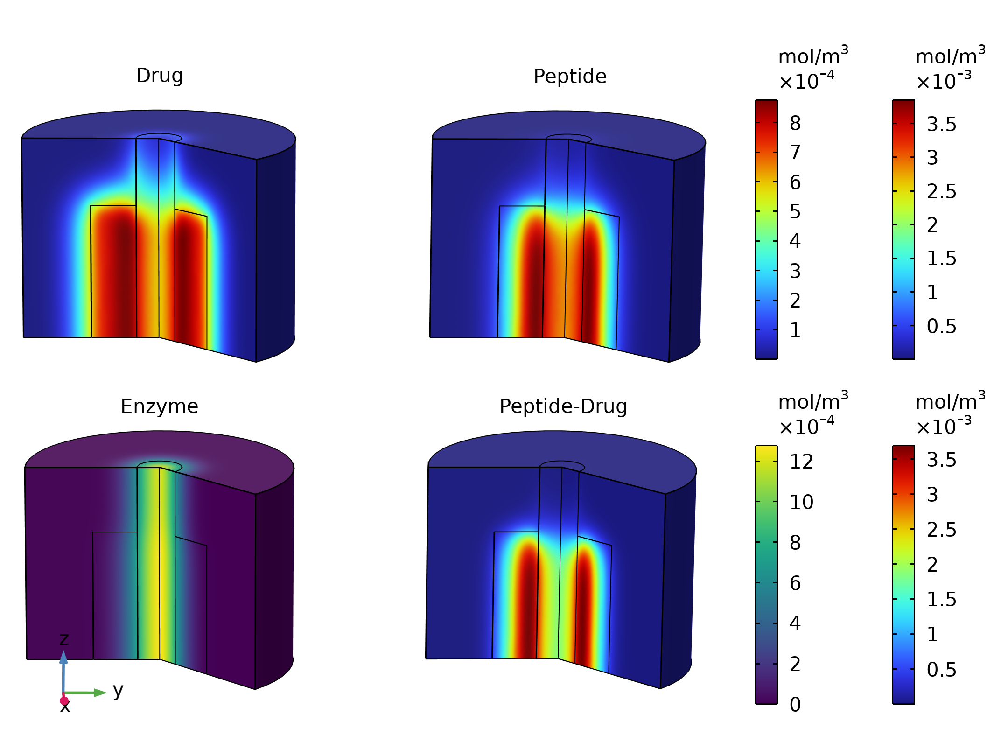
Results
The figure shows the concentration of the drug, and other modeled bulk species, across the modeling domain
Bulk species concentration after 1.5 h

Slide 9
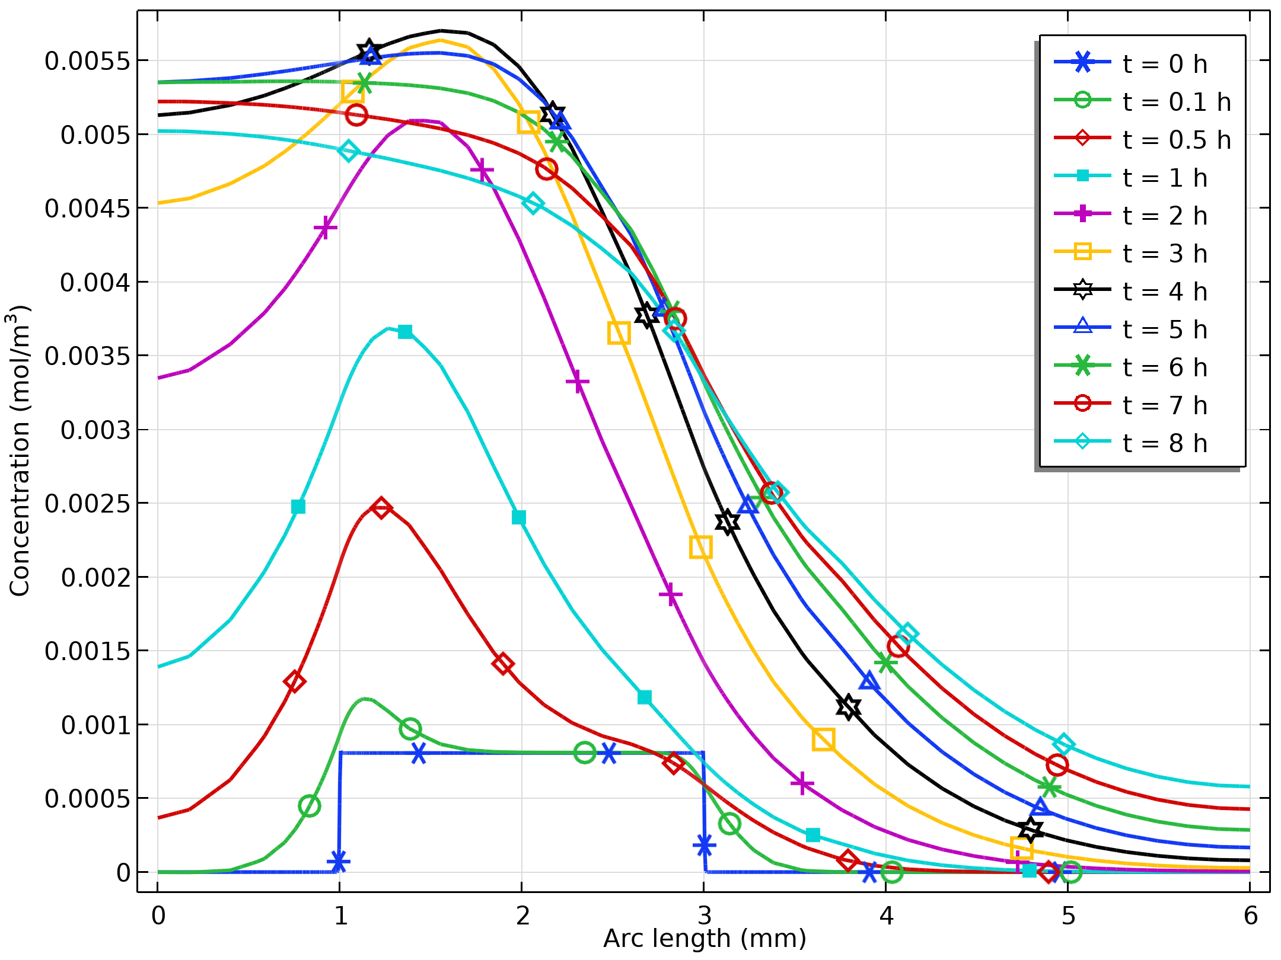
Results
As mentioned earlier, the enzyme originates from the nerve-cell tissue
From the figure, where the total drug release is shown, it is clear that matrix degradation has a directing effect on the drug release toward the damaged cell region
Concentration profiles describing the total drug concentration (c_{d} + c_{pd}) across the modeling domain. Profiles were collected at times up to 8 h

Slide 10
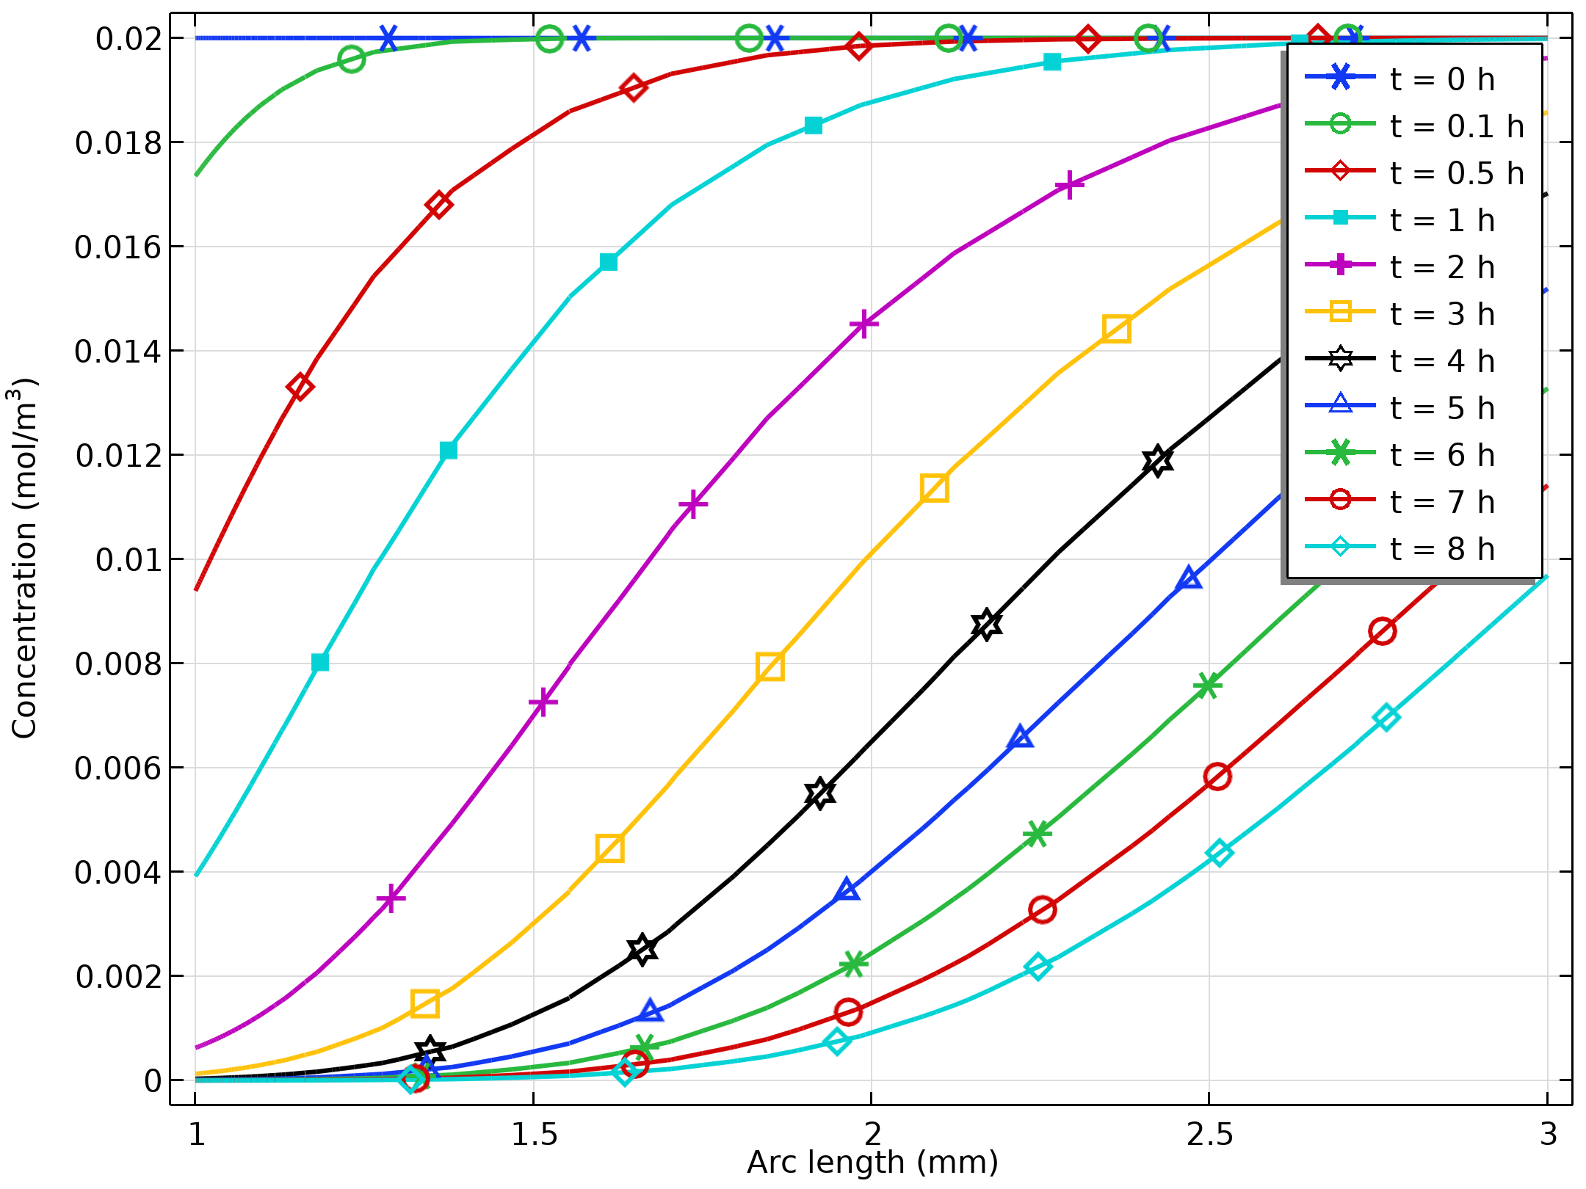
Results
The figure visualizes the biomaterial matrix degradation
The plotted total matrix site concentrations (c_{mp} + c_{mpd}) shows how the degradation front passes through the biomaterial geometry
Concentration profiles describing the total matrix site concentration (c_{mp} + c_{mpd})

Slide 11
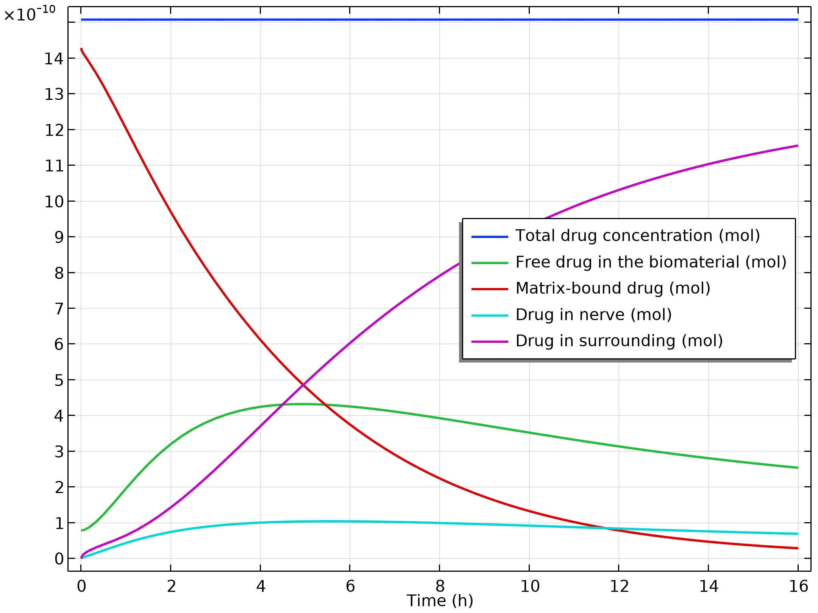
Results
The figure shows how the different forms of the drug are distributed over the domains, and also how they vary during the simulation
Note that the free drug (not bound to the matrix) reaches a maximum after about 5 h
Time development of the drug distribution among the domains

